Slide 1


College of Business & Tourism
Accounting & Finance
ECON 101
ECON 101
Introduction to microeconomics
Fall 2025
Assistant Prof. Abeer Alqayidi

Slide 2
Equilibrium Price Determination

Slide 3
Definition of Equilibrium Price
Equilibrium Price:
  The price at which quantity demanded equals quantity supplied.
Also known as the Market-Clearing Price.
At this price, there is no shortage and no surplus in the market.

Slide 4
Equilibrium Quantity
The amount of goods/services exchanged at the equilibrium price.
Determined at the intersection of demand and supply.
Both buyers and sellers are satisfied at this point.

Slide 5
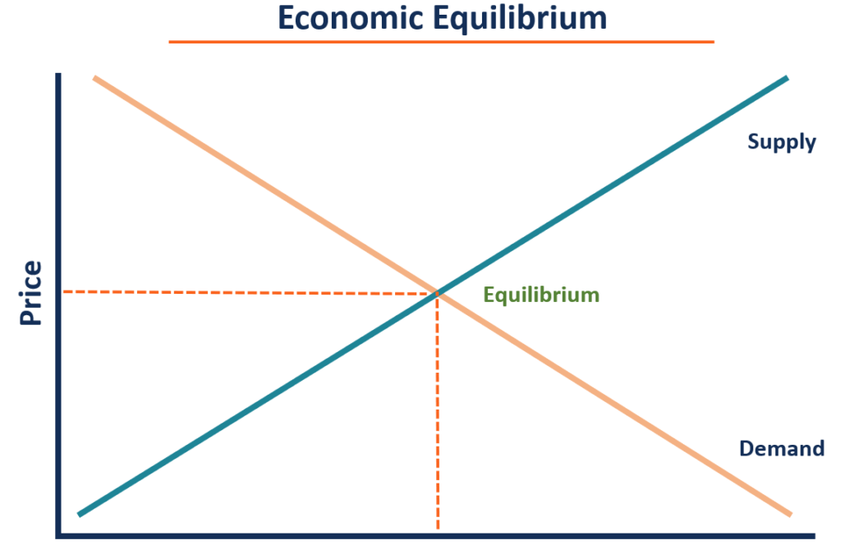
Graphical Representation of Equilibrium

Slide 6
Importance of Equilibrium Price
Ensures efficient resource allocation.
Balances interests of buyers (consumers) and sellers (producers).
Provides stability in the market.
Acts as a signal for production and consumption decisions.

Slide 7
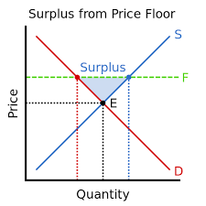
Disequilibrium: Surplus
Occurs when market price is set above equilibrium.
Quantity supplied > Quantity demanded.
Unsold goods accumulate; sellers lower price to restore balance.

Slide 8
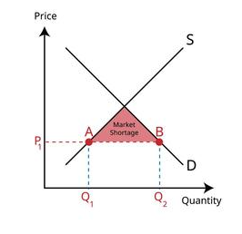
Disequilibrium: Shortage
Occurs when market price is set below equilibrium.
Quantity demanded > Quantity supplied.
Results in queues, waiting lists, or price bidding.
Drives price upward until equilibrium is reached.

Slide 9
Market Forces Toward Equilibrium
Surpluses push prices down.
Shortages push prices up.
Invisible hand of the market guides adjustment toward equilibrium.

Slide 10
Shifts in Demand and New Equilibrium
Increase in demand → Equilibrium price rises, quantity rises.
Decrease in demand → Equilibrium price falls, quantity falls.
Example: New product popularity raising demand curve.

Slide 11
Shifts in Supply and New Equilibrium
Increase in supply → Equilibrium price falls, quantity rises.
Decrease in supply → Equilibrium price rises, quantity falls.
Example: Bad harvest shifting supply curve left.

Slide 12
Real-World Examples
Oil market: Geopolitical shocks reduce supply → higher prices.
Housing market: Population growth increases demand → higher prices.
Agricultural markets: Weather impacts supply and shifts equilibrium.

Slide 13
Government Intervention
Price Ceiling (maximum price) → below equilibrium, creates shortage.
Price Floor (minimum price) → above equilibrium, creates surplus.
Examples: Rent control, minimum wage.

Slide 14
Conclusion
Equilibrium price is where demand equals supply.
It stabilizes markets and ensures efficiency.
Changes in demand or supply create new equilibriums.
Understanding equilibrium is key to analyzing markets.

Slide 15
Class Exercises
Given the following demand and supply schedules:
Price (SAR) | Quantity Demanded | Quantity Supplied
10 | 100 | 40
20 | 80 | 60
30 | 60 | 80
40 | 40 | 100
Plot the demand and supply curves.
Identify the equilibrium price and quantity.

