Slide 1
Floating Point Numbers
Week 3
Part 1,2

Slide 2
Floating Point Number - Introduction
The term floating point refers to the fact that a number's radix point (decimal point, or, more commonly in computers, binary point) can "float"; that is, it can be placed anywhere relative to the significant digits of the number. This position is indicated as the exponent component, and thus the floating-point representation can be thought of as a kind of scientific notation.

Slide 3
Floating Point - Examples
Consider a decimal number 256.38
It can be expressed in different forms as shown below
256.38 = 25638.0 x 10⁻²
256.38 = 2563.8 x 10⁻¹
256.38 = 256.38 x 10⁰
256.38 = 25.638 x 10¹
256.38 = 2.5638 x 10²
256.38 = .25638 x 10³

Slide 4
Why use Floating Point?
Represent a wide range of numbers
  Smallest to Largest
    Avogadro's number 6.022140857 × 10 ²³
    Diameter of the nucleus 1.75 x 10⁻¹⁵ m
    Distance between sun and earth
    Population of India and China together
How to use scientific notation in computers?
  8-bit, 16 bit, 32 bit……

Slide 5
FP – Binary Example
0101=5
  0.1010 = 5 x 2⁻³
  01.010 = 5 x 2⁻²
  010.10 = 5 x 2⁻¹
  0101.0 = 5 x 2⁰
  01010. = 5 x 2¹
  010100. = 5 x 2²
  Hence 101.0 = 10.10 x 2¹ = 1.010 x 2² = 0.1010 x 2³
  Hence 101.0 = 1010 x 2⁻¹ = 10100 x 2⁻² = 10100 x 2⁻³

Slide 6
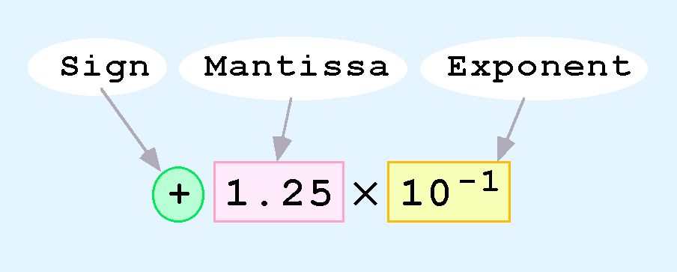
Floating-Point Representation
Computers use a form of scientific notation for floating-point representation
Numbers written in scientific notation have three components:

Slide 7
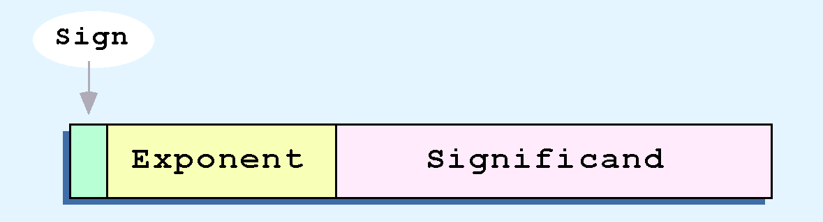
Floating-Point Representation
Computer representation of a floating-point number consists of three fixed-size fields:
This is the standard arrangement of these fields.
Note: Although “significand” and “mantissa” do not technically mean the same thing, many people use these terms interchangeably. We use the term “significand” to refer to the fractional part of a floating point number.

Slide 8
Floating-Point Representation
The one-bit sign field is the sign of the stored value.
The size of the exponent field determines the range of values that can be represented.
The size of the significand determines the precision of the representation.
Single precision: 8 exp bits, 23 frac bits, for 32 bits total.

Slide 9
So what is the Problem?
Given the following binary representation:
37.25₁₀ = 100101.01₂
7.625₁₀ = 111.101₂
0.3125₁₀ = 0.0101₂
How we can represent the integer and fraction part of the binary rep. in 4 bytes?

Slide 10
Solution is Normalization
Every binary number, except the one corresponding to the number zero, can be normalized by choosing the exponent so that the radix point falls to the right of the leftmost 1 bit.
37.25₁₀ = 100101.01₂ = 1.0010101 x 2⁵
7.625₁₀ = 111.101₂ = 1.11101 x 2²
0.3125₁₀ = 0.0101₂ = 1.01 x 2⁻²

Slide 11
So what Happened ?
After normalizing, the numbers now have different mantissas and exponents.
37.25₁₀ = 100101.01₂ = 1.0010101 x 2⁵
7.625₁₀ = 111.101₂ = 1.11101 x 2²
0.3125₁₀ = 0.0101₂ = 1.01 x 2⁻²

Slide 12
IEEE Floating Point Representation
Floating point numbers can be represented by binary codes by dividing them into three parts:
the sign-1bit, the exponent-8bits, and the mantissa-remaining 23bits.
1
2 9
10 32

Slide 13
IEEE Floating Point Representation
The first, or leftmost, field of our floating point representation will be the sign bit:
  0 for a positive number,
  1 for a negative number.

Slide 14
IEEE Floating Point Representation
The second field of the floating point number will be the exponent.
Since we must be able to represent both positive and negative exponents, we will use a convention which uses a value known as a bias of 127 to determine the representation of the exponent.
  An exponent of 5 is therefore stored as 127 + 5 or 132;
  an exponent of -5 is stored as 127 + (-5) OR 122.
The biased exponent, the value actually stored, will range from 0 through 255. This is the range of values that can be represented by 8-bit, unsigned binary numbers.

Slide 15
IEEE Floating Point Representation
The mantissa is the set of 0’s and 1’s to the left of the radix point of the normalized (when the digit to the left of the radix point is 1) binary number.
  ex:1.00101 X 2³
The mantissa is stored in a 23 bit field,

Slide 16
Converting decimal floating point values to stored IEEE standard values.
Example: Find the IEEE FP representation of 40.15625.
Step 1.
Compute the binary equivalent of the whole part and the fractional part. ( convert 40 and .15625. to their binary equivalents)

Slide 17
Converting decimal floating point values to stored IEEE standard values.
40 .15625
- 32 Result: - .12500 Result:
8 101000 .03125 .00101
- 8 - .03125
0 .0
So: 40.15625₁₀ = 101000.00101₂

Slide 18
Converting decimal floating point values to stored IEEE standard values.
Step 2. Normalize the number by moving the decimal point to the right of the leftmost one.
101000.00101 = 1.0100000101 x 2⁵

Slide 19
Converting decimal floating point values to stored IEEE standard values.
Step 3. Convert the exponent to a biased exponent (Here 5 is exponent.)
127 + 5 = 132
==> 132₁₀ = 10000100₂

Slide 20
Converting decimal floating point values to stored IEEE standard values.
Step 4. Store the results from above
Sign Exponent (from step 3) Mantissa ( from step 2)
0 10000100 01000001010 .. 0

Slide 22
Converting decimal floating point values to stored IEEE standard values.
Ex : Find the IEEE FP representation of –24.75
Step 1. Compute the binary equivalent of the whole part and the fractional part.
24 .75
- 16 Result: - .50 Result:
8 11000 .25 .11
- 8 - .25
0 .0
So: -24.75₁₀ = -11000.11₂

Slide 23
Converting decimal floating point values to stored IEEE standard values.
Step 2.
Normalize the number by moving the decimal point to the right of the leftmost one.
-11000.11 = -1.100011 x 2⁴

Slide 24
Converting decimal floating point values to stored IEEE standard values.
Step 3. Convert the exponent to a biased exponent
127 + 4 = 131
==> 131₁₀ = 10000011₂
Step 4. Store the results from above
Sign Exponent mantissa
1 10000011 1000110..0

Slide 25
Converting from IEEE format to the decimal floating point values.
Do the steps in reverse order
In reversing, the normalization step move the radix point to the number of digits that equal to the exponent. if exponent is +ve move to the right, if –ve move to the left.

Slide 26
Converting from IEEE format to the decimal floating point values.
Ex: Convert the following 32 bit binary numbers to their decimal floating point equivalents.
Sign Exponent Mantissa
a. 1 01111101 010..0

Slide 27
Converting from IEEE format to the decimal floating point values.
Step 1 Extract exponent (unbias exponent)
biased exponent = 01111101 = 125
exponent: 125 - 127= -2

Slide 28
Converting from IEEE format to the decimal floating point values.
Step 2 Write Normalized number
1 . ____________ x 2 ⁻⁻⁻⁻
-1. 01 x 2 ^{–2}
Exponent
mantissa

Slide 29
Converting from IEEE format to the decimal floating point values.
Step 3: Write the binary number (denormalize value from step2)
-0.0101₂
Step 4: Convert binary number to FP equivalent
-0.0101₂ = - ( 0.25 + 0.0625) = -0.3125

Slide 30
Converting from IEEE format to the decimal floating point values.
Ex: Convert the following 32 bit binary numbers to their decimal floating point equivalents.
Sign Exponent Mantissa
0 10000011 1101010..0

Slide 31
Converting from IEEE format to the decimal floating point values.
Step 1 Extract exponent (unbias exponent)
biased exponent = 10000011 = 131
exponent: 131 - 127= 4

Slide 32
Converting from IEEE format to the decimal floating point values.
Step 2 Write Normalized number
1 . ____________ x 2 ⁻⁻⁻⁻
1. 110101 x 2 ⁴
Exponent
mantissa

Slide 33
Converting from IEEE format to the decimal floating point values.
Step 3 Write the binary number (denormailze value from step 2)
11101.01₂
Step 4 Convert binary number to FP equivalent ( add column values)
11101.01₂ = 16 + 8 + 4 + 1 + 0.25 = 29.25₁₀
To multiply two numbers, given their logarithms, one just adds the characteristic (integer part) and the mantissa (fractional part). By contrast, to multiply two floating-point numbers, one adds the exponent (which is logarithmic) and multiplies the significand (which is linear). Using "mantissa" for both terms obscures this distinction.

Slide 35
Part 2
Computer Arithmetic

Slide 36
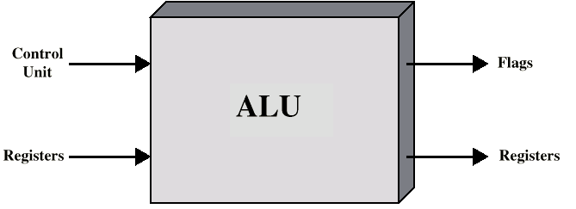
Arithmetic & Logic Unit
Does the calculations
Everything else in the computer is there to service this unit
Handles integers
May handle floating point (real) numbers
May be separate FPU (maths co-processor)
May be on chip separate FPU (486DX +)
Human: -1101.0101₂ = -13.3125₁₀

Slide 37
Addition and Subtraction
Normal binary addition
Monitor sign bit for overflow
Take two’s complement of subtrahend and add to minuend
  i.e. a - b = a + (-b)
So we only need addition and complement circuits

Slide 38
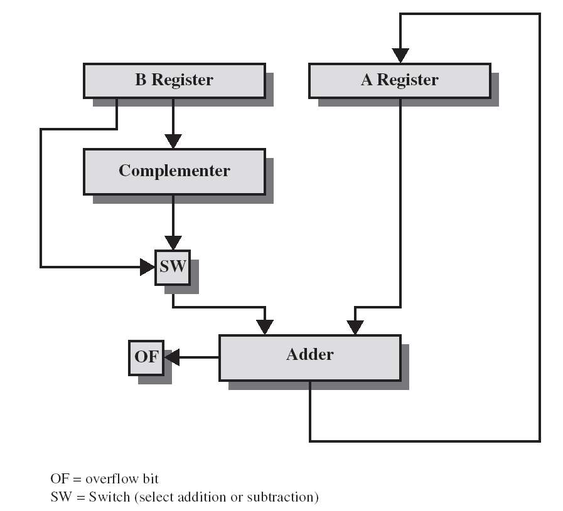
Hardware for Addition and Subtraction

Slide 39
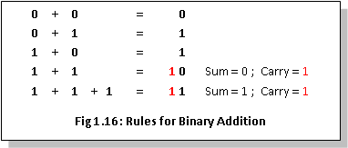


Binary Arithmetic
The ALU of the Processor is used to perform arithmetic operations on binary numbers. The binary arithmetic is carried out in much the same manner as that on decimal numbers and it is much simpler for the reason that the operations are to be performed using only two numbers 0 and 1.

Slide 40
Binary Addition Examples
 | 1 | 1 | 1 |  |  | 1
 |  | 1 | 0 | 1 | 1 | 0 | 1
+ |  |  | 1 | 1 | 0 | 0 | 1
 | 1 | 0 | 0 | 0 | 1 | 1 | 0
 | 1 |  |  |  | 1
 |  | 1 | 0 | 0 | 0 | 1
+ |  | 1 | 1 | 1 | 0 | 1
 | 1 | 0 | 1 | 1 | 1 | 0
 | 1 | 1 | 1 | 1
 |  | 1 | 0 | 1 | 1 | 0 | 0 | 1
+ |  |  | 1 | 1 | 1 | 0 | 1 | 0
 | 1 | 0 | 0 | 1 | 0 | 0 | 1 | 1
 | 1 | 1 | 1
 |  | 1 | 1 | 1 | 0
+ |  | 1 | 1 | 1 | 1
 | 1 | 1 | 1 | 0 | 1

Slide 41
Try Yourself………
Add the following in binary and verify the result
0100100 and 010110
0101001 and 011011

Slide 42
Binary Subtraction
  0 – 0 = 0
  1 – 0 = 1
  1 – 1 = 0
  0 – 1 = 1 (Borrow 1)
0 |  | 0
 | ×1 | 10 | ×1 | 10 | 1 | 1 | 0
− |  | 1 | 0 | 1 | 0 | 1 | 0
 |  | 1 | 0 | 1 | 1 | 0 | 0
 | 1 | 0 | 1 | 1 | 0 | 1 | 1
− |  |  | 1 | 0 | 0 | 1 | 0
 | 1 | 0 | 0 | 1 | 0 | 0 | 1
0 | 1 | 1
 | ×1 | ×10 | ×10 | 10 | 1 | 0 | 1
− |  | 1 | 0 | 1 | 1 | 0 | 0
 |  |  | 1 | 1 | 0 | 0 | 1

Slide 43
Binary Subtraction using 2’s complement
Now let's consider how we would solve our problem of subtracting 1₁₀ from 7₁₀ using 2's complement.
First, we need to convert 0001₂ to its negative equivalent in 2's complement. | 0111 (7) - 0001 - (1)
To do this we change all the 1's to 0's and 0's to 1's and add one to the number. Notice that the most-significant digit is now 1 since the number is negative. | 0001 -> 1110 1 1111
Next, we add the negative value we computed to 0111₂. This gives us a result of 10110₂. | 0111 (7) + 1111 +(-1) 10110 (?)
Notice that our addition caused an overflow bit. Whenever we have an overflow bit in 2's complement, we discard the extra bit. This gives us a final answer of 0110₂ (or 6₁₀). | 0111 (7) - 0001 - (1) 0110 (6)

Slide 44
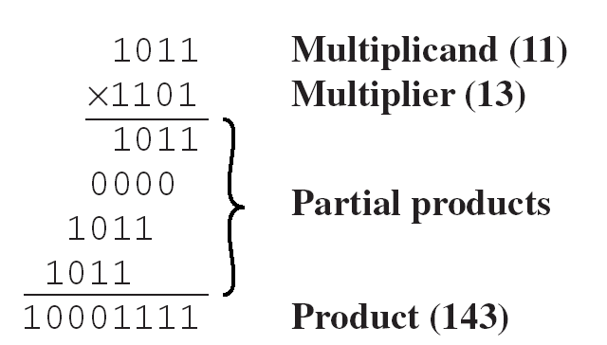
Multiplication
Complex
Work out partial product for each digit
Take care with place value (column)
Add partial products
Note: need double length result

Slide 45
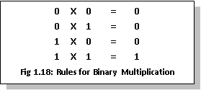
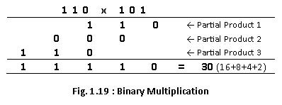
Binary Multiplication
Multiplication on unsigned binary numbers is exactly same as that of decimal multiplication, except that the digits in the multiplicand and multiplier are 0 and 1 only.
Hence the partial product will either be zero (when multiplied with 0) or the multiplicand itself (when multiplied with 1).

Slide 46
Try Yourself………
Perform the following multiplication operation
011001 x 001100

Slide 47
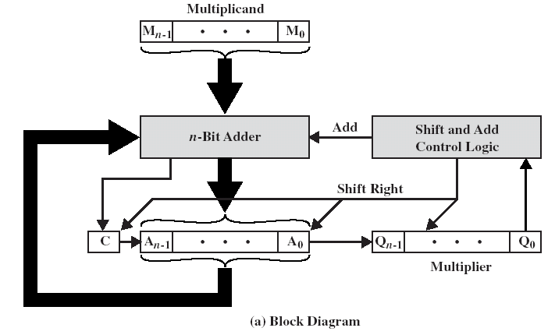
Unsigned Binary Multiplication

Slide 48
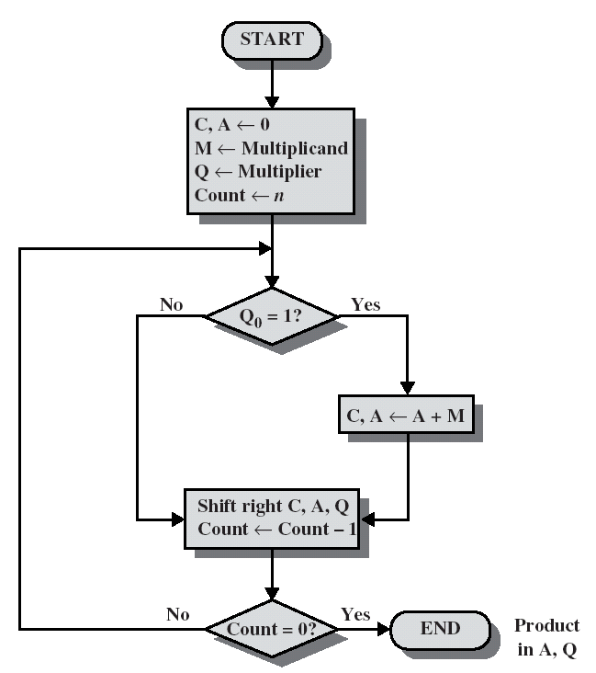
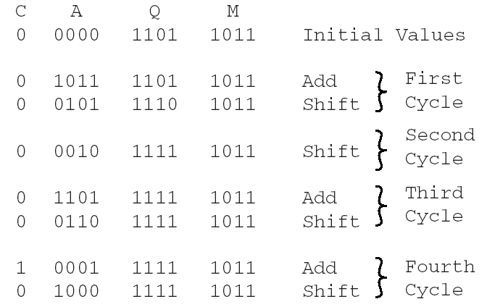
Flowchart for Unsigned Binary Multiplication

