Slide 1
Introduction to Biostatistics and data analysis concepts
Presented by:
Mohammad Jaffar, Pharmacy Program,
Department of Pharmacology,
BMC, Jeddah

Slide 3

BMC
Introduction to Biostatistics and data analysis concepts

Slide 4

Introduction to Biostatistics
Learning Objectives
  Define biostatistics and its importance in health sciences.
  Differentiate between descriptive and inferential statistics.
  Identify types of data and appropriate summary measures.
  Understand key concepts: probability, hypothesis testing, and confidence intervals.
  Recognize common statistical tests and their uses.
  Appreciate the role of software in data analysis.

Slide 5
Introduction to Biostatistics
What is Biostatistics?
Definition: The application of statistical principles to questions and problems in medicine, public health, and biology.
Core Idea: It's the science of learning/understanding from health-related data.
For example:
Research question: What is causing this sudden outbreak of diarrhea in our community?
Data collection
They interview patients (cases) and a control group of healthy people about their recent activities and food consumption
(e.g., "Did you eat outside junk food in the last week?"
"Did you eat the salad outside home?").
Data collection
They collect stool samples from ill patients to test for specific pathogens
Data collection
They collect stool samples from ill patients to test for specific pathogens
Determine the association basing up on the significance
Statistical analysis
Perform correlation analysis

Slide 6
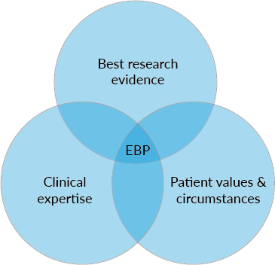
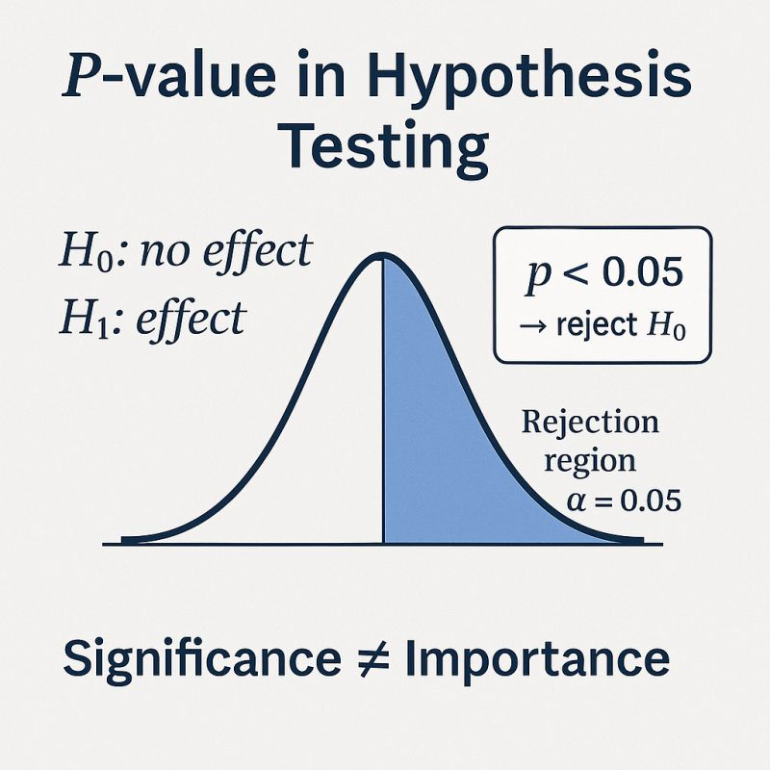
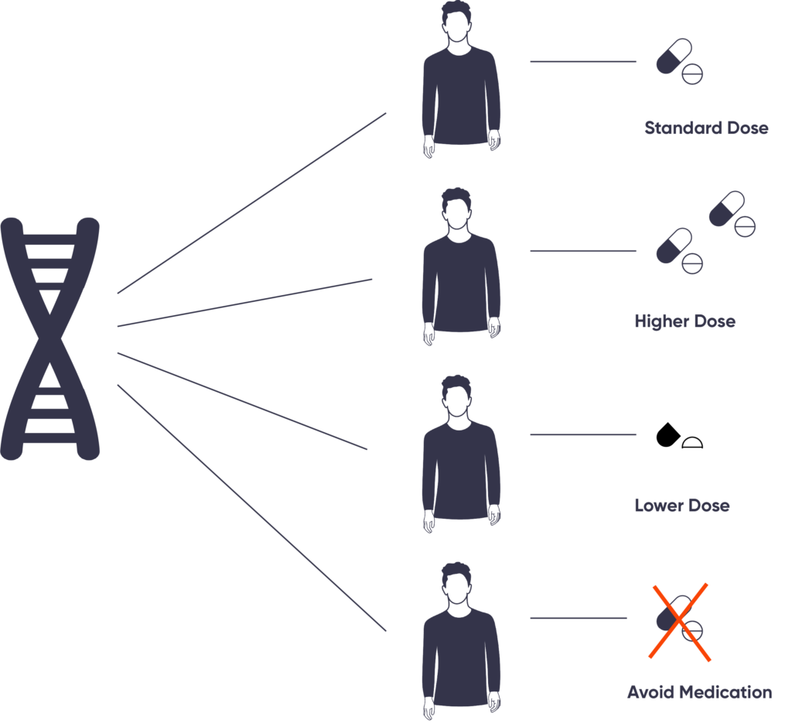
Why is it important
Evidence-Based Medicine (EBP): Does this new drug really work? (Clinical Trials)
Public Health: What are the risk factors for heart disease? (Epidemiology)
Epidemiology: Track and predict the spread of diseases.
Health Policy: Allocate resources efficiently based on population data.
Genetics: Identify genes associated with specific diseases.

Slide 7
Introduction to Biostatistics
The Two Main Branches
1. Descriptive Statistics
  Purpose: To summarize, organize, and simplify data.
  Examples: Mean, median, mode, standard deviation, graphs, charts.
  Icon: Bar chart or pie chart.
2. Inferential Statistics
  Purpose: To make predictions or inferences about a population based on a sample.
  Examples: Hypothesis testing, confidence intervals, regression.
  Icon: A graph showing a sample and an arrow pointing to a larger population.

Slide 8
Introduction to Biostatistics
Types of Data - The Foundation
Know Your Data: Categorical vs. Numerical
1. Categorical (Qualitative): Represents groups or categories.
  Nominal: No order (e.g., Blood Type: A, B, AB, O; Sex: Male, Female).
  Ordinal: Ordered ranks (e.g., Pain Scale: Mild, Moderate, Severe).
2. Numerical (Quantitative): Represents measurable quantities.
  Discrete: Counts (e.g., Number of hospital visits, Number of children).
  Continuous: Measurements (e.g., Height, Weight, Blood Pressure, Age).

Slide 9
Introduction to Biostatistics
What type of data
Categorical: Are categories ordered?
Yes: Ordinal
No: Nominal
Numeric: Which is measured
Counted: Discrete
Measured: Continuous
Classifying the Variables

Slide 10
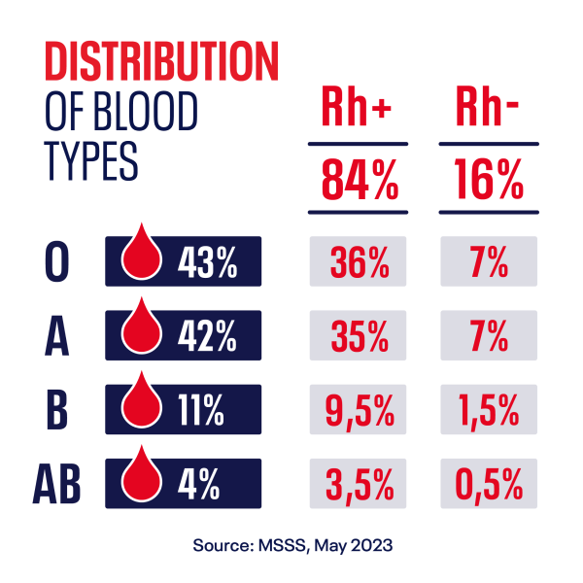
Introduction to Biostatistics
Categorical Data
Tools:
  Frequency Tables: Counts and percentages.
  Bar Charts: Compare counts between categories.
  Pie Charts: Show proportions of a whole.
Example: A simple bar chart showing the percentage of patients with Blood Types A, B, AB, and O.

Slide 11
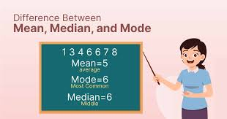
Introduction to Biostatistics
Numerical Data - Central Tendency
Title: Describing Numerical Data: Where is the center?
Measures of Central Tendency:
  Mean: The average
  Median: The middle value
  Mode: The most frequent value.
Visual: A simple symmetric distribution curve showing where mean, median, and mode fall. Then, a skewed distribution showing how they differ.

Slide 12
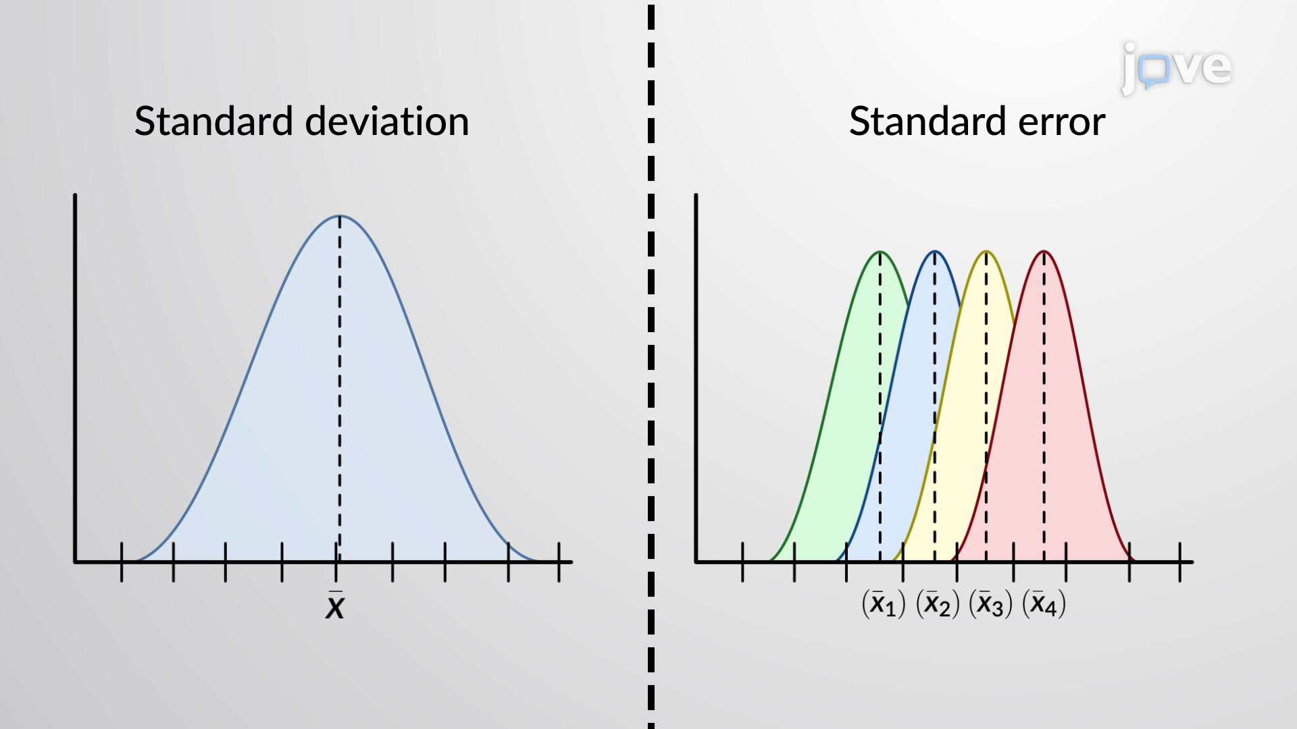
Introduction to Biostatistics
Numerical Data - Variability
Title: Describing Numerical Data: How spread out is it?
Measures of Variability (Spread):
  Range: Max - Min (simple but misleading).
  Standard Deviation (SD): The average distance of each data point from the mean. (Low SD = data clustered around mean. High SD = data spread out)
  Standard Error of Mean (SEM): how precisely the sample mean estimates the population mean
  Interquartile Range (IQR): The range of the middle 50% of the data.

Slide 13
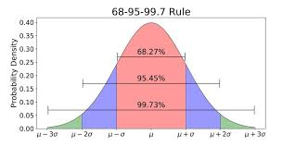
Introduction to Biostatistics
The concept of Distribution
The Normal Distribution
Key Message: Many biological measurements (height, BP) follow a "bell-shaped" curve.
Visual: A classic bell curve.
Highlight the 68-95-99.7 Rule:
  ~68% of data falls within 1 SD of mean.
  ~95% of data falls within 2 SDs of mean.
  ~99.7% of data falls within 3 SDs of mean.
This is a foundational concept for inference.

Slide 14
Introduction to Biostatistics
Description to Inference: The Bridge: From Sample to Population
Key Terms:
  Population: The entire group you want to study (e.g., all diabetic patients in the country).
  Sample: A subset of the population you actually measure (e.g., 200 diabetic patients from 3 clinics).
  Parameter: A numerical characteristic of a population (e.g., true mean HbA1c of all diabetics).
  Statistic: A numerical characteristic of a sample (e.g., mean HbA1c of your 200 patients).
Goal of Inference: Use the statistic to estimate the parameter.

Slide 15
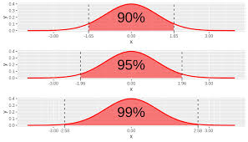
Introduction to Biostatistics
The Core of Inference: Confidence Intervals
Estimation: Confidence Intervals (CI)
Definition: A range of values that is likely to contain the true population parameter.
Common Example: "We are 95% confident that the true mean systolic BP is between 118 and 122 mmHg."
Interpretation: It's about confidence in the method, not the specific interval. If we repeated the study 100 times, 95 of the calculated CIs would contain the true mean.

Slide 16
Introduction to Biostatistics
The Core of Inference: Hypothesis Testing
Hypothesis Testing: A Five-Step Process
Null Hypothesis (H₀): Statement of "no effect" or "no difference" (e.g., Drug A = Drug B).
Alternative Hypothesis (H₁): Statement we want to prove (e.g., Drug A ≠ Drug B).
Conduct a statistical test (e.g., t-test, chi-square).
Obtain a p-value.
Make a conclusion: Reject H₀ or Fail to Reject H₀.
Null Hypothesis (H₀): There is no difference in average blood pressure between patients taking Drug A and those taking a placebo.
Alternative Hypothesis (H₁): There is a difference in average blood pressure between patients taking Drug A and those taking a placebo.

Slide 17
Introduction to Biostatistics
What is a P-value?
Explaining the P-value
Definition: The probability of obtaining results at least as extreme as the observed results, assuming the null hypothesis (H₀) is true.
It is NOT the probability that H₀ is true.
The Threshold (Alpha α): Typically set at 0.05.
  If p-value ≤ 0.05: The result is "statistically significant." We reject H₀. The observed effect is unlikely due to chance alone.
  If p-value > 0.05: The result is "not statistically significant." We fail to reject H₀. We can't say the effect isn't due to chance.

Slide 18
Introduction to Biostatistics
Common Statistical Tests (Overview)
Choosing the Right Tool: Common Statistical Tests
A simple decision table:
  Comparing Means (Numerical Data):
    Two groups: T-test
    Three or more groups: ANOVA
  Comparing Proportions (Categorical Data):
    Chi-Square Test
  Assessing Relationship: Between two numerical variables:
    Correlation: Measures strength and direction of relationship
    Regression: Not only shows the relationship but also provides an equation to make predictions

Slide 19
Introduction to Biostatistics
The Data Analysis Pipeline
The Steps of a Statistical Analysis
A numbered list of the process:
  Define the Research Question
  Design Study & Collect Data
  Data Management & Cleaning (Crucial step)
  Descriptive Analysis (Explore your data: graphs, summary stats)
  Inferential Analysis (Apply statistical tests)
  Interpretation & Communication (Tell the story of the data)

Slide 20
Introduction to Biostatistics
The Role of Software
Tools of the Trade
Message: Software handles complex calculations, allowing us to focus on design and interpretation.
Logos of common software:
  Professional: R, SAS, Stata, SPSS
  General Use: Python (with pandas/stats models), Microsoft Excel (for basics)
Emphasize: The principle is more important than the tool.*

Slide 21
Introduction to Biostatistics
Key Takeaways & Summary
Key Takeaways
  Biostatistics turns data into evidence for health decisions.
  Start by describing your data (type, center, spread).
  Use samples to make inferences about populations.
  Confidence intervals estimate effects; hypothesis tests assess significance.
  P-values measure evidence against the null hypothesis.
  Always choose the right test for your data and question.

Slide 22

Introduction to Biostatistics
Thank You & Questions?
Dr Mohammad Jaffar,
Jaffar.sadiq@bmc.edu.sa
Daniel, W. W., & Cross, C. L. (2013).
Biostatistics: A Foundation for Analysis in the Health Sciences. Wiley.

Slide 23
Thank You

