Slide 1



كل عام وأنتن بخير
Course Title: Probability Theory with Applications
Course Code: Stat 221
Lecture (1): Review of Probability
Course coordinator: Dr. Huda M Alshanbari
Associate Professor; Department of Mathematical Sciences, College of Science, Princess Nourah bint Abdulrahman University

Slide 2

References
1- Larson Hogg. R. and A. Crag, Introduction to mathematical Statistics, (1978).
2- Hodges J., Lehmann E (1964/70), Basic concepts of probability and statistics.
3- Ugarte, M. D., Militino, A. F., & Arnholt, A. T. (2008). Probability and Statistics with R. CRC press
4- Kerns, G. J. (2010). Introduction to probability and statistics using R. Lulu. Com
5- Hogg, R. V., Tanis, E. A., & Zimmerman, D. L. (2010). Probability and statistical inference (Chapter (1)). Upper Saddle River, NJ, USA:: Pearson/Prentice Hall.

Slide 3

Learning Objectives
After careful study of this lecture, you will learn the following:
Review of probability: random experiment, sample space, event operations, axioms of probability, conditional probabilities, and independent events.

Slide 4

Review of probability
Terms | Meaning
Random experiment | Random experiments can be defined as experiments that can be performed many times under the same conditions and their outcome cannot be predicted with complete certainty
Outcome | A possible result of a random experiment is called its outcome. Example: In an experiment of throwing a die, the outcomes are 1, 2, 3, 4, 5, or 6
Sample Space | The set of all possible outcomes of a random experiment is called the sample space connected with that experiment and is denoted by the symbol S. Example: In an experiment of throwing a die, sample space is S = {1, 2, 3, 4, 5, 6}
Sample point | Each element of the sample space is called a sample point.
Event | an event is a subset of the sample space,

Slide 5
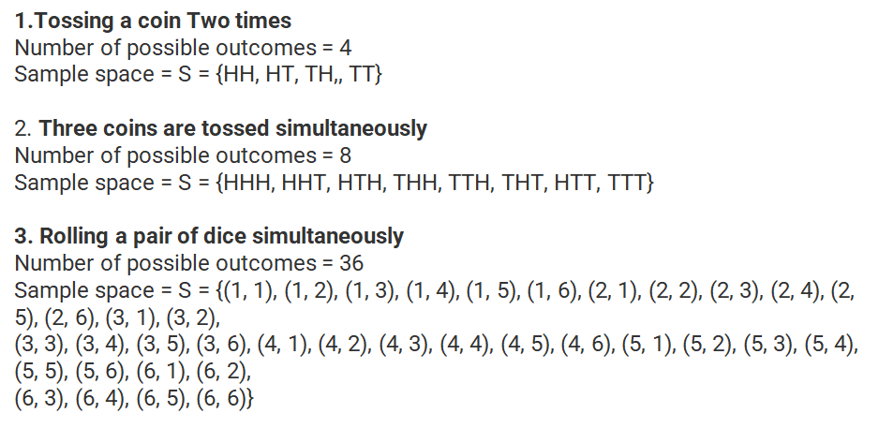
Example

Slide 6
How to do it in R

Slide 7
How to do it in R

Slide 8
How to do it in R

Slide 9
How to do it in R

Slide 10
Operation of Events

Slide 11
How to do it in R
> S = cards()
> A = subset(S, suit == "Heart")
> B = subset(S, rank %in% 7:9)
> head(A);head(B)
rank suit
27 2 Heart
28 3 Heart
29 4 Heart
30 5 Heart
31 6 Heart
32 7 Heart
rank suit
6 7 Club
7 8 Club
8 9 Club
19 7 Diamond
20 8 Diamond
21 9 Diamond

Slide 12
How to do it in R
> intersect(A, B)
rank suit
32 7 Heart
33 8 Heart
34 9 Heart
> setdiff(A, B)
rank suit
27 2 Heart
28 3 Heart
29 4 Heart
30 5 Heart
31 6 Heart
35 10 Heart
36 J Heart
37 Q Heart
38 K Heart
39 A Heart

Slide 13
Probability Function

Slide 14
How to do it in R

Slide 15
How to do it in R

Slide 16
How to do it in R

Slide 17
How to do it in R
> S <- cards(makespace = TRUE)
> A <- subset(S, suit == "Heart")
> B <- subset(S, rank %in% 7:9)
> Prob(A)
[1] 0.25
> Prob(S, suit == "Heart")
[1] 0.25

Slide 18
Conditional probability

Slide 19
Conditional probability

Slide 20
How to do it in R
> S <- rolldie(2, makespace = TRUE) # assumes ELM
> A <- subset(S, X1 == X2)
B <- subset(S, X1 + X2 >= 8)
> Prob(A, given = B)
[1] 0.2
> Prob(B, given = A)
[1] 0.5
>

Slide 21
Conditional Probability

Slide 22
Conditional Probability

Slide 23
How to do it in R
> L <- rep(c("red", "green"), times = c(7, 3))
> M <- urnsamples(L, size = 3, replace = FALSE, ordered = TRUE)
> N <- probspace(M)
> Prob(N, isrep(N, "red", 3))
[1] 0.2916667
What is the probability of getting two "red"s
> Prob(N, isrep(N, "red", 2))
[1] 0.525

Slide 24
Independent Event

Slide 25
Independent Event

Slide 26
How to do it in R
Example 4.41. Toss ten coins. What is the probability of observing at least one Head?
> S <- tosscoin(10, makespace = TRUE)
> A <- subset(S, isrep(S, vals = "T", nrep = 10))
> 1 - Prob(A)
[1] 0.9990234

Slide 27
Bayes’ Rule

Slide 28
Bayes’ Rule

Slide 29
Bayes’ Rule

Slide 30
How to do it in R

Slide 31
How to do it in R
> prior <- c(0.6, 0.3, 0.1)
> like <- c(0.003, 0.007, 0.01)
> post <- prior * like
> post/sum(post)
[1] 0.3673469 0.4285714 0.2040816

Slide 32
Homework
Ex1.1, Page 10: 1.1-1, 1.1-3, 1.1-5, 1.1-11
Ex1.3, Page 27: 1.3-1, 1.3-3
Ex1.4, Page 33: 1.4-1, 1.4-3, 1.4-5, 1.4-7

