Slide 1

CEN-1303
Introduction to Digital Signal processing
Chapter 1_Fundamentals of Signals and Systems
1

Slide 2
Overview:
This chapter covers:
The fundamental principles of signals and systems.
Signal representation and classification
System modeling and analysis
Applications

Slide 3
1. Introduction
Signals and Systems is a fundamental subject in electrical, computer, and information engineering.
A signal is a physical quantity that varies with time or space and carries information.
Examples of signals include:
Speech, is encountered in telephony, radio, and every-day life
Biomedical signals, (heart signals, brains signals)
Sound and music, as reproduced by the compact disc player
Video and image,
Radar signals, which are used to determine the range and bearing Of distant targets.

Slide 4
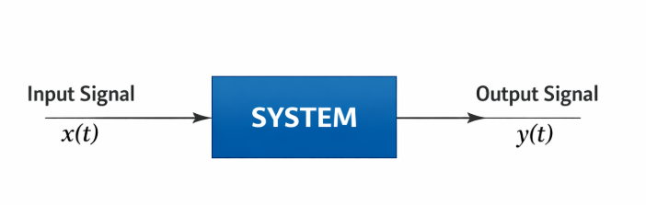
A system is a device or algorithm that processes input signals to produce output signals.
Common system operations include:
Amplification
Filtering
Modulation
Transformation
Signals and systems are analysed using mathematical models to predict behavior.

Slide 5
2. What is Digital Signal Processing (DSP)?
Digital Signal Processing (DSP) is the processing or manipulation of signals using digital techniques.
DSP involves representing real-world signals in a digital form and applying mathematical operations to them.
DSP Components:
D – Discrete / Digital:
Signals and systems represented in discrete-time and digital form.
S – Signals:
Information-bearing quantities such as sound, images, and sensor data.
P – Processing:
Operations such as amplification, filtering, compression, and analysis.

Slide 6
3. What is a Signal?
A signal is a physical quantity that varies with time, space, or another independent variable and carries information.
Types of Signals:
Electrical Signals: Voltages, currents, and electromagnetic fields.
Acoustic Signals: Mechanical vibrations and sound waves.
Mechanical Signals: Displacement, velocity, force, and torque.
Other Examples:
Biomedical signals (ECG, EEG)
Optical signals
Image and video signals
Sensor and measurement signals

Slide 7
4. Types of Signals
Continuous-time signals (analog signals): signals that are continuous in both amplitude and time.
Discrete-time signals (sequences): signals that are continuous in amplitude but discrete in time.
Digital signals: signals that are discrete in both time and amplitude.

Slide 8
5. Signal Processing
Signal processing is the analysis, interpretation, and manipulation of signals like sound, images time-varying measurement values and sensor data etc…
For example biological data such as electrocardiograms, control system signals, telecommunication transmission signals such as radio signals, and many others.
Processing of such signals includes storage and reconstruction, separation of information from noise (e.g., aircraft identification by radar), compression (e.g., image compression), and feature extraction (e.g., speech-to-text conversion).

Slide 9
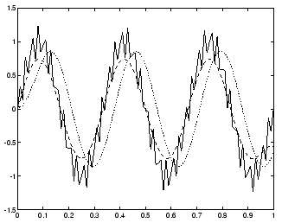
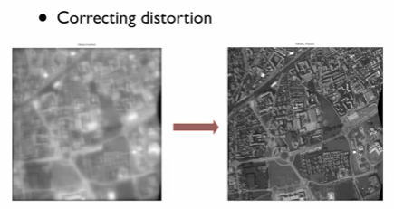
6. Need of Signal Processing
When a signal is transmitted from one point to another there is every possibility of contamination /deformation of the signal by external noise. So, to retrieve the original signal at the receiver suitable filters are to be used. i.e the signal is processed to obtain the pure signal.

Slide 10
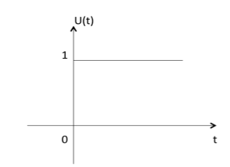

7. Basic Signals
Here are a few basic signals:
a. Unit Step Function
Unit step function is denoted by u(t). It is defined as :
It is used as best test signal.
Area under unit step function is unity.

Slide 11
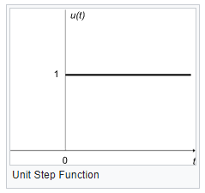
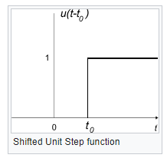
Derivative
The unit step function is level in all places except for a discontinuity at t = 0. For this reason, the derivative of the unit step function is 0 at all points t, except where t = 0. Where t = 0, the derivative of the unit step function is infinite.
The derivative of a unit step function is called an impulse function. The impulse function will be described in more detail next.

Slide 12

Integral
The integral of a unit step function is computed as such:
In other words, the integral of a unit step is a "ramp" function. This function is 0 for all values that are less than zero, and becomes a straight line at zero with a slope of +1.

Slide 13
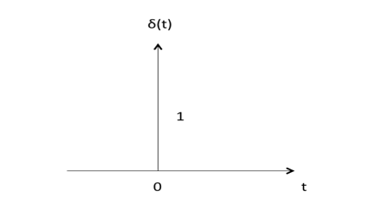

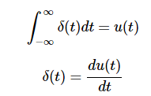
b. Unit Impulse Function
Impulse function is denoted by δ(t). and it is defined as
The symbol for an impulse is δ(t). If an impulse is used as an input to a system, the output is known as the impulse response. The impulse response defines the system because all possible frequencies are represented in the input.

Slide 14
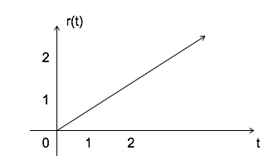

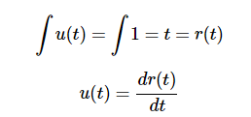
c. Ramp Signal
Ramp signal is denoted by r(t), and it is defined as :
Area under unit ramp is unity.

Slide 15
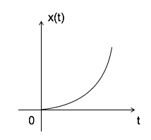

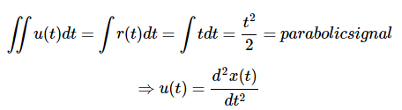
d. Parabolic Signal
Parabolic signal can be defined as:

Slide 16

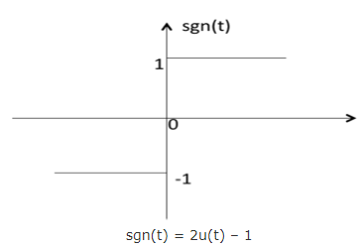
e. Signum Function
Signum function is denoted as sgn(t). It is defined as

Slide 17
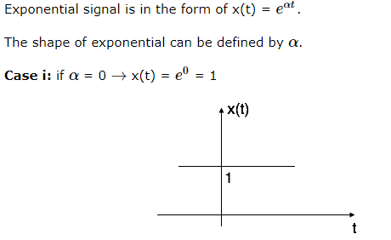
f. Exponential Signal

Slide 18
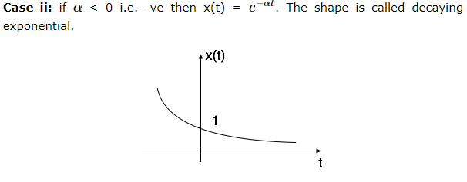
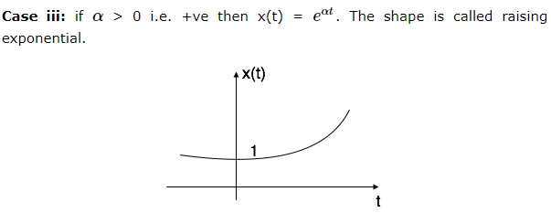

Slide 19
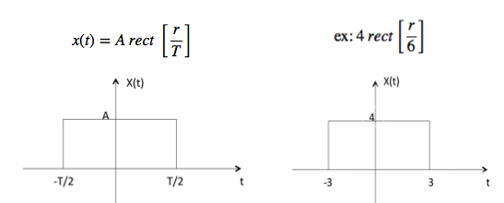
g. Rectangular Signal
Let it be denoted as x(t) and it is defined as
Or:
X(t)=A rect (t)
T

Slide 20
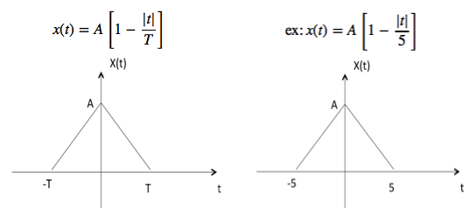
h. Triangular Signal
Let it be denoted as x(t)

Slide 21

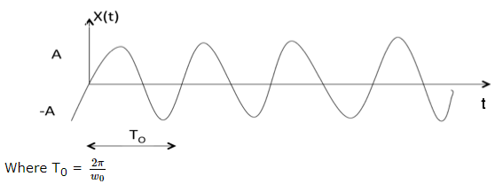
k. Sinusoidal Signal
Sinusoidal signal is in the form of:
T0: period =1/f (s); f: frequency

Slide 22
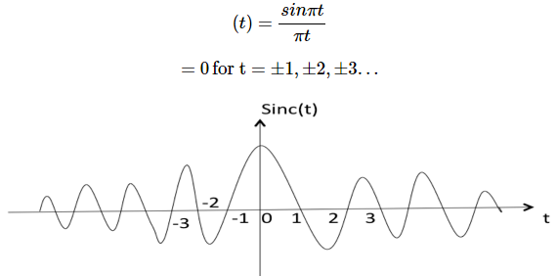
l. Sinc Function
It is denoted as sinc(t) and it is defined as sinc:

Slide 23


m. Complex exponential Function
$$e^{jw_{0}t}=cosw_{0}t+jsinw_{0}t$$
$$cosw_{0}t=\frac{e^{jw_{0}t}+e^{−jw_{0}t}}{2}$$
$$sinw_{0}t=\frac{e^{jw_{0}t}−e^{−jw_{0}t}}{2j}$$

Slide 24
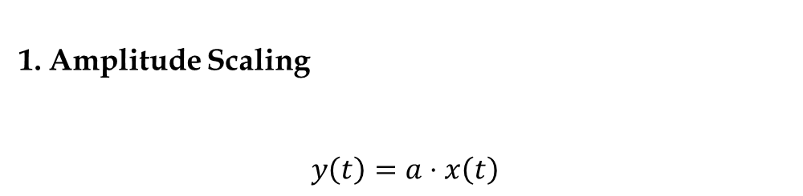
8. General basic operations on signals
The most common operations are:
Amplitude Scaling
$$y\left(t\right)=a⋅x\left(t\right)$$
Multiplies the signal by a constant a.
Changes height, not width.

Slide 25
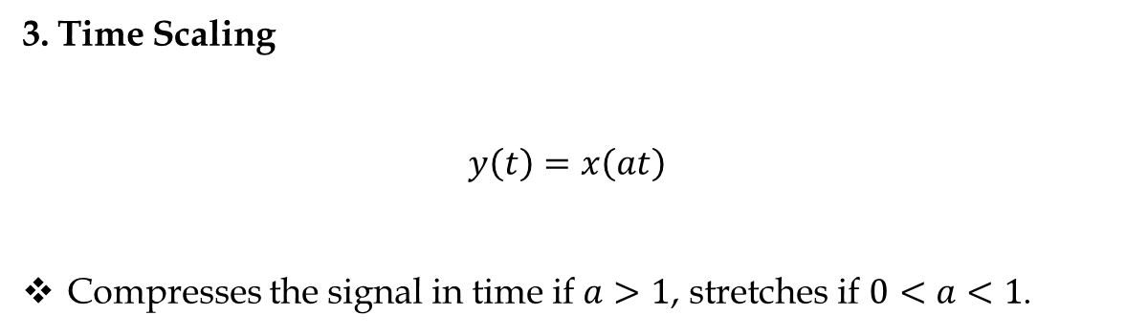
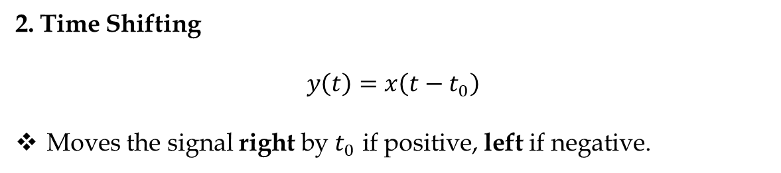
2. Time Shifting
$$y\left(t\right)=x\left(t−t_{0}\right)$$
Moves the signal right by $t_{0}$ if positive, left if negative.
3. Time Scaling
$$y\left(t\right)=x\left(at\right)$$
Compresses the signal in time if $a>1$, stretches if $0<a<1$.

Slide 26
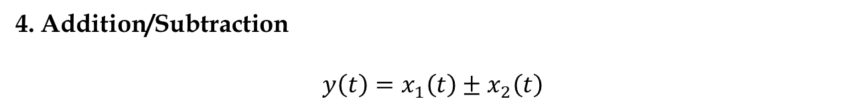
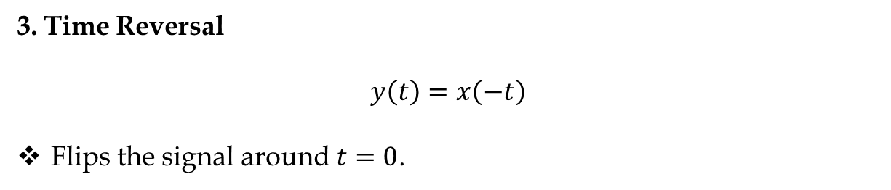
3. Time Reversal
$$y\left(t\right)=x\left(−t\right)$$
Flips the signal around $t=0$.
4. Addition/Subtraction
$$y\left(t\right)=x_{1}\left(t\right)±x_{2}\left(t\right)$$
Combines signals pointwise.

Slide 27
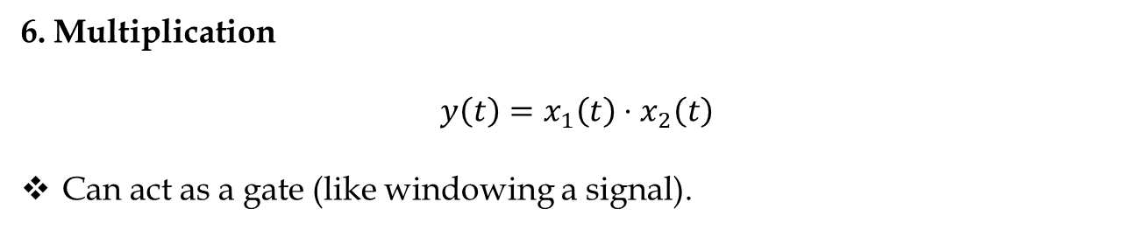
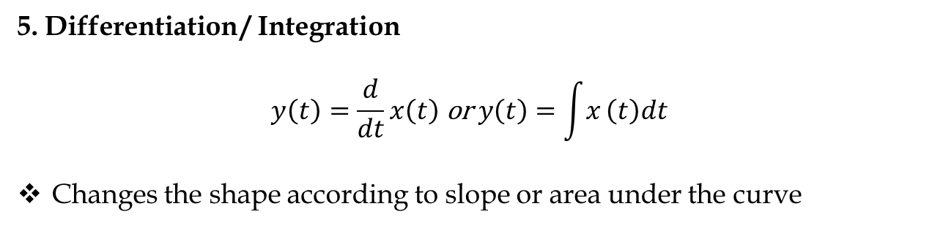
5. Differentiation / Integration
$$y\left(t\right)=\frac{d}{dt}x\left(t\right) \text{or} y\left(t\right)=\int{x}\left(t\right)dt$$
Changes the shape according to slope or area under the curve
6. Multiplication
$$y\left(t\right)=x_{1}\left(t\right)⋅x_{2}\left(t\right)$$
Can act as a gate (like windowing a signal).

Slide 28
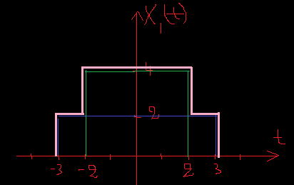
Example
x(t)+y(t)
Example:
X1(t)=2.rect (t)+4.rect (t)
6
4

Slide 29
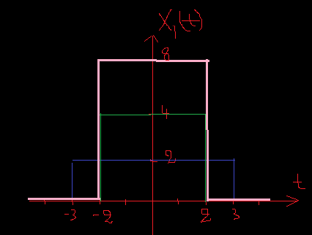
x(t).y(t)
Example:
X1(t)=2rect (t). 4rect (t)
6
4

Slide 30
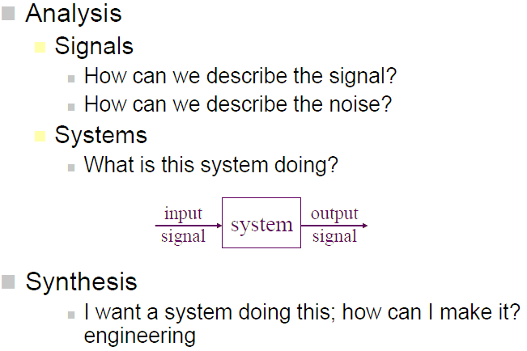
9. What is a System
1️⃣ Definition of a System
A system is an entity or device that accepts one or more input signals, processes them, and produces one or more output signals.
Inputs → Processing → Outputs
Systems can be physical, like electrical circuits, or mathematical, like algorithms.

Slide 31

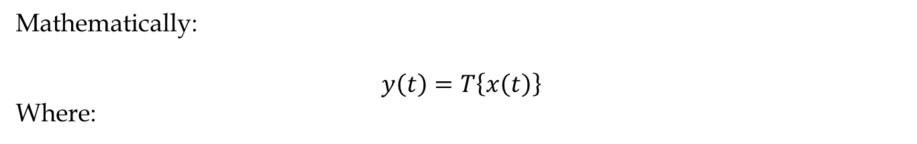
Mathematically:
$$y\left(t\right)=T\left\{x\left(t\right)\right\}$$
Where:
x(t) = input signal (could be voltage, sound, etc.)
y(t) = output signal
T{⋅} = system operator (the rule that transforms input to output)
In discrete time, we write
$$y\left[n\right]=T\left\{x\left[n\right]\right\}$$

Slide 32
2️⃣ Types of Systems
a) Continuous-time vs Discrete-time
Continuous-time system: Input and output signals vary continuously with time.
Example: Analog amplifier, analog filter.
Discrete-time system: Input and output signals are defined at discrete time steps.
Example: Digital audio processing, digital filters.

Slide 33
b) Linear vs Nonlinear Systems
Linear system: Follows superposition principle
If x1​(t)→y1​(t) and x2(t)→y2(t) then: ax1(t)+bx2(t)→ay1(t)+by2(t)
Example: Resistor-capacitor (RC) circuit.
Nonlinear system: Does not follow superposition.
Example: Transistor in saturation, clipping amplifier.

Slide 34

c) Time-invariant vs Time-variant
Time-invariant system: System behavior does not change over time.
If $x\left(t\right)→y\left(t\right)$, then $x\left(t−t_{0}\right)→y\left(t−t_{0}\right)$
Example: Ideal amplifier, low-pass filter.
Time-variant system: System behavior changes over time.
Example: Automatic gain control, time-varying channels in communication.

Slide 35
d) Causal vs Non-causal
Causal system: Output depends only on present and past inputs.
Example: Real-time audio filter.
Non-causal system: Output depends on future inputs.
Example: Some digital signal processing techniques, like smoothing using future values (not real-time)
e) Stable vs Unstable
Stable system: Bounded input produces bounded output (BIBO stable).
Unstable system: Bounded input can produce unbounded output.

Slide 36


3️⃣ Systems Representation
Systems can be represented in several ways:
1. Mathematical equation:
2. Impulse response $h\left(t\right)$(for linear time-invariant systems):
3. Block diagrams: Graphical representation of inputs, system operations, and outputs.

Slide 37
10. Importance and Applications
1. Importance of Signal Processing
Enhancing Signal Quality: Removes noise from signals (audio, images, medical signals).
Feature Extraction: Extracts useful information from signals for decision-making.
Real-time Processing: Enables fast responses in systems like robotics, radar, and control systems.

Slide 38
2. Applications of Signal Processing
Communication Systems
Audio and Speech Processing
Image and Video Processing
Medical Applications
Control Systems and Robotics
Industrial Applications

Slide 39
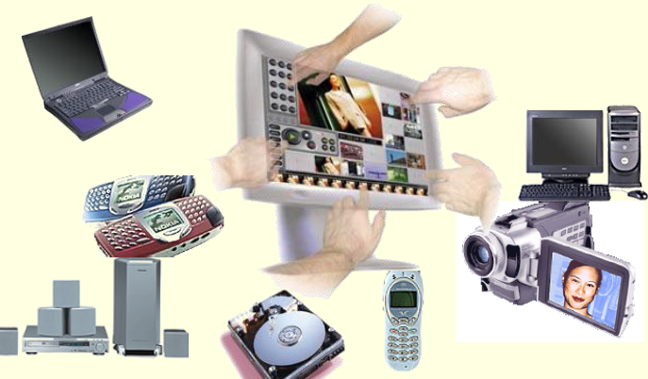
End

