Slide 1
Information Technology Fundamentals
Notes:
To the instructor:
This presentation attempts to cover every term in the text, sometimes via a slide, sometimes via the Notes page.
Additional material beyond what is in the text is presented via either:
Occasional “FACTOID” notations on the Notes page or,
Occasional hyperlinks in the slides themselves. ScreenTip text has been added to each hyperlink allowing you to see in advance where that link will take you.
In addition, the last 20 slides are questions covering the material just presented. They can be used to increase interaction between the instructor and students at the end of each lecture, to ensure students understand the material just presented, etc.
Finally, some of the Notes pages include “Discussion questions” for encouraging student interaction during the lecture.

Slide 2
Is this really all that important to know ?
Server
Program
Client
Network
CPU
Operating System
bit, byte, kilobyte, megabyte …
Memory
Storage
Expansion Slots
MHz
Application Software
Upload
FTP
IT
Network Drive
World Wide Web
Internet
etc.

Slide 3
Becoming Computer Savvy
Understand general computer terms.
Have a better sense of computers when buying.
Know how to fix ordinary problems
Efficiently use the Internet
Know how to learn new and different programs

Slide 4
What is a computer?
A programmable machine
A machine that accepts input (raw data), processes that input, and produces output (information).

Slide 5
What is a network?
Two or more computers connected together using communications equipment.

Slide 6
Then along came …
Being “online” – using a computer to access information from another computer through the use of a network.
The Internet
World Wide Web
E-mail
Information technology (“infotech”):
  IT - Technology that helps in the production, processing, storing, communication and dissemination of information.
The E-World (E-business, E-commerce, E-government, E-learning, E-waste)
Notes:
online learning – E-learning, distance learning

Slide 7
The Internet, the World Wide Web, & the “Plumbing of Cyberspace”
Cyberspace
  encompasses the whole wired and wireless world of communications.
  Term created by William Gibson – author
  Not a commonly used term in the field of Computer Science.
Internet
  A global network of networks (tangible)
  Do not confuse with WWW.
World Wide Web
  Most common use of the Internet
  Encompasses information that can be viewed through a web browser (web pages).
  Do not confuse with the Internet.
Notes:
Internet - a worldwide network that connects hundreds of thousands of smaller networks.
The World Wide Web - an interconnected system of computers all over the world that store information in multimedia form.
Multimedia (from “multiple media”) - technology that presents information in more than one medium, such as text, still images, moving images, and sound.

Slide 8
The “All-Purpose Machine”: The Varieties of Computers
Supercomputers
Mainframes
Workstations
Microcomputers
Microcontrollers
Notes:
Factoid: The fastest computer in the world, which cost $350 million and looks like rows of refrigerator-size boxes, is the NEC Earth Simulator in Yokohama, Japan.
Consists of thousands of processors and can carry out several trillion calculations per second.

Slide 9
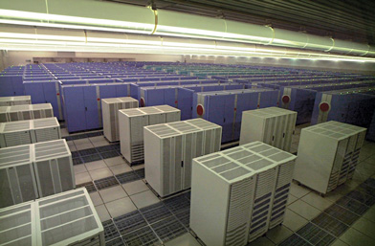
Supercomputers
Fastest computer
Can cost one million to 350 million dollars
looks like rows of refrigerator-size boxes
Consists of thousands of processors and can carry out several trillion calculations per second.
Used for computer simulations
  tracking hurricanes, biological contamination, or understanding ocean currents.

Slide 10
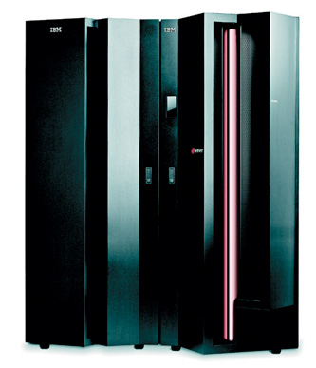
Mainframes
Small mainframes (mid-size computers or minicomputers).
5,000 to 5 million dollars
Used in large organizations – banks, airlines, insurance companies, colleges.
Processes billions of instructions per second.
Often used with a terminal.

Slide 11
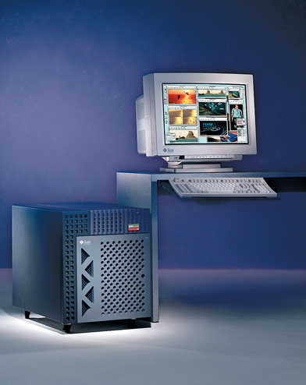
Workstations
usually used for complex scientific, mathematical, and engineering calculations and for computer-aided design
Example: designing airplanes, special effects in movies
Notes:
Workstations - expensive, powerful computers usually used for complex scientific, mathematical, and engineering calculations and for computer-aided design and computer-aided manufacturing.
Workstations provide capabilities comparable to midsize mainframes. They are used for tasks such as designing airplane fuselages, prescription drugs, and movie special effects.
Factoid: In 2003, IBM launched a new mainframe line code-named T-Rex and formally called the z900 models.

Slide 12
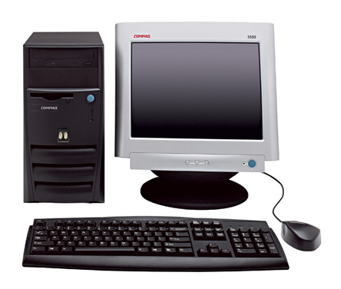
Microcomputer
$500 - $5000
Personal Computer (PC)
  Tower PC
  Desktop PC
  Laptop / Notebook
  Personal digital assistants (PDAs), also called handheld computers or palmtops
Mac
  While a Mac is a PC, most people relate the term, PC, with systems that run the Windows operating system.
Notes:
Microcomputers - also called personal computers. Cost $500 - $5000. Can fit next to a desk or on a desktop, or can be carried around.
Tower PC - PC in which the case sits as a “tower,” often on the floor beside a desk, thus freeing up desk space.
A Mac is also a PC but PC is commonly used to refer to a computer running a Microsoft operating system
FACTOID: Some computer manufacturers produce PCs called “mini-towers.”
Local area network (LAN) - a network connecting, usually by special cable, a group of desktop PCs and other devices, such as printers, in an office or a building.
Desktop PC - those in which the case or main housing sits on a desk, with keyboard in front and monitor (screen) often on top. In addition to the desktop PC, microcomputers can also be:
Notebook computers, also called laptop computers
Personal digital assistants (PDAs), also called handheld computers or palmtops
The following pages show pictures of both types of microcomputers.

Slide 13
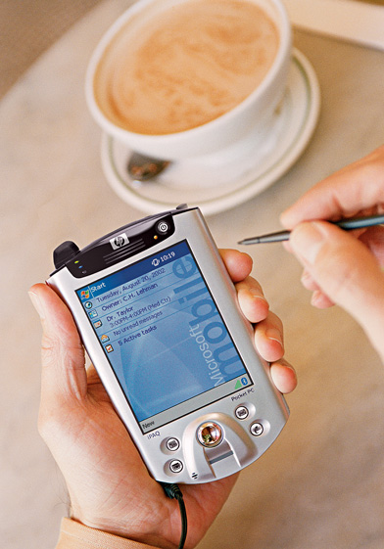
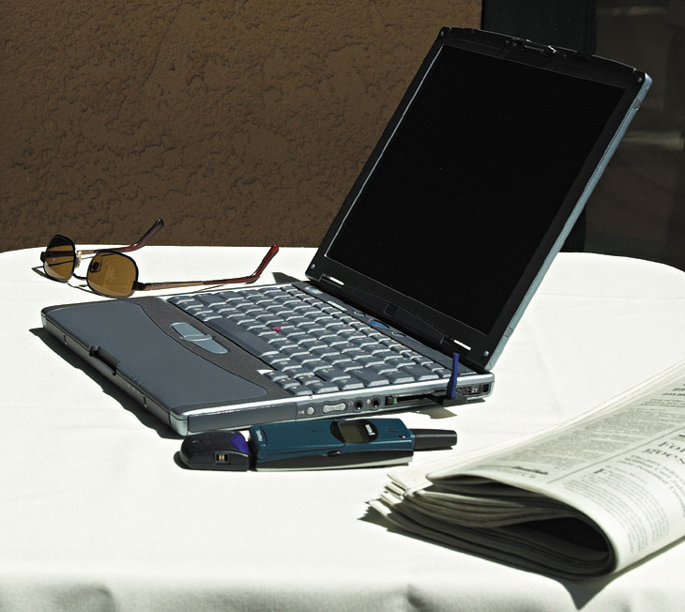
Other types of microcomputers.
Personal Digital Assistant
Laptop computer
Notes:
Laptop computers - also called notebook computers. These are lightweight portable computers with built-in monitor, keyboard, hard-disk drive, battery, and AC adapter.

Slide 14
Microcontrollers
tiny, specialized microprocessors installed in “smart” appliances and automobiles
also called embedded computers
Notes:
Microcontrollers -also called embedded computers
. They are the tiny, specialized microprocessors installed in “smart” appliances and automobiles.

Slide 15
Servers
The word “server” refers to how a computer is used.
Server - a central computer that holds collections of data & programs for clients
Clients - PCs, workstations, & other devices attached to a server
Server + Clients linked together form a client/server network
Notes:
Discussion point: If applicable, the instructor might mention at this point the name of the server being used by the students along with the type (size) of computer it is, and then explain what is stored on the server vs. the clients that the students use.

Slide 16
How Computers Work
The purpose of a computer is to process data into information.
Data (Input)
  The raw facts and figures that are processed into information
Information (Output)
  Data that has been summarized or otherwise manipulated for use in decision making

Slide 17
Computers consist of hardware and software.
Hardware
  All the machinery and equipment in a computer system
  Tangible
Software
  All the instructions that tell the computer how to perform a task
  Intangible

Slide 18
All computers follow the same five basic operations.
Input
Processing
Storage
Output
Communications
Notes:
Input - whatever is put into (“input”) a computer system.
Input hardware - devices that allow people to put data into the computer in a form that the computer can use.
Mouse - an input device that is used to manipulate objects viewed on the computer display screen.
Keyboard - an input device that converts letters, numbers, and other characters into electrical signals readable by the processor.
FACTOID (to accompany hyperlink for Keyboard): Most keyboards were designed with a right-handed computer user in mind. However, approximately 10% of the population is left-handed. Some manufacturers produce keyboards especially for the left-handed computer user. One Web site that offers such keyboards for sale is thelefthand.com. Notice the differences in the left-hand keyboard pictured on their site. The numeric pad has been moved from its normal position on the right-hand side of the keyboard to the left-hand side. Similarly, the arrow keys along with the help, home, page up, page down, etc., keys that are normally adjacent to the numeric pad have been moved to the left-hand side of the keyboard. These two changes would allow a left-handed user to do frequent operations such as numeric data-entry and up/down, left/right movements on the screen with his or her dominant hand—the left one.
FACTOID on mouse: A computer mouse may provide one, two, three or more buttons, depending on which system software it is to be used with. Most use two buttons since that is the minimum number needed for working with the popular Microsoft Windows operating system.

Slide 19
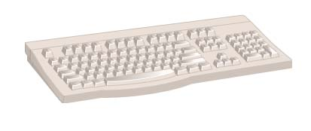
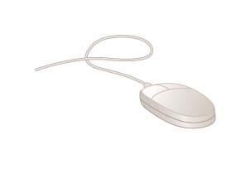
Input
Keyboard
Mouse
Notes:
Input - whatever is put into (“input”) a computer system.
Input hardware - devices that allow people to put data into the computer in a form that the computer can use.
Mouse - an input device that is used to manipulate objects viewed on the computer display screen.
Keyboard - an input device that converts letters, numbers, and other characters into electrical signals readable by the processor.
FACTOID (to accompany hyperlink for Keyboard): Most keyboards were designed with a right-handed computer user in mind. However, approximately 10% of the population is left-handed. Some manufacturers produce keyboards especially for the left-handed computer user. One Web site that offers such keyboards for sale is thelefthand.com. Notice the differences in the left-hand keyboard pictured on their site. The numeric pad has been moved from its normal position on the right-hand side of the keyboard to the left-hand side. Similarly, the arrow keys along with the help, home, page up, page down, etc., keys that are normally adjacent to the numeric pad have been moved to the left-hand side of the keyboard. These two changes would allow a left-handed user to do frequent operations such as numeric data-entry and up/down, left/right movements on the screen with his or her dominant hand—the left one.
FACTOID on mouse: A computer mouse may provide one, two, three or more buttons, depending on which system software it is to be used with. Most use two buttons since that is the minimum number needed for working with the popular Microsoft Windows operating system.

Slide 20
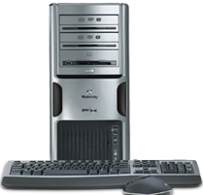
Processing
- Manipulating data into information
Case or system cabinet
  the box that houses
    the processor chip
    (CPU – Central Processing Unit)
    memory chips (RAM)
    motherboard with power supply
    secondary storage devices
    video card
    Etc. …..
Notes:
Processing - the manipulation a computer does to transform data into information.
Case or system cabinet - the box that houses the processor chip (CPU), the memory chips, and the motherboard with power supply, as well as some secondary storage devices.
FACTOID: The popular iMac microcomputer manufactured by Apple Computer does not have a case separate from its monitor. Instead, the monitor, CPU, memory chips, motherboard, power supply, hard-disk drive, and CD or CD/DVD drive are all contained in one compact unit.

Slide 21
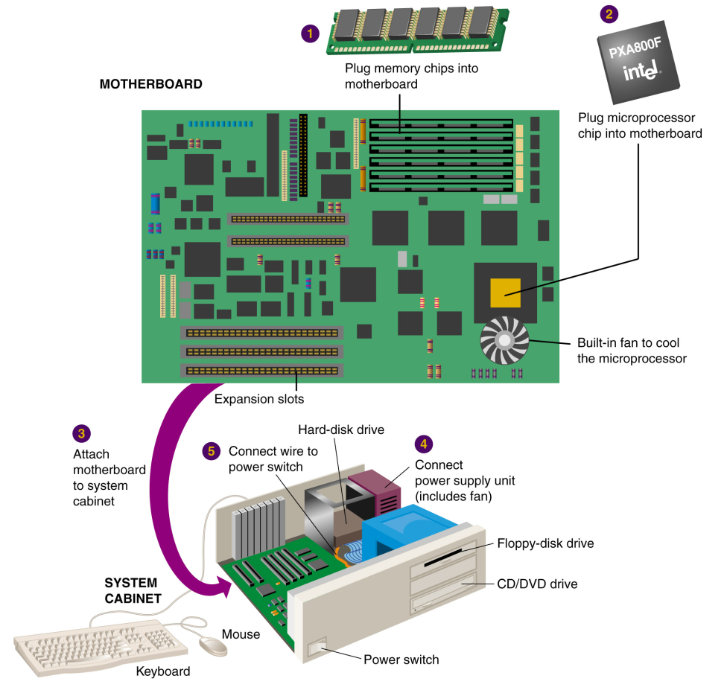
Motherboard
Motherboard - the main circuit board in the computer.
Everything else attaches to the motherboard through connections called ports.
Expansion slots - “plugs” on the motherboard for expanding the PC’s capabilities via additional circuit boards.

Slide 22
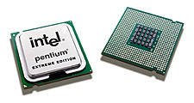
Processing
Front
Back
Processor chip
A tiny piece of silicon that contains millions of miniature electronic circuits.
Notes:
Processor chip - A tiny piece of silicon that contains millions of miniature electronic circuits.

Slide 23
Storage
Primary storage
  Computer circuitry that temporarily holds data waiting to be processed and after it has been processed
  Also called:
    Memory or primary memory
    RAM – Random Access Memory
    Temporary storage

Slide 24
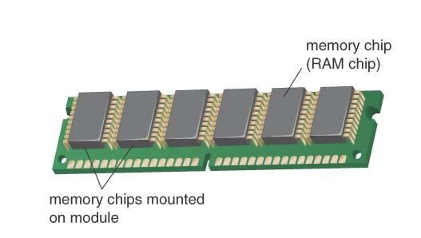
RAM
Memory chips
Notes:
Memory chips:
Also known as RAM (Random Access Memory).
Represent primary storage or temporary storage.
Hold data before processing and information after processing.

Slide 25
Secondary storage
  The area in the computer where data or information is held permanently
  Also simply called:
    Storage

Slide 26
Storage capacity is measured in:
1 byte - 1 character is represented using 1 byte.
  = 8 bits (a bit is a 0 or a 1)
1 kilobyte - 1,024 characters.
= 2¹⁰ bytes (approx. 10³ bytes)
1 megabyte – 1024 KB
= 2²⁰ bytes (approx. 10⁶ bytes)
1 gigabyte – 1024 MB
  = 2³⁰ bytes (approx. 10⁹ bytes)
1 terabyte – 1024 GB
  = 2⁴⁰ bytes (approx. 10¹² bytes)
  1 Peta Byte – 1024 TB

Slide 27
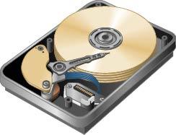
Storage
Hard-disk drive
Notes:
Hard-disk drive - a storage device that stores billions of characters of data on a nonremovable disk platter.

Slide 28
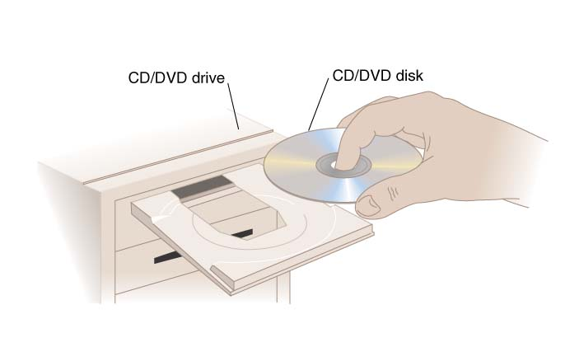
Storage
CD drive
Notes:
CD (Compact Disk) drive or DVD (Digital Video Disk) drive - a storage device that uses laser technology to read data from optical disks.
FACTOID: Many people who have to travel often for work like to take along their laptop computers so that they can make good use of their time while flying in an airplane, waiting at airports, etc. The advent of DVD players in laptops made this an even more attractive alternative, as travelers could carry along a DVD movie for their own personal entertainment. More and more desktop and tower microcomputers are beginning to feature DVD players as well, which further blurs the distinction between a computer and a television. One company that has taken advantage of this increase in computer-based DVD players (accompanied by a similar increase in home-entertainment DVD players) is netflix.com. This WWW-based business is an online substitute for a video rental store. Netflix members pay a fixed amount per month for as many movie DVDs as they can order, watch, and return (in prepaid mailing envelopes) to the company.

Slide 29
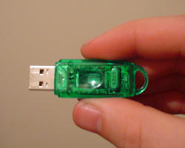
Storage
Flash Memory Sticks

Slide 30
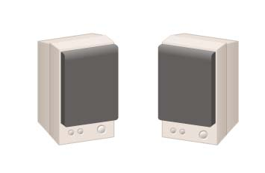
Output
Speakers
Notes:
Speakers - the devices that play sounds transmitted as electrical signals from the sound card.

Slide 31
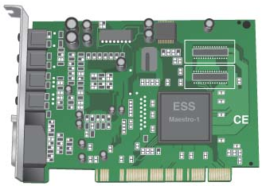
Speaker output requires a sound card.
Sound card
Notes:
Output hardware - devices which translate info processed by the computer into a form that humans can understand.
Peripheral device - any component or piece of equipment that expands a computer’s input, storage, and output capabilities.
Sound card - enhances the computer’s sound-generating capabilities by allowing sound to be output through speakers.

Slide 32
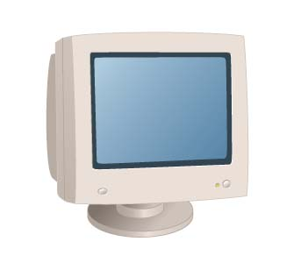
Output
Monitor
Notes:
Monitor - the display device that takes the electrical signals from the video card and forms an image using points of colored light on the screen.

Slide 33
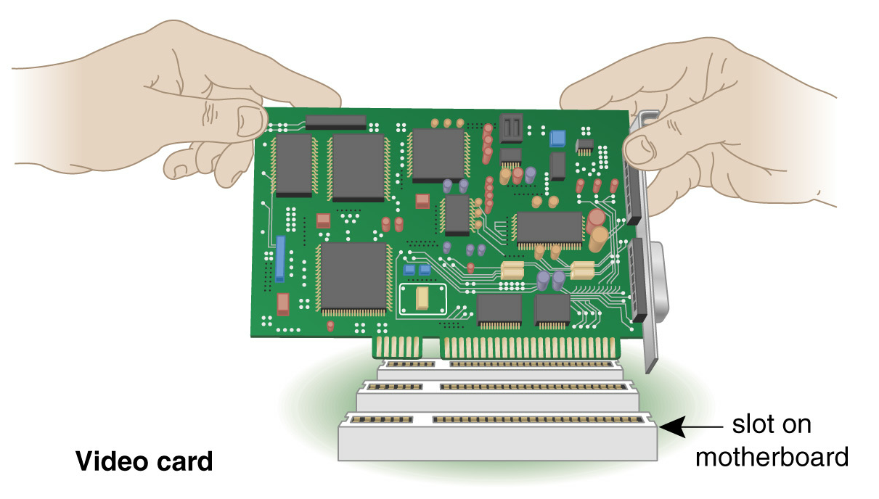
A video card controls the video display of your monitor.
Notes:
Video card - converts the processor’s output information into a video signal that can be sent through a cable to the monitor.

Slide 34
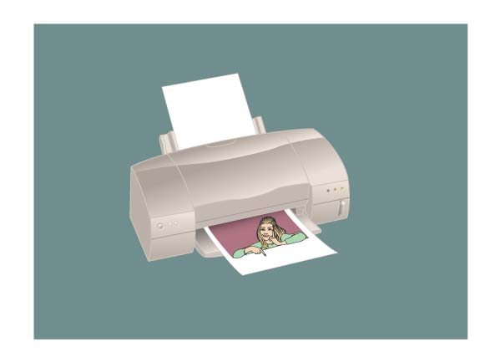
Output
Printer
Notes:
Printer - an output device that produces text and graphics on paper.

Slide 35
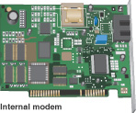
Communications
Notes:
Modem - a device that sends and receives data over telephone lines to and from computers.

Slide 36
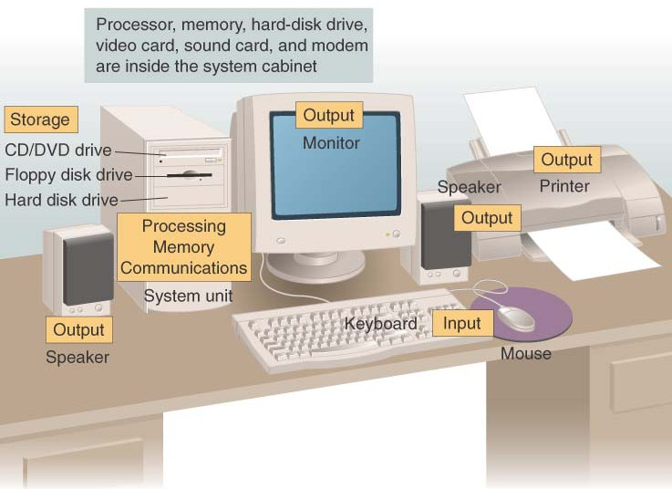
Put all the hardware together and…

Slide 37
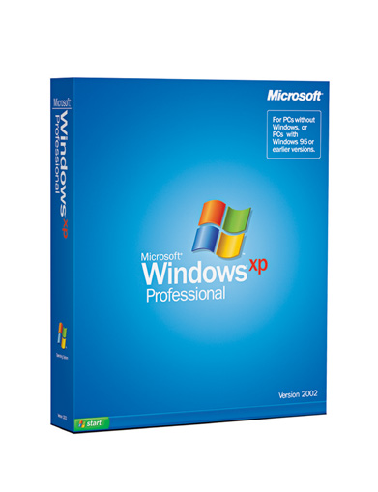
You still need the software!
System software
Discussion in Next Class/Chapter!

