Slide 1
Chapter 2
Network topology

Slide 2
Introduction
Overview:
  Network topologies define the physical or logical arrangement of nodes (devices) in a network.
  They determine how data flows and interacts between devices within a network.
  Different topologies offer varying benefits and drawbacks in terms of scalability, fault tolerance, and cost.
Key Points:
  Network topologies influence the performance, reliability, and manageability of a network.
  Choosing an appropriate topology depends on the specific network requirements and constraints.
  Common network topologies include bus, ring, star, mesh, and hybrid topologies.

Slide 3
Why we need a topology
Choosing one topology over another can impact :
  type of equipment the network needs
  capabilities of the equipment
  network’s growth
  way a network is managed

Slide 4
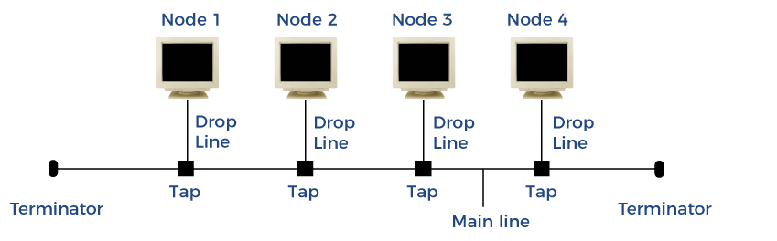
Bus

Slide 5
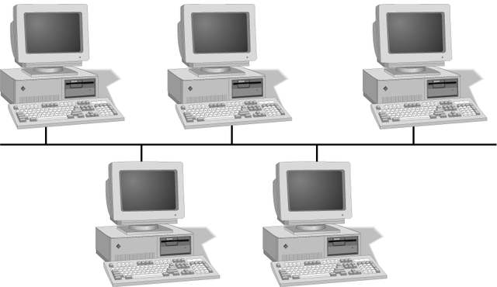
Simple Physical Topologies
Characteristics:
  Devices are connected to a single central cable or backbone.
  Data travels in both directions along the cable, and all devices receive all transmissions.
  Terminators at the ends of the cable prevent signal reflections.
Applications:
  Small networks with a limited number of devices.
  Educational and home networks

Slide 6
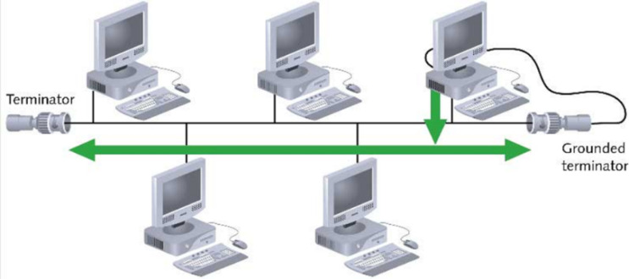
Bus (continued)
Devices share responsibility for getting data from one point to another
Terminators stop signals after reaching end of wire
  Prevent signal bounce
Inexpensive, not very scalable
Difficult to troubleshoot, not fault-tolerant

Slide 7
Bus
Advantages
Disadvantage
Simple and inexpensive to implement.
Easy to install and troubleshoot.
Limited scalability and performance as the number of devices increases.
A break in the cable can disrupt the entire network.

Slide 8
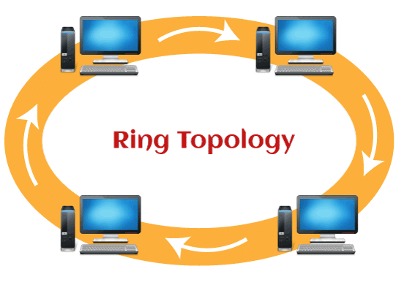
Ring

Slide 9
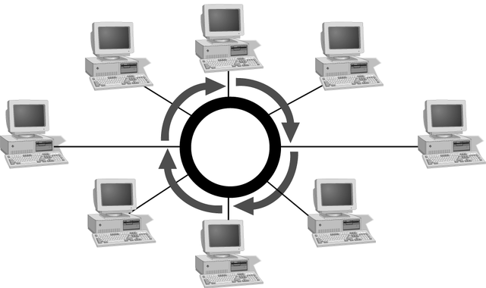
Simple Physical Topologies
Characteristics:
  Devices are connected in a circular fashion, forming a closed loop.
  Data travels in one direction, passing through each device in the ring.
  Tokens are used to control data transmission, ensuring orderly communication.
Applications:
  Token Ring networks for reliable data transmission.
  Token Bus networks for distributed control and data flow.

Slide 10
Ring
Advantages
Disadvantage
Deterministic data flow, preventing collisions.
Fault-tolerant, as data can continue to flow if one device fails.
Difficult to install and troubleshoot.
Adding or removing devices can disrupt the ring.

Slide 11
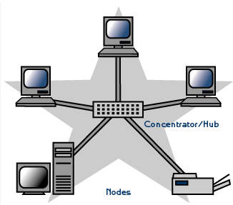
Star

Slide 12
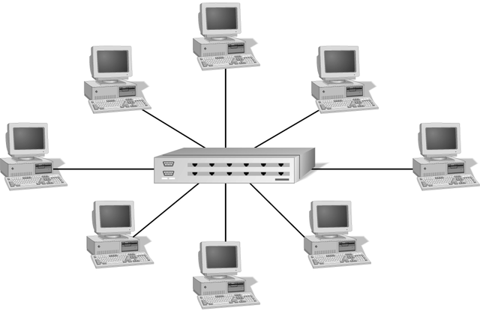
Simple Physical Topologies
Characteristics:
  Devices are connected to a central hub or switch.
  Data is transmitted from the sender to the central device, which then broadcasts it to the intended recipient.
  Traffic is directed, reducing collisions and improving data transfer efficiency.
Applications:
  Local Area Networks (LANs) in offices and buildings.
  Ethernet networks for high-speed data transmission.

Slide 13
Star
Advantages
Disadvantage
Easy to install and manage.
Scalable to a large number of devices.
Fault-tolerant, as a central device failure doesn't affect the entire network.
Relies on the central device for data transmission.
A central device failure can disrupt the network.
More expensive than bus or ring topologies.

Slide 14
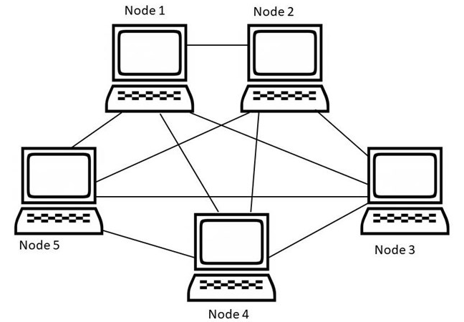
Mesh

Slide 15
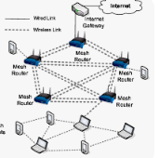
Mesh
Characteristics:
  Devices are interconnected in multiple redundant paths.
  Data can travel through multiple routes, providing high fault tolerance and flexibility.
  Routing algorithms are used to determine the optimal data paths.
Applications:
  Wide Area Networks (WANs) for large-scale networks.
  Wireless Mesh Networks for flexible and resilient connectivity.
  Peer-to-Peer (P2P) networks for distributed file sharing.

Slide 16
Mesh
Advantages
Disadvantage
Highly scalable and reliable.
Data can continue to flow even if multiple devices or connections fail.
Provides multiple paths for data transmission, reducing congestion.
Complex to install and manage.
Requires more cabling and equipment.
Routing overhead can increase network latency.

Slide 17
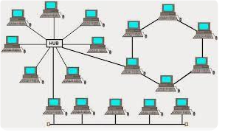
Hybrid Physical Topologies
Characteristics:
  Combines two or more basic topologies to create a hybrid topology.
  Provides the benefits of multiple topologies, addressing specific network requirements.
  Common hybrid topologies include star-bus, star-ring, and tree topologies.
Applications:
  Enterprise

Slide 18
Hybrid Toplogy
Advantages
Disadvantage
Flexibility to combine the strengths of different topologies.
Scalability and fault tolerance depending on the chosen hybrid topology.
Efficient data transmission for specific network scenarios.
Complexity in design and implementation.
Potential compatibility issues between different topologies.
Increased cost compared to basic topologies.

