Slide 1
Chapter1: A Framework for Crisis Management

Slide 2
Crisis Definition
Pearson and Clair (1998) offered one of the first of the comprehensive definitions:
An organizational crisis is a low-probability, high-impact event that threatens the viability of the organization and is characterized by ambiguity of cause, effect, and means of resolution, as well as by a belief that decisions must be made swiftly. (p. 60)

Slide 3
Crisis Definition
The following implications of this definition should be highlighted:
A crisis is a low-probability event. This characteristic makes the planning for a crisis even more troublesome. Events that are not perceived to be imminent are hard to plan for. In addition, it is often difficult for management to find the motivation to plan for such an event.
A crisis can have a high-damage impact. Because of this reality, it should be remembered that a crisis can devastate an organization, drive it into the ground.
The reference to ambiguity means that the causes and effects of the crisis might be unknown, at least initially.

Slide 4
Crisis Definition
A more recent definition by Timothy Coombs (2007) states:
A crisis is the perception of an unpredictable event that threatens important expectancies of stakeholders and can seriously impact an organization's performance and generate negative outcomes. (pp. 2-3)
This definition emphasizes perception. A crisis is generally perceived to be a threat by the organization's stakeholders. Stakeholders are various groups that have an interest in the organization. For example, employees, customers, and the community in which the organization resides are considered stakeholders.
.

Slide 5
Examples of Crises
Natural Disasters
Economic Crises
Informational Crises
Reputation Crises

Slide 6
Strategic Orientation
In many instances, crisis events in organizations are addressed with a short- term, reactive perspective. When a crisis occurs, select individuals in an organization-perhaps those on an established crisis management team- convene to minimize the damage and present a positive image to the public.
Any preparations for dealing with such crises often focus on effective communications and public relations. In contrast, organizations constantly face strategic challenges.
They must adapt to their changing business environments and modify their strategies to survive and remain competitive. In doing so, their leaders tend to adopt a long-term, proactive, and analytical perspective on strategic planning.

Slide 7
Strategic Orientation
Between the extremes of traditional organizational crises and strategic challenges are important obstacles to organizational success that are not always easy to classify. At times, distinguishing between a crisis and a strategic challenge may be difficult. Consider the following example:
A supplier in another country produces a product that turns out to be defective. The result is that the product is assembled as a component into a domestic product, which causes the final product to fail. Is this a crisis or a strategic challenge? The answer is both. It is a crisis because there has now been a loss of life due to a defective product. It is a strategic challenge because the supplier was selected for its ability to offer a low cost for the product.

Slide 8
Previous Crisis Management Frameworks: Classifications of Crises
There are different types of crisis management frameworks. Some of the earlier ones looked at types of crises. In their work on presenting corporate policy during a crisis:
Marcus and Goodman (1991) identified three types of crises: accidents, product safety and health incidents, and scandals.
Pearson and Mitroff's (1993) framework identified seven crisis families: economic attacks, environmental accidents, occupational health diseases, psycho events (e.g., product tampering), damage to reputation, informational attacks, and breaks (e.g., recalls, product defects, computer breakdowns).

Slide 9
Previous Crisis Management Frameworks: Classifications of Crises
In a similar crisis family arrangement, Myers (1993) offered a framework of crises consisting of natural disasters (floods, hurricanes, etc.), environmental events (aircraft accidents), and incited incidents (arson).
In Crandall, McCartney, and Ziemnowicz (1999) used a five-family crises framework in their study of internal auditors. Specifically, they identified crises in terms of operational problems, negative publicity events, fraudulent crises, natural disasters, and legal issues.

Slide 10
A Framework for Crisis Management used in this book
Next Table presents another framework for crisis management-the one we have adopted in this book. With this framework, the author draw from the work of previous crisis management researchers and add another dimension to the analysis, the existence of the internal and external landscapes that engulf and surround the organization.

Slide 11
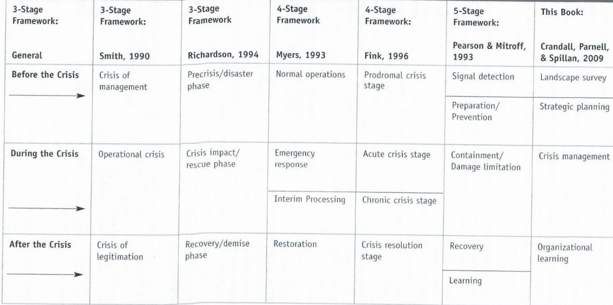
TABLE 1.1 Frameworks for Crisis Management

Slide 12
11
Landscape Survey
Identify the organization's weaknesses Determine the enthusiasm for
crisis management Overview the organizational culture
Assess the ethical environment Evaluate company safety policies
Determine the degree of industry vulnerability quan Determine the ruldegree of political stability Assess the
organization in relation to globalization implications Assess the
technological implications
Strategic
Planning
Form the crisis management team Develop worst- Return organi an ope status m for case scenarios Manag agement Formulate crisis
primar the management plan stakeh ional
Conduct mockdisasters and ethical training
ent Crisis company ficies
Consider existing government
regulations Consider current industry standards Develop working
relationships with the media
Crisis Management
Return the organization to an operational status Manage the primary stakeholders Manage reactions of external stakeholders
Negative media coverage o Public outcry Pro Web-based
criticism and company hate Web sites Impending
government regulations
Organizational
Learning
Evaluate the success and failure outcomes of the crisis
management process Strive for it
organizational learning Strive for organizational renewal
Reap the benefits of industry renewal
Be ready for
new government regulations Be aware of new stakeholder
outlooks
The internal landscape
The External Landscape

Slide 13
Landscape Survey
The internal landscape lies within the organization. It consists of the employees, as well as the organizational culture of the organization. It is the human side of the company that displays the strengths and weaknesses of the organization.
The external landscape resides outside of the organization. It consists of all stakeholders who have some vested interest in the organization, but are not directly part of it. These include government regulatory agencies, consumer groups, industry associations, and the media. It also consists of groups that are not necessarily stakeholders but can still have a huge impact on the operations of the company. The external environment can also include vague types of forces, such as the weather and other natural disaster.

Slide 14
Strategic Planning
The strategic planning phase focuses on preventing crises when possible, and planning how to mitigate their effects when prevention is not possible. Within the internal landscape of the organization, crisis planning begins with forming the crisis management team.
The team acts as the body that prevents or manages crisis events. One of the tasks of the team is to periodically assess potential crises that may happen to the organization. For example, the quick evacuation of a building such as in the event of a fire.

Slide 15
Crisis management
Crisis management teams also formulate plans that lay out general guidelines for managing a crisis (Coombs, 2006). Such guidelines include who should address the media, where to locate key contact information for stakeholders such as employees and customers, and procedures for managing specific crises that are unique to the organization. In other words, these guidelines address the organization's potential crises. During the strategic planning stage, some teams will conduct mock disasters in order to test the organization's crisis management response.
The crisis management stage addresses the acute phase of the crisis. From the organizational (internal landscape) perspective, efforts are focused on containing the crisis and resuming operations as quickly as possible.

Slide 16
Organizational Learning
After the crisis ends, the organization must take time to learn from what has occurred. One of the keys to learning the most from a crisis is not to wait too long after the event has occurred. In this stage, the organization has returned to normal operations, and the motivation to evaluate and learn from the crisis wanes.
At a minimum, management must evaluate how the crisis was handled and what changes need to be made in the crisis management plan. Pearson and Clair (1998) suggested that such an evaluation can be examined in terms of degrees of success and failure. For example, an organization may succeed in resuming operations in a timely manner, but fail at protecting its reputation. Instead of learning from a crisis, some organizations do not seem to heed the lessons from the event, and as a result, repeat the same mistakes when similar incidents occur in the future. On the other hand, an organization that is successful at learning will change its policies and procedures when and apply that new knowledge to future crisis events

Slide 17
Why study crisis management?
Organizational crisis management assists in:
Understanding causes of crises
Dealing with crises effectively
Preventing potential damages that may occur in organizations.

Slide 18


