Slide 1
Shock
By
Prof. Atallah Alenezi

Slide 2


Slide 3
Learning Objectives
Upon completing this lecture students should be able to:
Definition of Shock
Differentiate between different types of shock:
Cardiogenic shock
Anaphylactic shock
Hypovolemic shock
Septicemic shock

Slide 4
Introduction
Shock is a pathological state in which there is an insufficiency in oxygen supply and demand. Adequate oxygen delivery is an essential requirement for the survival of every cell in the body, the lack of which can result from a variety of pathological disturbances and can lead to life-threatening alterations.

Slide 5
Physiological need for oxygen
The requirement for oxygen is as important as a cell’s need for biochemical energy, without which no cellular or biochemical process can occur.
Therefore, the need for adequate oxygenation and delivery of oxygen to tissues across the body is essential for normal physiology.

Slide 6
Oxygen delivery
For proper oxygenation of tissues, oxygen delivery is essential and is achieved by the circulation of oxygenated blood.
To understand the mechanisms and factors that influence delivery one must first understand certain terms and their interconnected influence on oxygen delivery.

Slide 7
Oxygen delivery
Firstly, the term oxygen delivery (DO2) refers to the rate at which oxygen is delivered per unit of time to cells, tissues, and organs
Oxygen consumption (VO2) subsequently is the rate at which oxygen is consumed per unit of time by a cell, tissue, or organ
Oxygen delivery is dependent on two factors: Cardiac output (CO) and arterial oxygen content (CaO2).
A change in one of these can decrease or increase the amount of global oxygen delivery .
Physiologically, these factors are not independent and changes in one will be compensated with changes in the other to maintain adequate delivery of O2.

Slide 8
Shock Pathophysiology: Classifications and Management
- When the oxygen supply is inadequate, the body undergoes several physiological changes to maintain the oxygen delivery requirements and perfusion pressure.
- This stage is referred to as compensated shock and early signs of shock may be appreciated during this stage.
- At this point, it is important to identify the underlying cause and correct it to prevent any lasting complications

Slide 9
Shock Pathophysiology: Classifications and Management
When compensatory mechanisms are inadequate and delivery of O2 begins to fall beyond the critical point, the shock has progressed to the uncompensated stage.
During this stage there is rapid deterioration of the patient due to prolonged hypoxia and anaerobic respiration.
When this state persists, a cascade of events occurs resulting in various pathophysiological outcomes.

Slide 10
Systems response in compensated and uncompensated shock
System | Compensated shock | Uncompensated shock
Neurological | Alert and oriented. Irritable | Altered mental status, Decreased responsiveness
Cardiovascular | Tachycardia | Tachycardia, Hypotension (MAP < 60 mmHg)
Respiratory | Tachypnea, Increased Work of Breathing | Tachypnea, Decreased oxygen saturation,
Gastrointestinal | Nausea, Anorexia | Absence/Hypoactive bowel sounds, Ischemic bowel
Renal/GU | Decreased urine output | Metabolic acidosis, Anuria
Endocrine | Hyperglycemia | Hypoglycemia

Slide 11
Classifications of shock
Shock can be broadly classified into four different types based on the pathological mechanism resulting in impaired oxygen delivery to the tissues.
When dealing with a patient presenting with shock, it is important to identify the type of shock as all of them are treated differently. The four types of shock are:

Slide 12
Classifications of shock
Cardiogenic shock
Anaphylactic shock
Hypovolaemic shock
Septicaemia

Slide 13
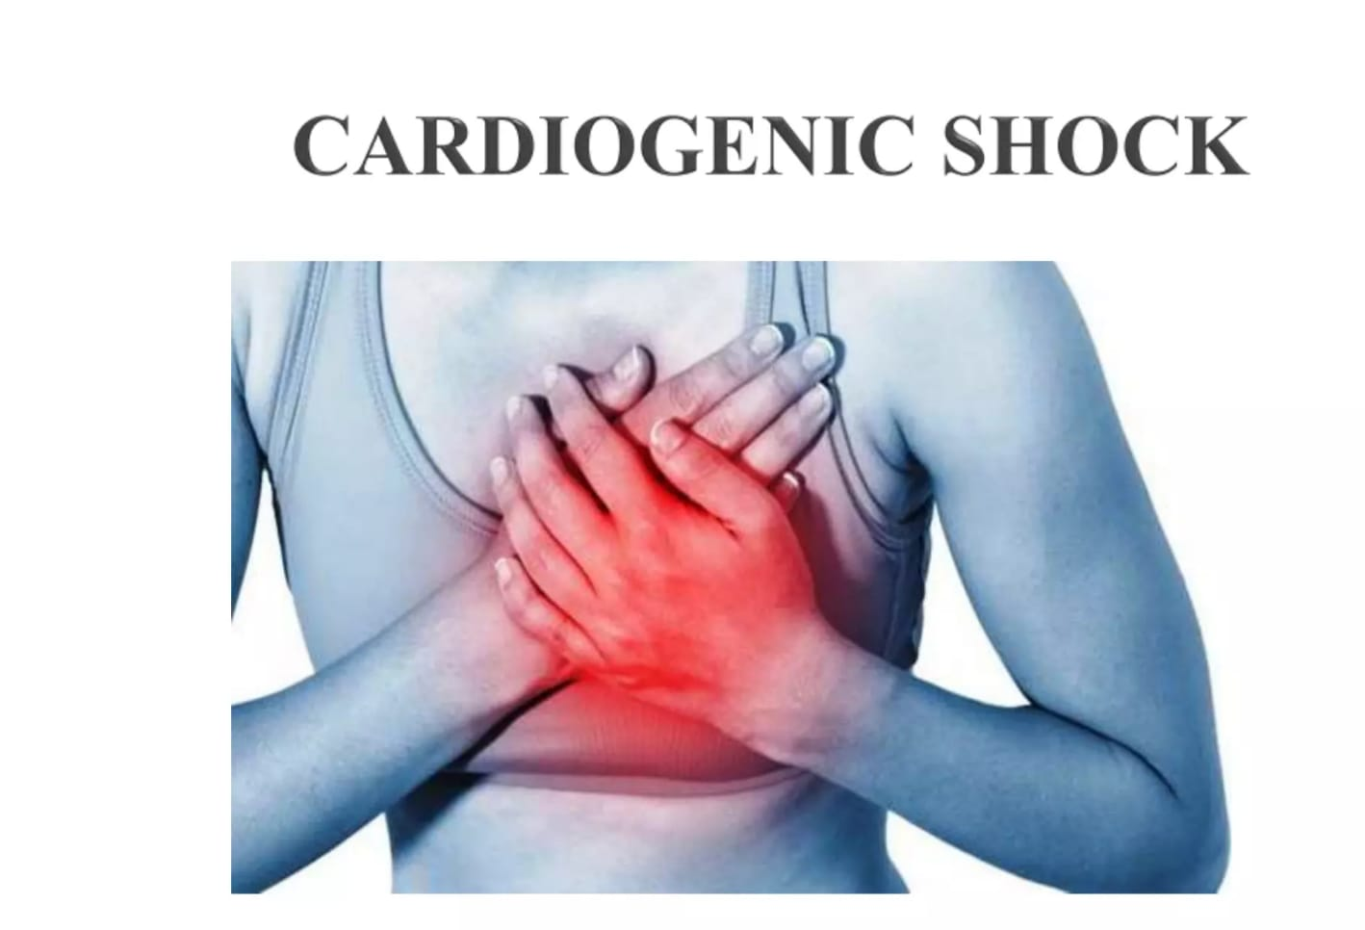

Slide 14
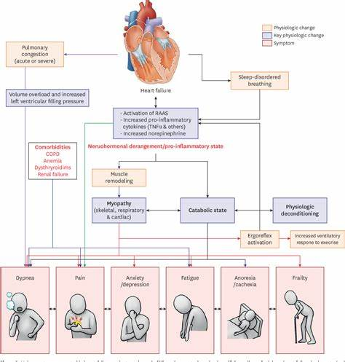
Definition of Cardiogenic Shock
Is a condition in which the heart can not pump enough blood to meet the needs of the body.

Slide 15
Incidence
Cardiogenic shock occurs as a serious complication in 5% to 10% of hospitalized patients with acute MI.
Historically, the mortality rate for cardiogenic shock has been 80% to 90% but, recent studies indicate that the rate has dropped to 56% to 67% due to improved interventional procedures and better therapies.
More common in men than in women.

Slide 16
Risk Factors
Old age
History of heart attack and heart failure
Blockage in several heart arteries
Chronic diseases such as diabetes or hypertension
Existing cardiac disease

Slide 17
Causes
Myocardial Infarction
Myocardial Ischemia
Myocarditis (inflammation of the heart valves)
Drug overdose

Slide 18
Classification
Coronary cardiogenic shock
Non coronary cardiogenic shock

Slide 19
Classification
Coronary cardiogenic shock is more common than non-coronary and is seen most often in patients with acute myocardial infarction.
Non-coronary cardiogenic shock is related to condition that stress the myocardium as well as condition that result in infective myocardial function.

Slide 20
Symptoms
Clammy skin
Decreased systolic blood pressure
Tachycardia
Rapid respiration
Oliguria
Cyanosis
Mental confusion

Slide 21
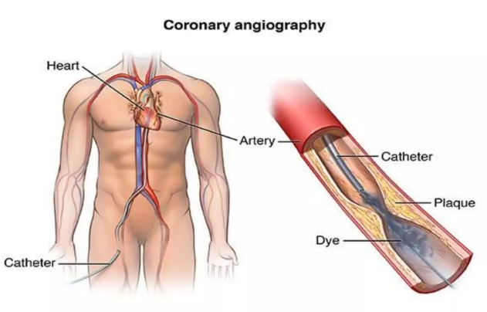
Diagnosis
Physical examination
History collection
Chest Xray
ECG
Echocardiogram
Cardiac cath.

Slide 22

Prevention
Avoid smoking
Maintain a healthy weight
Eat less cholesterol
Limit added sugar
Exercise regularly

Slide 23
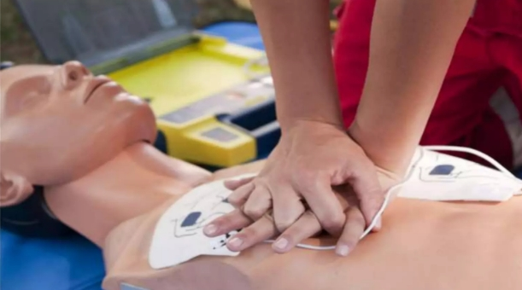
Management
Emergency life support
Vasodilators as Nitrate
Beta-blockers such as Propranolol to decrease the heart workload
Calcium channel blockers to improve blood flow

Slide 24
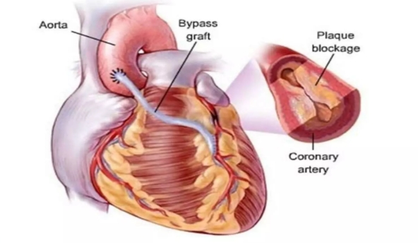
Management
Thrombolytic drugs to dissolve blood clots
Antiplatelet drugs to prevent the formation of new blood clots
Surgery such as coronary artery bypass

Slide 25
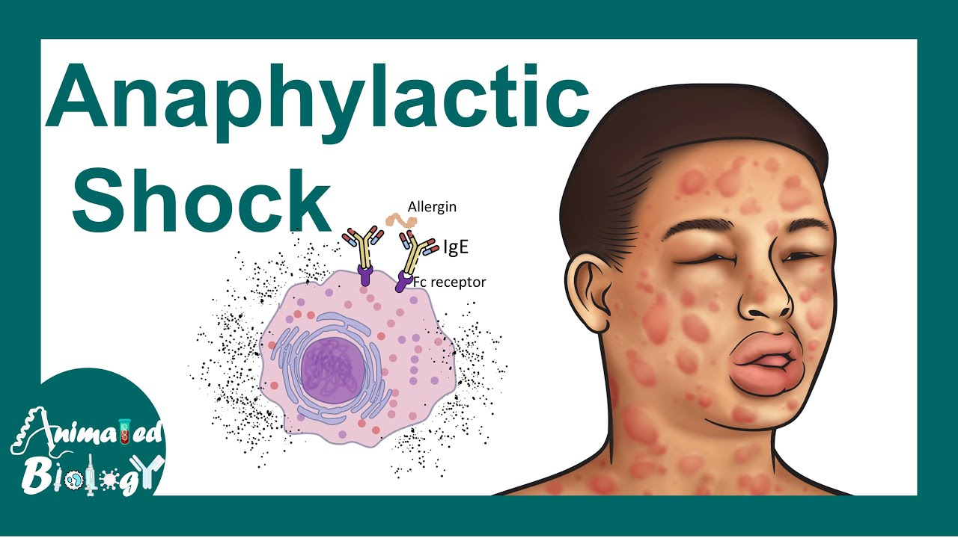

Slide 26

Definition of Anaphylactic Shock
Is a severe potentially life-threatening allergic reaction. It can occur within seconds or minutes of exposure to the allergen.

Slide 27
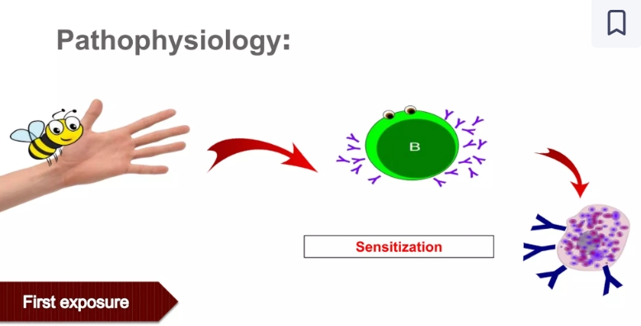
Pathophysiology of anaphylactic Shock

Slide 28
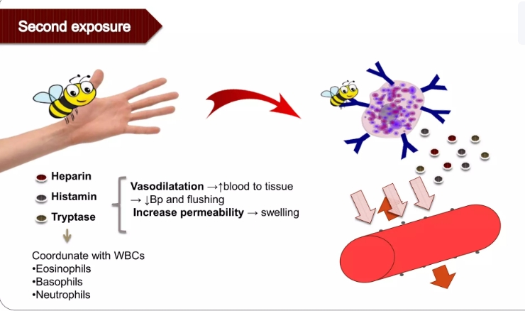
Pathophysiology of anaphylactic Shock

Slide 29
Signs & Symptoms
Skin: itching, erythema and Urtica
Respiratory: Sneezing, runny nose, clogged, coughing, wheezing, swollen larynx, tightness, hoarseness and cyanosis.
Digestive: nausea, vomiting, diarrhea and abdominal pain
Eye: itching and tears
Cardiovascular: collapse, fainting, hypotension, pale, tachycardia, arrhythmias and cardiac arrest.

Slide 30
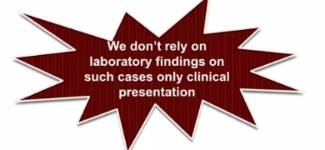
Diagnosis
Plasma histamine
Serum or plasma total tryptase

Slide 31
Management
Epinephrine
Anti-histaminic drugs
Corticosteroids
Bronchodilators
Oxygen
Fluids

Slide 32
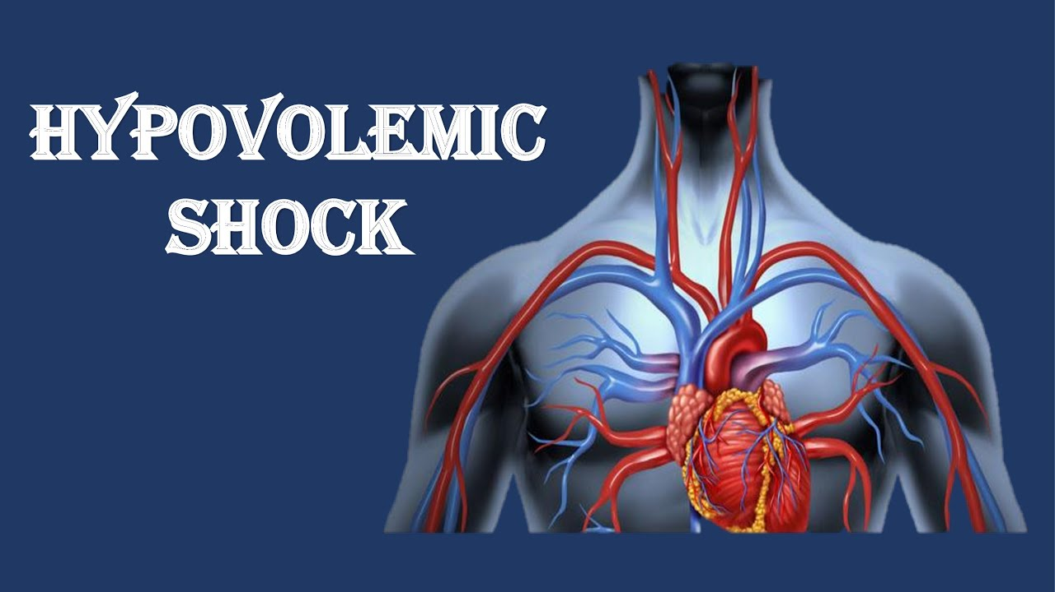

Slide 33
Definition of hypovolemic Shock
Hypovolemic shock is characterized by inadequate cardiac output due to insufficient circulating volume, as seen in bleeding, pancreatitis, and large burns.
This type of shock can cause many organs to stop working.

Slide 34
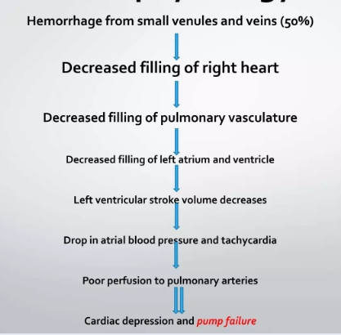
Pathophysiology

Slide 35
Risk factors for hypovolemic shock
External: fluid losses such as trauma, surgery, vomiting, diarrhea
Internal: fluid shifts such as ascites, hemorrhage, burn, and dehydration

Slide 36
Classification of hypovolemic shock
Hemorrhagic: trauma and GIT bleeding
Non- Hemorrhagic: external fluid loss

Slide 37
Signs and symptoms of hypovolemic shock
Breathing faster than normal.
Feeling confused or anxious.
Sweating a lot.
Passing out.
Having skin that feels cool.
Anxiety, confusion
Low or no urine output
Pale skin and sclera
Tachycardia
Dizziness
loss of consciousness
Low Blood pressure
Abdominal pain
Dyspnea
Weak pulse
Clammy skin
Hematemesis for Internal bleeding

Slide 38
Management
The treatment of hemorrhagic shock, which is the most common cause of shock in trauma, comprises interruption of bleeding and volume replacement, which blood and its derivatives or solutions, like crystalloids or colloids.
The most used component in volume replacement is crystalloid solutions, to reestablish cardiac output and tissue perfusion

Slide 39


Slide 40
Definition of Septic Shock
Septic shock is a potentially fatal medical condition that occurs when sepsis, which is organ injury or damage in response to infection, leads to dangerously low blood pressure and abnormalities in cellular metabolism
Septic shock is defined by persisting hypotension requiring vasopressors.

Slide 41
Definition of Septic Shock
Sepsis is the leading cause of admission to the intensive care unit (ICU) and a major cause of mortality

Slide 42
Signs & symptoms
Fever of >38 C, shortness of breath, pallor, malaise, diaphoresis, anorexia, respiratory rate of ≥22/min, altered mental status, tachycardia, and hypoxia, among others.
Hypothermia < 36 C, abnormal breath sounds, and sputum production are found in pneumonia

Slide 43
Management
Septic shock patients should be managed systematically as follows:
1. Source Control
During the first hours of diagnosis, empiric antibiotic therapy, such as broad-spectrum antibiotics, should be initiated for all suspected patients to help in the source control
2. Management of Shock
Fluid replacement
3. Antimicrobial therapy

Slide 44


