Slide 1
Chapter One
Introduction

Slide 2
Chapter One / Introduction
What is Chemistry?
Chemistry is
Matter is anything that occupies space and has mass
Thus Matter is everything around us.
The study of Matter and changes it undergoes.

Slide 3
Chapter One / Introduction
Is a combination of two or more substances in which the substances retain their distinct identities. Example: Air, soft drink, and pizza
Is a form of matter that has a definite (constant ) composition and distinct properties. Example: water , sugar and gold
Matter
Pure
substance
Mixture
Element
Compound
Homogeneous
Heterogeneous
Is a substance that cannot be separated into simpler substances by chemical means
Is a substance composed of atoms of two or more elements chemically united in fixed proportions. Example: water, ammonia
Is a mixture in which the composition is the same throughout. Example: sugar in water
Is a mixture in which the composition is not the same uniform. Example: fruit salad

Slide 4
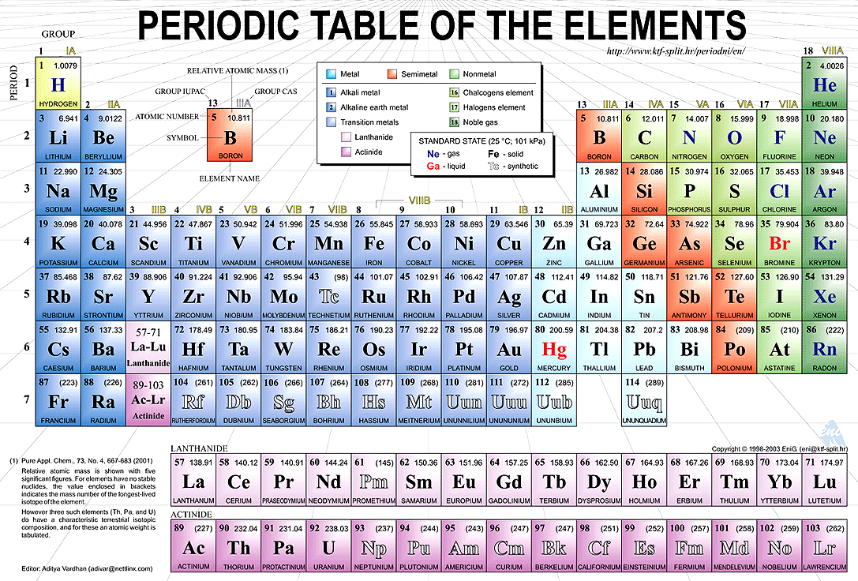
Chapter One / Introduction

Slide 5
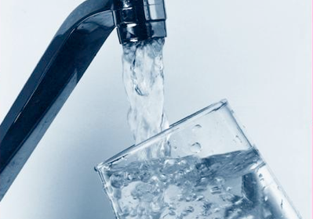
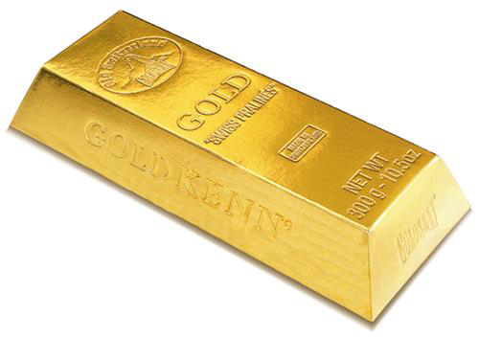
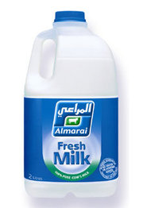
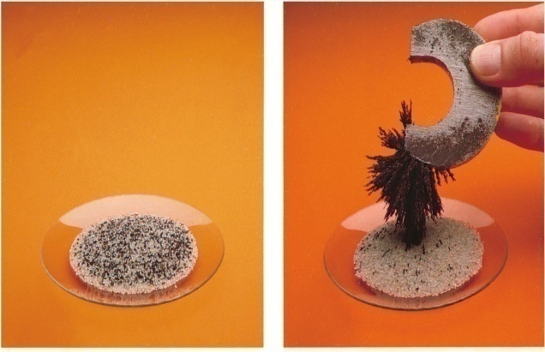
Chapter One / Introduction
Element
compound
magnet
Heterogeneous mixture
Homogeneous mixture

Slide 6
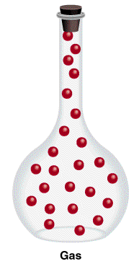
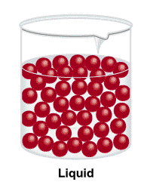
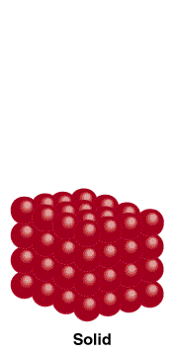
Chapter One / Introduction
States of matter
Gas
Liquid
Solid
Molecules are separated by distance
Have no definite shape
Have no definite volume
Molecules are close together but not held so rigidly in position and can move past on another
Have no definite shape
Have a definite volume
Molecules are held close together in orderly fashion with little freedom of motion.
Have a definite shape
Have a definite volume

Slide 7
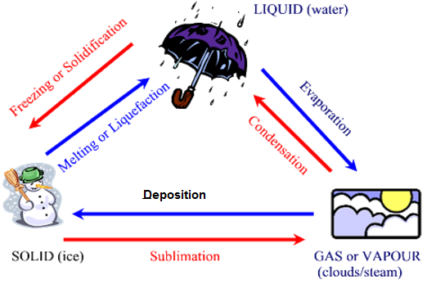
Chapter One / Introduction
States of matter
Gas
Liquid
Solid

Slide 8
Measurement in chemistry
In every measurement there is a number followed by a unit.
Units are essential to stating measurements correctly.
The international system of units (SI) is used world wide to reports result.
There are seven SI base units as following:
Base Quantity | Name of unit | Symbol
Length | meter | m
Mass | kilogram | kg
Time | second | s
Electrical current | ampere | A
Temperature | kelvin | K
Amount of substance | mole | mol
Luminous intensity | candela | cd

Slide 9
Derived Units
Derived units are unit made up of combination of SI base units such as:
(1) area (A) = Length x width
Then The unit of area is
unite of Length x unite of width:
i.e unite of area = m x m = m²
(2) velocity (v) = Distance/ time or d/t
then the unit of velocity or speed
= unite of distance / unite of time
i.e unite of velocity = m / s or ms⁻¹

Slide 10
The units of Acceleration and Force
(1) Acceleration (a) = velocity / time or a =Δv / t
then the unite of Acceleration=
unite of velocity / unite of time or m/s.s
i.e the unite of Acceleration (a) = m/s² or ms⁻²
(2) Force (F) = mass x acceleration or F = m . a
then the unit of Force = kg . ms⁻²
Kg . ms⁻² = Neyton (N)

Slide 11
Working with larger and smaller units
The SI solves the problem of fractions and larger numbers by creating larger and smaller units by modifying the basic units with decimal factors and prefixes.
Symbol | Prefix | Factor | Symbol | Prefix | Factor
d c m u n p f a | deci centi milli micro nano pico femto Atto | 10⁻¹ 10⁻² 10⁻³ 10⁻⁶ 10⁻⁹ 10⁻¹² 10⁻¹⁵ 10⁻¹⁸ | E P T G M K H da | Exa Peta Tera Giga Mega kilo Hecto deka | 10¹⁸ 10¹⁵ 10¹² 10⁹ 10⁶ 10³ 10² 10¹

Slide 12
Symbol | Examples | Factor | Prefix
km kg dm cm mm mg ms um ug nm ng | 1 kilometer = 1000 meter (10³) 1 kilogram = 1000 gram 1 decimeter = 0.1 meter (10⁻¹) 1 centimeter = 0.01 meter (10⁻²) 1 millimeter = 0.001 meter (10⁻³) 1 milligram = 0.001 gram 1 millisecond = 0.001 second 1 micrometer = 0.000,001 meter (10⁻⁶) 1 microgram = 0.000,001 gram 1 nanometer = 10⁻⁹ meter 1 nanogram = 10⁻⁹ gram | 1000 (10³) 1/10 (10⁻¹) 1/100 (10⁻²) 1/1000 (10⁻³) 1/1,000,000 (10⁻⁶) 1/1,000,000,000(10⁻⁹) | Kilo- deci- centi- milli- micro nano-

Slide 13
1- prefix to Base unit
To remove a prefix from a value, insert the numerical value of the prefix in place of the symbol.
Example
Convert 8.53 pm to meters?
Replace p with x 10⁻¹², therefore the answer is 8.53 x 10⁻¹² m
To insert a prefix into a value, insert both the prefix and the inverse of its numerical number.
Example
Convert 0.000462 g to milligrams ?
0.000462 x 10³ mg = 0.462 mg
2- Base unit to prefix

Slide 14
How many second are in a microseconds ?
(a) 1 x 10⁻¹
(b) 1 x 10⁻⁶
(c) 1 x 10⁻¹⁵
(d) 1 x 10 ⁶
Which of the following is the smallest distance?
(a) 21 m
(b) 2.1 x 10² cm
(c) 21 mm
(d) 2.1 x 10⁴ pm
Put all of them in the same unit

Slide 15
Chapter One / Introduction
Example 1
A desk is found to be 1437 mm wide. What is this width expressed in meter?
Answer: 1437 mm = 1437 x 10⁻³ m
= 1,437 m
Example 2
A certain person is 172 cm tall. Express this height in decimeters.
Answer: 172 cm = ? dm
1cm = 10⁻² m and 1dm = 10⁻¹ m
172 x 10⁻² = 1.72 m
1.72 / 10⁻¹ m = 17.2 dm
Notes:
Stopped here

Slide 16
Example 3: calculate the number of cubic centimeters in 0.225 dm³
Answer: 0.225 dm³ = ? cm³
1 dm = 10⁻¹ m
1 cm = 10⁻² m
We can obtain cubic units by cubing each side of each equation
1 dm³ = 10⁻³ m³
1 cm³ = 10⁻⁶ m³
0.225 dm³ x (10-³ m³ / 1 dm³ ) x (1 cm³ /10⁻⁶ m³) = 255 cm³
Thus 0.225 dm³ = 255 cm³

Slide 17
Common Units
1- Volume:
1 liter = 1000 ml =1000 cm³ =1 dm³
1 liter = 1 dm³ and 1 ml = 1 cm³
2-Temperature
a. Celsius scale (°C, in science)
Freezing point of water at 0 ºC
Boiling point of water at 100 ºC
b. Kelvin (K, SI unit).
Freezing point of water at 273 k
Boiling point of water at 373 k
c. Fahrenheit (°F, common use in US)
Freezing point of water at 32 º F
Boiling point of water at 212 º F

Slide 18
Convert from degrees Celsius to Kelvin
T (k) = T (ºC) + 273
Convert from degrees Celsius to Kelvin
T_{(°C)} = T_{(K)} - 273
Convert from units of degrees Celsius to degrees Fahrenheit
t (°F) = t (°C) × 1.8 + 32
Convert from units of degrees Fahrenheit to degrees Celsius
t (°C) = ⁵⁄₉ x [t (°F) − 32]

Slide 19
Example
a. Convert 20 degrees Celsius to Kelvin
b. Convert 300 Kelvin to degrees Celsius
c. Convert 20 degrees Celsius to degrees Fahrenheit
d. Convert 68 degrees Fahrenheit to degrees Celsius

Slide 20
Properties of Matter
Physical properties
Chemical properties
Physical Properties of Matter
Definition
- a characteristic of a substance that can be observed or measured without changing the composition of the substance
ex. Density, viscosity, conductivity, malleability, melting point, boiling point
- remain the same for all pure substances
ex. water always boils at 100 and freezes at 0 ºC

Slide 21
a. Density and specific gravity
Density = mass / volume
d = m/V (g /ml)
Example:
A student determines that a piece of an unknown material has a mass of 5.854 g and a volume of 7.57 cm³. What is the density of the material?
d = m/V
= 5.854 (g) / 7.57 (cm³) = 0.773 g/cm³ = 0.773 g/mL
Example
A piece of silver (Ag) metal weighing 194.3 g is placed in a graduated cylinder containing 242.0 mL of water. The volume of water now reads 260.5 mL. From these data calculate the density of silver?
volume of silver = volume of water (after) – volume of water ( before )
= 260.5 – 242.0 = 18.5 ml
d = m/V = 194.3 / 18.5 = 10.5 g/ml
Mass (g)
Density (g/ml)
Volume (ml)
Specific gravity (sp.gr.) = d (substance) /( d water)

Slide 22
Chemical Properties of Matter
Definition
- any ability to produce a change in the composition of matter
- can only be observed when the substances in a sample of matter are changing into a different substance

