Slide 1
CS 131
Computer Programming I
Mr. Hamad Alhadyan
Spring 2026
Prepared by Dr. Saleh Haridy

Slide 2
CS 131: Computer Programming 1
Course Code: CS 131 Credits: 4 (3 Lec., 2 Lab, 0 Tutorial)
Convenor: Mr. Hamad Alhadyan
Textbook:
"Starting Out with C++: From Control Structures through Objects", Tony Gaddis, 9th edition, Pearson, 2019.
References:
“Problem Solving with C++”, Walter Savitch, 10th edition, Pearson, 2018.
“C++: How To Program”, Deitel and Deitel, 9th edition, Prentice Hall, 2014.
Online Resources:
https://www.w3schools.com/cpp/cpp_getstarted.asp
https://cplusplus.com/doc/tutorial/
https://www.tutorialspoint.com/cplusplus/index.htm
Lecture and Lab Time:
      As per schedule

Slide 3
Evaluation and Grading Policy
Midterm Exam: | 20
Quizzes | 20
Programming Assignments (Lab classes) | 10
Lab exams | 10
Final Exam | 40
Total | 100

Slide 4
Course Learning Outcomes
Identify the basic components of a computer system.
Design an algorithm to solve a given problem using the top-down design approach.
Understand and use the three basic programming structures: sequence, selection, repetition.
Understand the concept of using functions to increase modularity and reusability
Use arrays, strings and pointers to manipulate data.

Slide 5
Course Contents
Week | Course Topics | Book’s Chapter | Event Name
1 | Introduction to Computers | 1
2 | Problem solving techniques-Flowchart, algorithms | 1
3 | Introduction to C++, Variables ,Data types, Operators, input/output statements | 2
4 | Conditional statements (if.., if ..else .. , switch..) | 4 | TEST 1
5 | Repetition statements I (while..,for, do while ) | 5
6 | Repetition statements II (nested loop, break, continue) | 5
7 | Midterm Exam
8 | Functions I | 6
9 | Functions II (recursive function) | 6
10 | Arrays I (1-D array) | 7
11 | Arrays II (2-D array) | 7 | TEST 2
12 | Pointers | 8
13 | Strings | 8
14 | Revision
15 | FINAL EXAM

Slide 6
نصائح هامة
الالتزام بالحضور في الوقت المحدد للمحاضرة
أغلق هاتفك أو ضعه على وضع الصامت.
الكتابة تساعدك علي تثبيت المعلومات
اقرأ المواضيع التي ستتناولها المحاضرة مسبقًا لتكوين فكرة عامة.
اسأل الأسئلة إذا لم تفهم نقطة معينة.
أحرص علي كتابة البرامج بنفسك وعدم نسخها
أحرص علي المذاكرة من بداية الفصل الدراسي

Slide 7
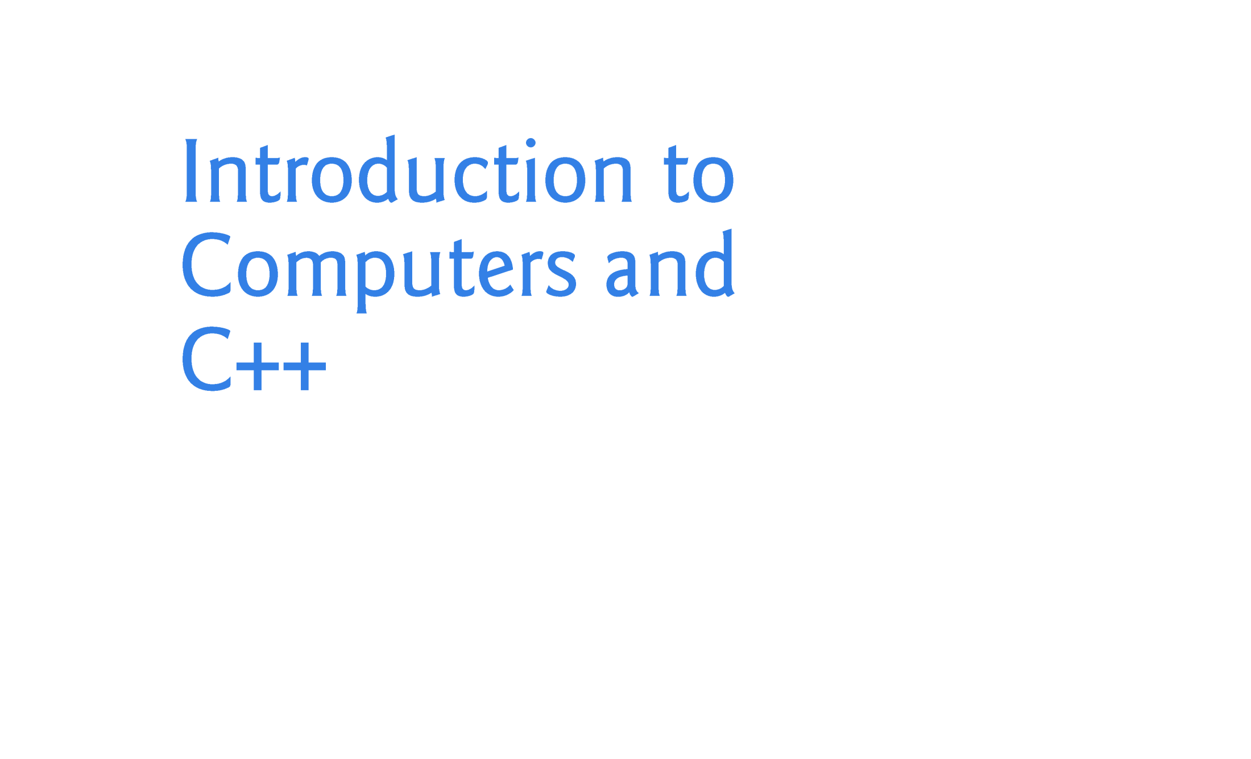
Week 1

Slide 8
Objectives
Why Program?
Computer Systems: Hardware and Software
Data Hierarchy
Types of Programming Languages?
C++ development environment (IDE)
What is a Program made of?
  Input, Processing, Output
  The Programming Process
Procedural and Object-Oriented Programming

Slide 9
Why Program?
Computer – programmable machine designed to follow instructions
Program – instructions in computer memory to do something (arithmetic, logic, input/output)
Programmer – person who writes instructions (programs) to make computer perform a task
SO, without programmers, no programs; without programs, a computer cannot do anything

Slide 10
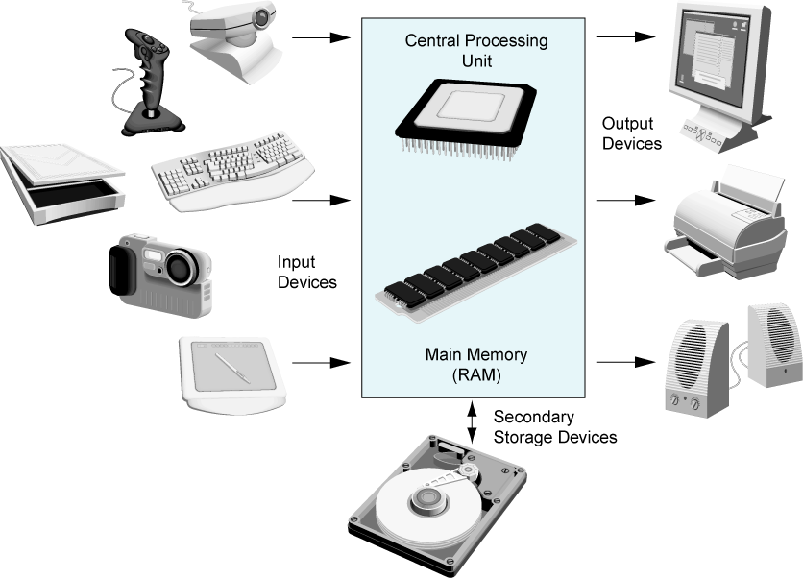
Main Hardware Component Categories:
Central Processing Unit (CPU)
Main Memory
Secondary Memory / Storage
Input Devices
Output Devices

Slide 11
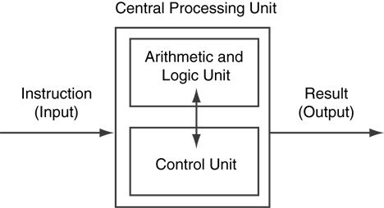
Central Processing Unit (CPU)
Comprised of:
  Control Unit:
    Retrieves and decodes program instructions
    Coordinates activities of all other parts of computer.
  Arithmetic & Logic Unit
    Hardware optimized for high-speed numeric calculation
    Hardware designed for true/false, yes/no decisions.

Slide 12
Main Memory
It is volatile. Main memory is erased when program terminates or computer is turned off.
Also called Random Access Memory (RAM)
Organized as follows:
  bit: smallest piece of memory. Has values 0 (off, false) or 1 (on, true)
  byte: 8 consecutive bits. Bytes have addresses.
Addresses – Each byte in memory is identified by a unique number known as an address.

Slide 13
Function of important computer units
Processor/CPU | The central processing unit which is used to coordinate and supervise the operations of all other units in the computer.
ALU | Arithmetic logic unit lies inside processor and used to perform all logic and arithmetic operations.
RAM | Random Access Memory is the main memory and used to temporary store data and code during program execution.
ROM | Read only memory used to store programs (BIOS) needed to start/boot the computer

Slide 14
Secondary Storage
Non-volatile: data retained when program is not running or computer is turned off
Comes in a variety of media:
  magnetic: floppy disk, hard drive
  optical: CD-ROM, DVD
  Flash drives, connected to the USB port

Slide 15
Input Devices
Devices that send information to the computer from outside
Many devices can provide input:
  Keyboard, mouse, scanner, digital camera, microphone
  Disk drives, CD drives, and DVD drives

Slide 16
Software-Programs That Run on a Computer
Categories of software:
  System software: programs that manage the computer hardware and the programs that run on it. Example: operating systems, utility programs, software development tools.
  Application software: programs that provide services to the user. Examples: word processing, games, programs to solve specific problems.

Slide 17
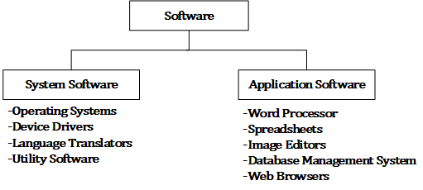
Type of Software
Antivirus
File management
Disk cleaner
File compression

Slide 18
Operating Systems
Operating systems
  Software systems that make using computers more convenient for users, application developers and system administrators.
  Provide services that allow each application to execute safely, efficiently and concurrently (i.e., in parallel) with other applications.
  The software that contains the core components of the operating system is called the kernel.
  Popular desktop operating systems include Linux, Windows and OS X (formerly called Mac OS X).
  Popular mobile operating systems used in smartphones and tablets include Google’s Android, Apple’s iOS and Windows 10 Mobile.

Slide 19
Windows—A Proprietary Operating System
Mid-1980s, Microsoft developed the Windows operating system, consisting of a graphical user interface built on top of DOS—an enormously popular personal-computer operating system of the time that users interacted with by typing commands.
Windows borrowed from many concepts (such as icons, menus and windows) developed by Xerox PARC and popularized by early Apple Macintosh operating systems.
Windows 11 is Microsoft’s latest operating system
Windows is a proprietary operating system—it’s controlled by Microsoft exclusively.
Windows is by far the world’s most widely used desktop operating system

Slide 20
Linux—An Open-Source Operating System
Linux
  The most popular open-source operating system.
  Developed by volunteers
  Popular in servers, personal computers and embedded systems.
  Source code is available to the public for examination and modification
  Free to download and install.
  Ability to completely customize the operating system to meet specific needs.

Slide 21
Apple’s OS X; Apple’s iOS for iPhone ®, iPad® and iPod Touch ® Devices
  Apple’s OS X operating system is a descendant of NeXTSTEP.
  Apple’s proprietary operating system, iOS, is derived from Apple’s OS X and is used in the iPhone, iPad and iPod Touch devices.
  In 2014, Apple introduced its new Swift programming language, which became open source in 2015.
  The iOS app-development community is gradually shifting from Objective-C to Swift.

Slide 22
Google’s Android
Android
  Fastest growing mobile and smartphone operating system
  Based on the Linux kernel and Java.
  Open source and free.
  Developed by Android, Inc., which was acquired by Google in 2005.
  According to IDC, after the first six months of 2015, Android had 82.8% of the global smartphone market share, compared to 13.9% for Apple, 2.6% for Microsoft and 0.3% for Blackberry.
  Used in numerous smartphones, e-reader devices, tablets, in-store touch-screen kiosks, cars, robots, multimedia players and more.
  At the time of this writing there were more than 1.4 billion Android users.

Slide 23
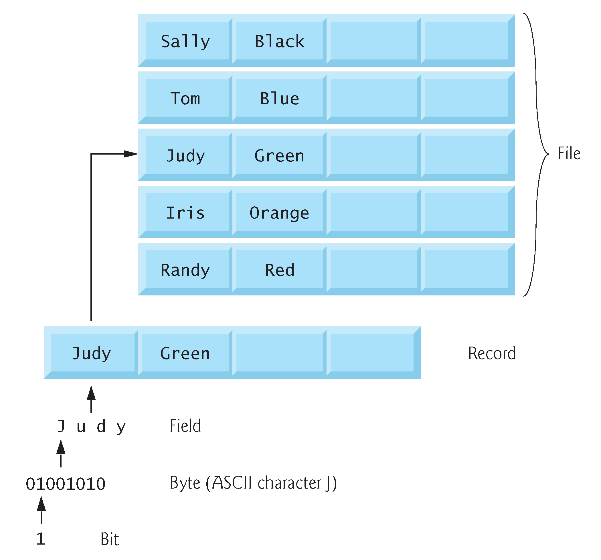
Data Hierarchy
Data items processed by computers form a data hierarchy that becomes larger and more complex in structure as we progress from bits to characters to fields, and so on.

Slide 24
Data Hierarchy
Bit: smallest data item in computer take values 0 or 1
Byte: equal 8 bits and can store on character like a,b,c
Field: group of characters like name, address
Record: group of fields such as student information
File: group of records
Database: group of files

Slide 25
Programs and Programming Languages
A program is a set of instructions that the computer follows to perform a task.
We start with an algorithm, which is a set of well-defined steps.
The algorithm is not ready to be executed on the computer.

Slide 26
Programming Languages
Programmers write instructions in various programming languages, some directly understandable by computers and others requiring intermediate translation steps.
These may be divided into three general types:
  Machine languages
  Assembly languages
  High-level languages

Slide 27
Programming Languages (Cont.)
Machine Languages
The computer only executes machine language instructions.
Any computer can directly understand only its own machine language (also called machine code), defined by its hardware architecture.
Machine languages generally consist of numbers (ultimately reduced to 1s and 0s). Such languages are cumbersome for humans.
1011010000000101

Slide 28
Programming Languages (Cont.)
Assembly Languages
English-like abbreviations to represent elementary operations. These abbreviations formed the basis of assembly languages.
Translator programs called assemblers were developed to convert early assembly-language programs to machine language.

Slide 29
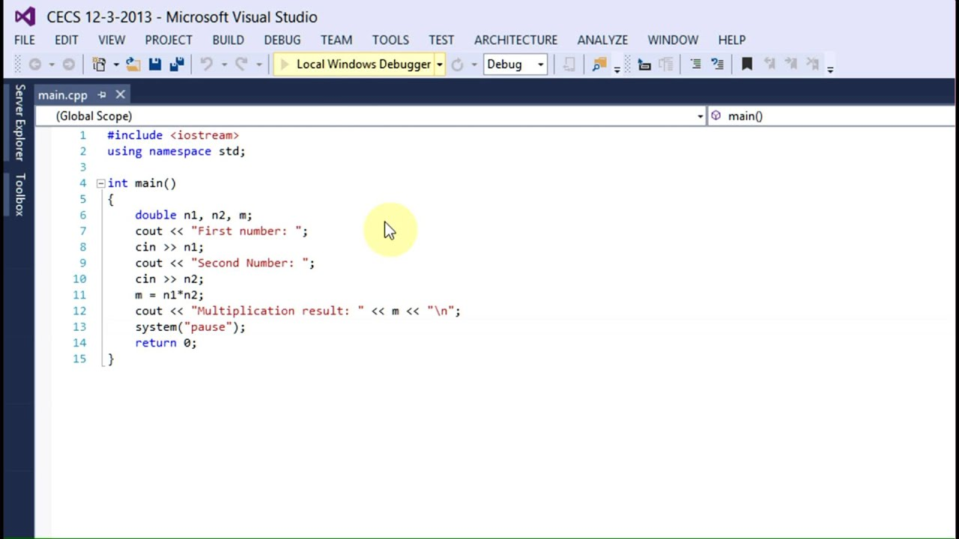
Programming Languages (Cont.)
High-Level Languages
To speed up the programming process further, high-level languages were developed in which single statements could be written to accomplish substantial tasks.
Translator programs called compilers convert high-level language programs into machine language.
Allow you to write instructions that look more like everyday English and contain commonly used mathematical expressions.

Slide 30
Programming Languages (Cont.)
Compiling a high-level language program into machine language can take a considerable amount of computer time.
Interpreter programs were developed to execute high-level language programs directly (without the need for compilation), although more slowly than compiled programs.
Scripting languages such as the popular web languages JavaScript, python, and PHP are processed by interpreters.

Slide 31
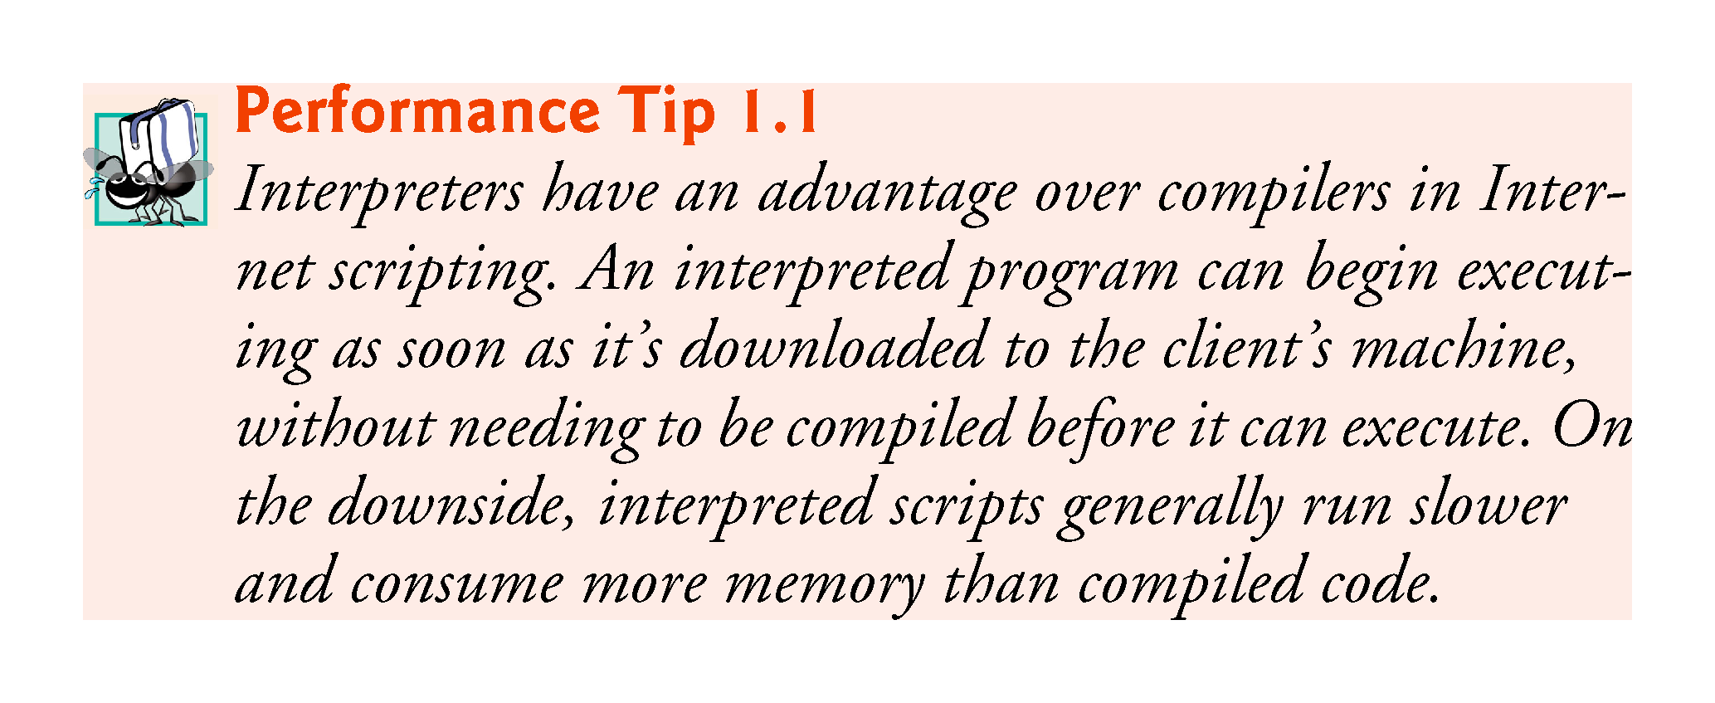
Rather than writing programs in machine language, programmers use programming languages.

Slide 32
Some Well-Known Programming Languages (Table 1-1 on Page 10)
C++
BASIC
Ruby
Java
FORTRAN
Visual Basic
C#
COBOL
JavaScript
C
Python

Slide 33
Procedural and Object-Oriented Programming
Procedural programming: focus is on the process. Procedures/functions are written to process data.
    Example: C, Basic, Pascal, Fortran.
Object-Oriented programming: focus is on objects, which contain data and the means to manipulate the data. Messages sent to objects to perform operations.
    Example: C++, Python (also supports procedural), ,Java, C#.

Slide 34
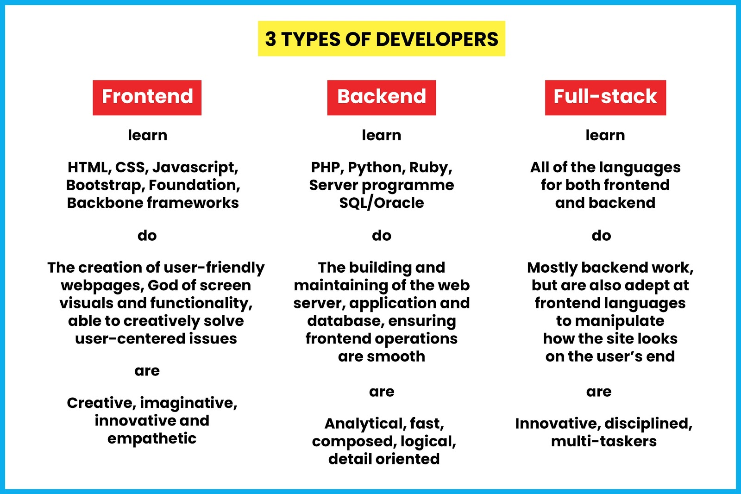

Slide 35
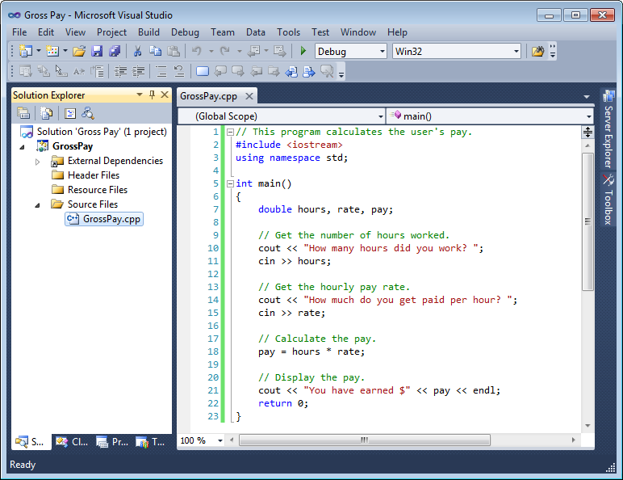
Integrated Development Environments (IDEs)
An integrated development environment, or IDE, combine all the tools needed to write, compile, and debug a program into a single software application.
Examples are Microsoft Visual C++, Turbo C++ Explorer, CodeWarrior, etc.

Slide 36
Typical C++ Development Environment
C++ systems generally consist of three parts: a program development environment, the language and the C++ Standard Library.
C++ programs typically go through six phases:
    edit
    preprocess
    compile
    link
    load
    execute.

Slide 37
Typical C++ Development Environment (Cont.)
Phase 1 consists of editing a file with an editor program, normally known simply as an editor.
  Type a C++ program (source code) using the editor.
  Make any necessary corrections.
  Save the program.
  C++ source code filenames often end with the .cpp, .cxx, .cc or .C extensions (note that C is in uppercase) which indicate that a file contains C++ source code.

Slide 38
Typical C++ Development Environment (Cont.)
Linux editors: vi and emacs.
C++ software packages for Microsoft Windows such as Microsoft Visual C++ (microsoft.com/express) have editors integrated into the programming environment.
You can also use a simple text editor, such as Notepad in Windows, to write your C++ code.
integrated development environments (IDEs)
  Provide tools that support the software-development process, including editors for writing and editing programs and debuggers for locating logic errors—errors that cause programs to execute incorrectly.

Slide 39
Typical C++ Development Environment (Cont.)
Popular IDEs
  Visual Studio Code
  Microsoft® Visual Studio community Edition
  Dev C++
  NetBeans
  Eclipse
  Apple’s Xcode
Online Compilers
https://www.onlinegdb.com/online_c++_compiler
https://cpp.sh/

Slide 40
Typical C++ Development Environment (Cont.)
In phase 2, you give the command to compile the program.
  A preprocessor program executes automatically before the compiler’s translation phase begins (so we call preprocessing Phase 2 and compiling Phase 3).
  The C++ preprocessor obeys commands called preprocessing directives, which indicate that certain manipulations are to be performed on the program before compilation.
  These manipulations usually include other text files to be compiled, and perform various text replacements.
  The most common preprocessing directives are discussed in the early chapters; a detailed discussion of preprocessor features appears in Appendix E, Preprocessor.

Slide 41
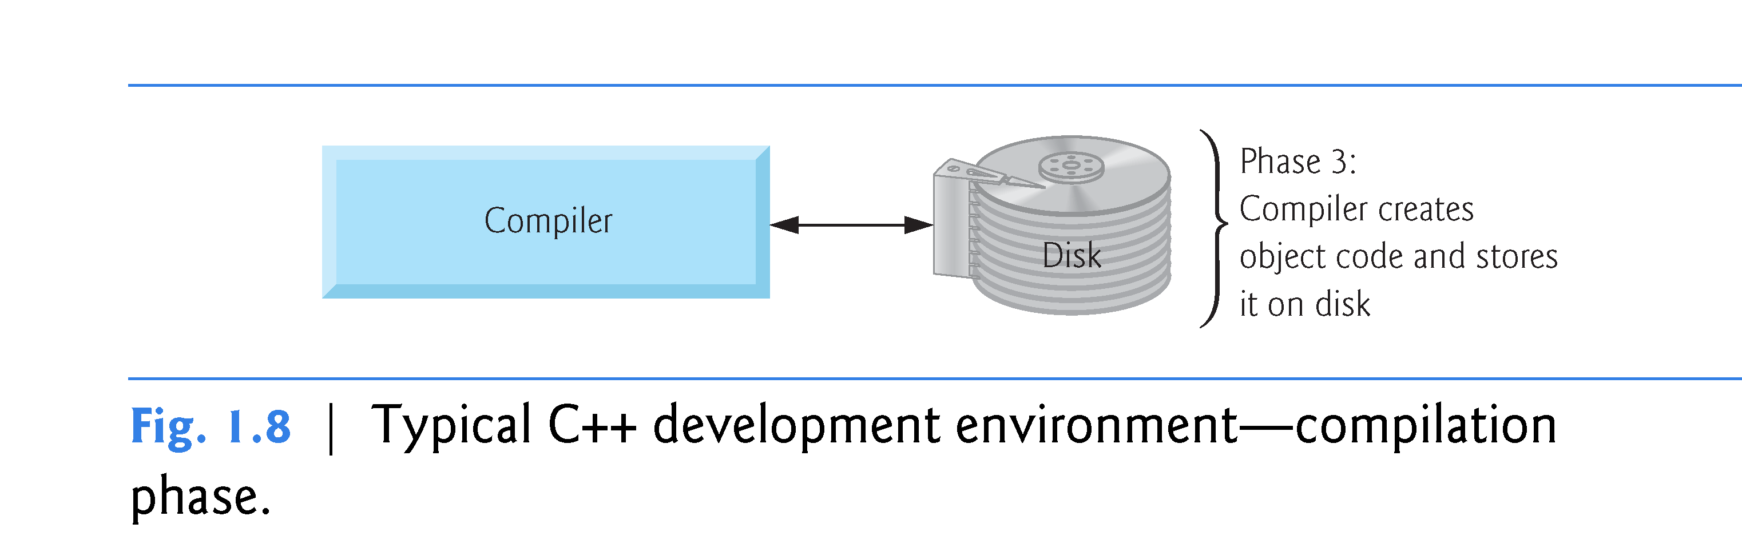
Typical C++ Development Environment (Cont.)
In Phase 3, the compiler translates the C++ program into machine-language code—also referred to as object code.

Slide 42
Typical C++ Development Environment (Cont.)
Phase 4 is called linking.
  The object code produced by the C++ compiler typically contains “holes” due to these missing parts.
  A linker links the object code with the code for the missing functions to produce an executable program.
  If the program compiles and links correctly, an executable image is produced.

Slide 43
Typical C++ Development Environment (Cont.)
Phase 5 is called loading.
  Before a program can be executed, it must first be placed in memory.
  This is done by the loader, which takes the executable image from disk and transfers it to memory.
  Additional components from shared libraries that support the program are also loaded.

Slide 44
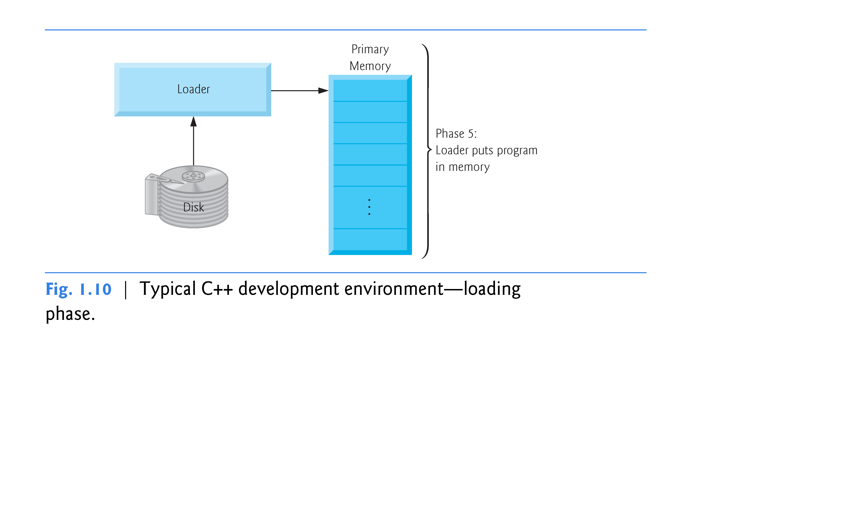

Slide 45
Typical C++ Development Environment (Cont.)
Phase 6: Execution
  Finally, the computer, under the control of its CPU, executes the program one instruction at a time.
  Some modern computer architectures can execute several instructions in parallel.

Slide 46
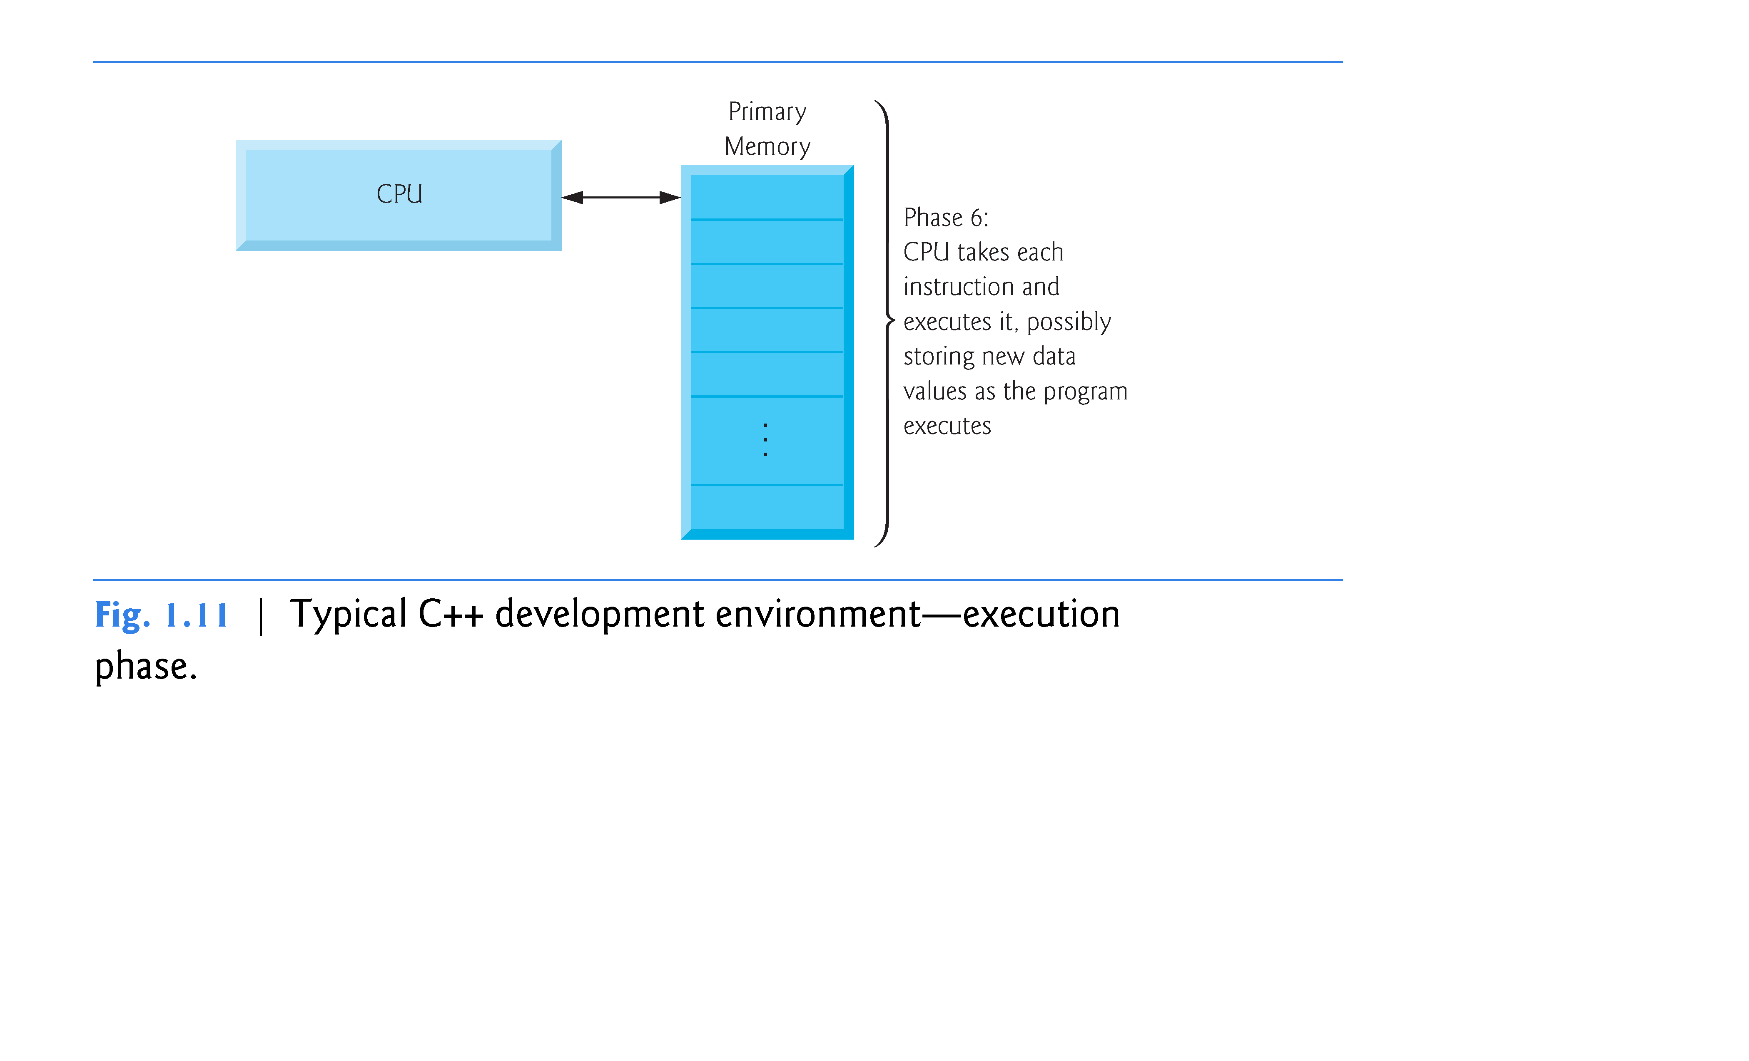

Slide 47
From a High-Level Program to an Executable File
Create file containing the program with a text editor.
Run preprocessor to convert source file directives to source code program statements.
Run compiler to convert source program into machine instructions.
Run linker to connect hardware-specific code to machine instructions, producing an executable file.
Steps b–d are often performed by a single command or button click.
Errors detected at any step will prevent execution of following steps.

Slide 48
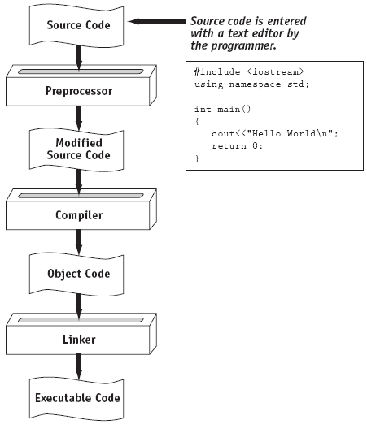
From a High-Level Program to an Executable File

Slide 49
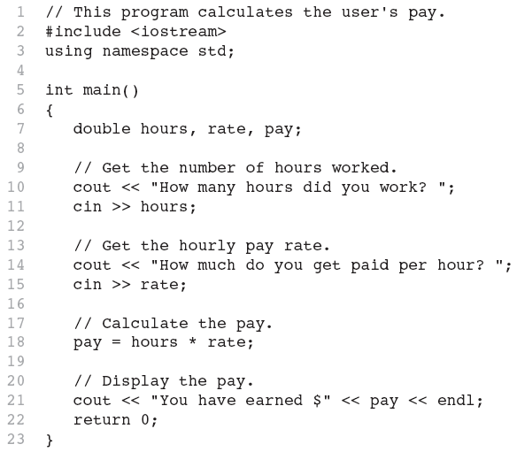
What is a Program Made of?
Common elements in programming languages:
Program 1-1
  Key Words
  Programmer-Defined Identifiers
  Operators
  Punctuation
  Syntax

Slide 50
Key Words
Also known as reserved words.
Have a special meaning in C++
Can not be used for any other purpose
Key words in the Program 1-1: using, namespace, int, double, and return

Slide 51
Programmer-Defined Identifiers
Names made up by the programmer
Not part of the C++ language
Used to represent various things: variables (memory locations), functions, etc.
In Program 1-1: hours, rate, and pay.

Slide 52
Operators
Used to perform operations on data
Many types of operators:
  Arithmetic - ex: +,-,*,/
  Assignment – ex: =
Some operators in Program1-1:
<< >> = *

Slide 53
Punctuation
Characters that mark the end of a statement, or that separate items in a list
In Program 1-1: , and ;

Slide 54
Syntax
The rules of grammar that must be followed when writing a program
Controls the use of key words, operators, programmer-defined symbols, and punctuation

Slide 55
Variables
A variable is a named storage location in the computer’s memory for holding a piece of data.
In Program 1-1 we used three variables:
  The hours variable was used to hold the hours worked
  The rate variable was used to hold the pay rate
  The pay variable was used to hold the gross pay

Slide 56
Variable Definitions
To create a variable in a program you must write a variable definition (also called a variable declaration)
Here is the statement from Program 1-1 that defines the variables:
double hours, rate, pay;

Slide 57
Variable Definitions (cont…)
There are many different types of data, which you will learn about in this course.
A variable holds a specific type of data.
The variable definition specifies the type of data a variable can hold, and the variable name.

Slide 58
Variable Definitions (cont…)
Once again, line 7 from Program 1-1:
double hours, rate, pay;
The word double specifies that the variables can hold double-precision floating point numbers. (You will learn more about that in Chapter 2)

Slide 59
Input, Processing, and Output
Three steps that a program typically performs:
  Gather input data:
    from keyboard
    from files on disk drives
  Process the input data
  Display the results as output:
    send it to the screen
    write to a file

Slide 60
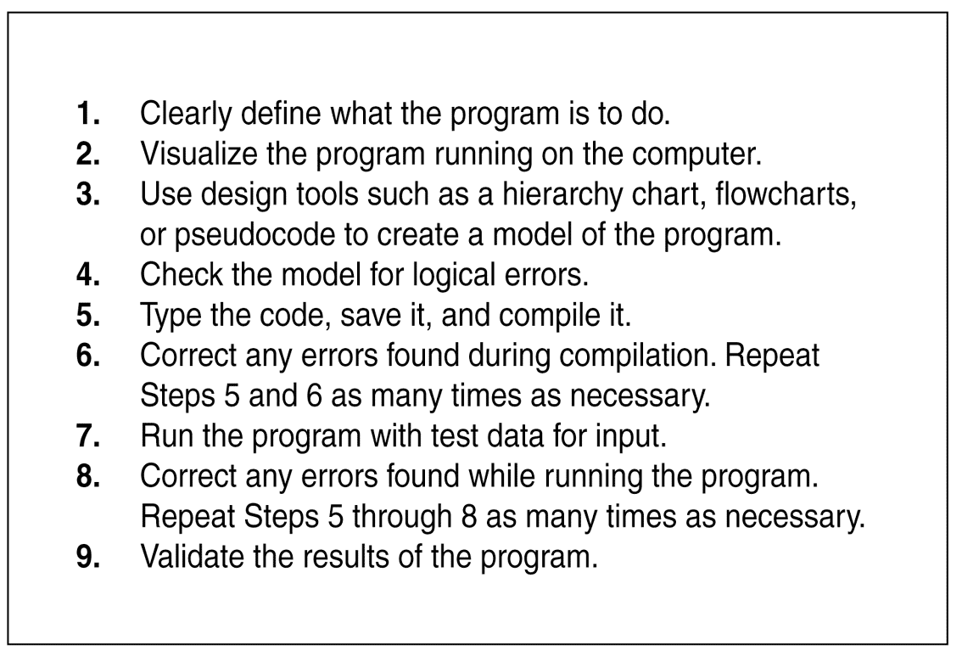
The Programming Process

