Slide 1


3
Human Resource Management Strategy and Analysis
Notes:
This chapter explains how to design and develop an HR system that supports the company’s strategic goals. We cover the strategic management process and how to develop a strategic plan. We also discuss the HR manager’s role in the process of strategy execution and formulation. Finally, we explain why metrics are essential for identifying and creating high-performance human resource policies and practices. Visit www.mymanagementlab.com for activities that are applied, personalized, and offer immediate feedback.

Slide 2
Learning Objectives
Explain with examples each of the eight steps in the strategic management process.
List with examples the main types of strategies.
Define strategic human resource management and give an example of strategic human resource management in practice.
Notes:
After studying this chapter, you will be able to:
1. Explain with examples each of the eight steps in the strategic management
process.
2. List with examples the main types of strategies.
3. Define strategic human resource management and give an example of
strategic human resource management in practice.

Slide 3
Learning Objectives
Give at least five examples of HR metrics.
Give five examples of what employers can do to have high-performance systems.
Notes:
After studying this chapter, you will be able to:
4. Give at least five examples of HR metrics.
5. Give five examples of what employers can do to have high-performance
systems.

Slide 4
Explain with examples each of the eight steps in the strategic management process.
Notes:
Managers can’t intelligently design their human resource policies and practices without understanding
the role these policies and practices are to play in achieving their companies’ strategic
goals. In this chapter, we look at how managers design strategic and human resource plans, and
how they evaluate the results of their plans.

Slide 5
The Strategic Management Process
Notes:
When the Ritz-Carlton Company took over managing the Portman Hotel in Shanghai, China, the
hotel already had a fine reputation among business travelers. But many new luxurious hotels
were opening there. To stay competitive, the Portman’s new managers decided to reposition the
hotel with a new strategy, one that emphasized top-notch customer service. But they knew that
improving the service would require new employee selection, training, and pay policies and practices.
We will see what they did and start with an overview of the basic management planning process.

Slide 6
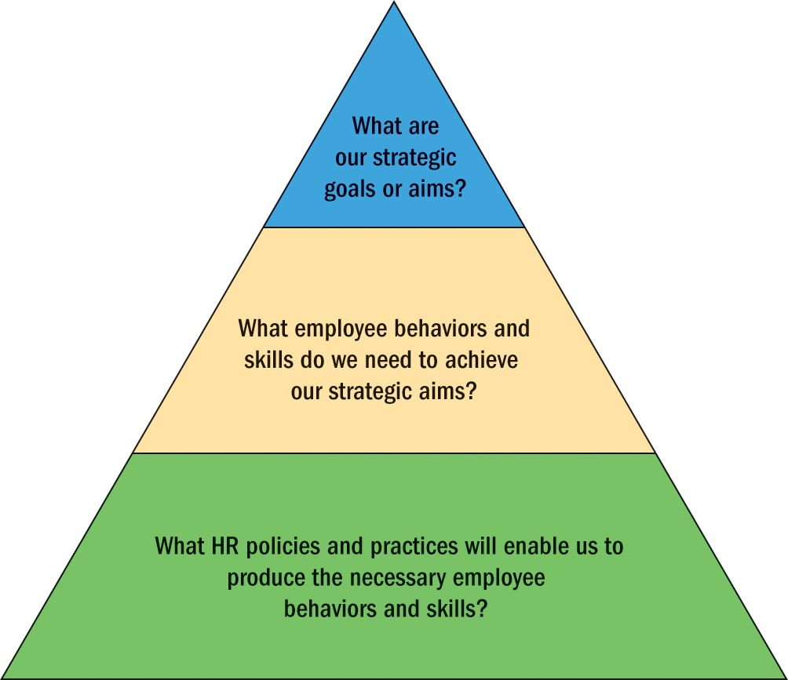
The Management Planning Process
The Hierarchy of Goals
Policies and Procedures
Notes:
The Hierarchy of Goals In companies, it is traditional to view the goals from the top of the
firm down to front-line employees as a chain or hierarchy of goals. Figure 3-1 illustrates this.
At the top, the president sets long-term or “strategic” goals (such as “double sales revenue to
$16 million in fiscal year 2015”). His or her vice presidents then set goals for their units that flow
from, and make sense in terms of accomplishing, the president’s goal. Then their
own subordinates set goals, and so on down the chain.
Policies and Procedures Policies provide day-to-day guidance employees
need to do their jobs in a manner that is consistent with the company’s plans and goals. Policies
set broad guidelines delineating how employees should proceed. For example, “It is the policy of
this company to comply with all laws, regulations, and principles of ethical conduct.” Procedures
spell out what to do if a specific situation arises.

Slide 7
Strategic Planning
Step 1. Ask, Where Are We Now
Step 2. Size Up The Situation: Perform External and Internal Audits
Step 3. Create Strategic Options
Step 4. Review Strategic Options
Notes:
Step 1. Ask, Where Are We Now? The logical place to start is by asking, “Where are we now as
a business?” Here the manager defines the company’s current business and mission. Specifically,
“What products do we sell, where do we sell them, and how do our products or services differ from
our competitors’?”
Step 2. Size Up The Situation: Perform External and Internal Audits The next step is to
ask, “Are we heading in the right direction given the challenges that we face?”
To answer this, managers need to study or “audit” the firm’s environment, and its internal
strengths and weaknesses. The environmental scan worksheet in Figure 3-3 is a guide for compiling
information about the company’s environment. It includes the economic, competitive, and
political trends that may affect the company.
Step 3. Create Strategic Options The situation may require that management consider
strategic options for the company. Several years ago, for instance, Microsoft, facing a surging
product lineup from Apple and competition from Google’s cloud-based office programs, had
to decide whether to change its mission and, if so, how. Should it continue to focus mostly
on software for microcomputers?
Step 4. Review Strategic Options Given the situation, which strategic option should we
pursue? Here the manager compares his or her strategic options to see which are most consistent
with the firm’s opportunities and threats, and its strengths and weaknesses. For P&G, management
had to assess whether building up its Oil of Olay brand was a better option than simply buying
(at great expense) a well-known high-tier cosmetics brand.

Slide 8
Strategic Planning
Step 5. Make a Strategic Choice
Step 6. Translate into Goals
Step 7. Implement the Strategies
Step 8. Evaluate Performance
Notes:
Step 5. Make a Strategic Choice Here the manager must finalize a strategic choice. For example,
after reviewing its competitive opportunities and threats, Procter & Gamble opted for a strategy of
building Oil of Olay into a top-tier brand, one competitive with the likes of L’Oreal. And Microsoft
introduced a line of tablet computers.
Step 6. Translate into Goals Next, management translates the new desired direction into
actionable strategic goals. At P&G, for instance, strategic goals might have included “generate
20% of corporate revenues from the Oil of Olay brand within 4 years,” and “capture 18% of
the top-tier beauty care market within 3 years.” Ford breathed life into its “Quality Is Job One”
mission by setting goals such as “no more than 1 initial defect per 10,000 cars.”
Step 7. Implement the Strategies Strategy execution means translating the strategies into
action. This means actually hiring (or firing) people, building (or closing) plants, and adding (or
eliminating) products and product lines. To do this, management uses the firm’s new top-level
strategic goals to formulate a hierarchy of goals, and policies and procedures. These guide action
down the chain of command at lower organizational levels, and in the firm’s various departments.
Step 8. Evaluate Performance Things don’t always turn out as planned. P&G soon built its
Oil of Olay line into a world-class brand. However initially, at least, Microsoft’s new tablets were
off to a slow start. Microsoft soon cut their prices.

Slide 9
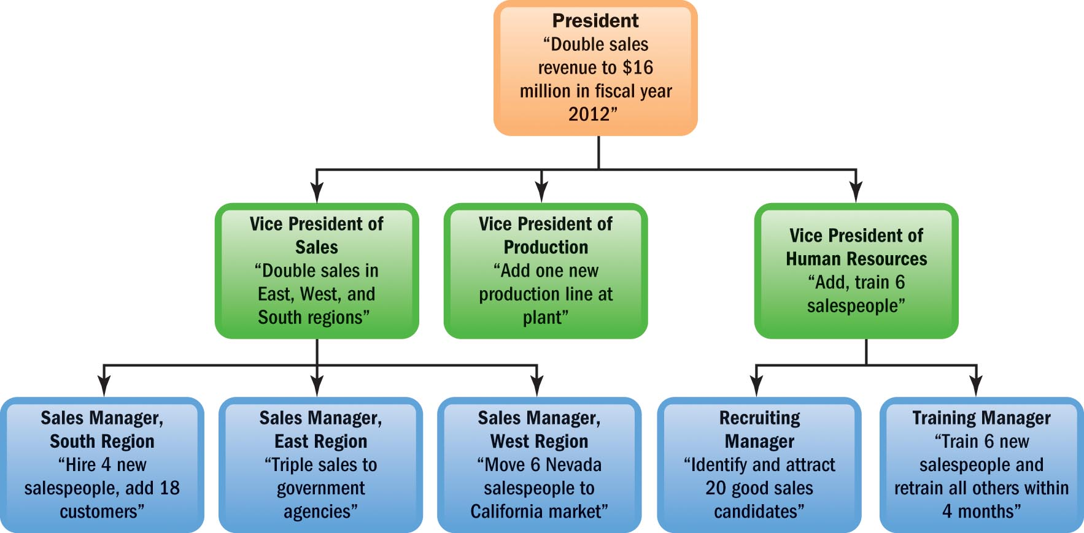
Review
Notes:
In companies, it is traditional to view the goals from the top of the firm down to front-line employees as a chain or hierarchy of goals. A strategic plan is the company’s plan for how it will match its internal strengths and weaknesses with external opportunities and threats. This will allow the organization to maintain a competitive advantage.
Finally, the seven steps in the planning process provide a rigorous mechanism to manage the process in a systematic manner.

Slide 10
List with examples the main types of strategies.
Notes:
In practice, managers engage in three types of strategic planning, corporate-level strategic planning,
business unit (or competitive) strategic planning, and functional (or departmental) strategic
planning.

Slide 11
Types of Strategies
Notes:
Next lets take a look at the three types of strategy at each company level.

Slide 12
Types of Strategies
Corporate Strategy
Competitive Strategy
Functional Strategy
Managers’ Roles in Strategic Planning
Notes:
Corporate-level strategy identifies the portfolio of businesses that comprise the company and the ways in which these businesses are related to each other.
Managers endeavor to achieve competitive advantages for each of their businesses. Competitive advantages enable a company to differentiate its product or service from those of its competitors. Such differentiation allows a company to increase its market share.
Functional strategies identify the basic course of action that each department will pursue in order to help the business attain its competitive goals. Human capital is one of the best competitive advantages because it is hard to duplicate a company’s personnel.
“Strategic fit” sums up the idea that each department’s functional strategy should fit and support the company’s competitive aims. The “fit” point of view states that all of the firm’s activities must be tailored to or fit its strategy.

Slide 13
Improving Mergers and Acquisitions
Critical human resource M&A tasks include:
  Choosing top management
  Communicating changes to employees
  Merging the firms’ cultures
  Retaining key talent
Notes:
Mergers and acquisitions (M&A) are among the most important strategic decisions companies make. When mergers and acquisitions fail, it’s often not due to financial issues but to personnel-related ones, such as employee resistance. Prudent top managers therefore tap their human resource managers’ input early in
the merger process.
Critical human resource M&A tasks include choosing top management, communicating changes to employees, merging the firms’ cultures, and retaining key talent. Human resource consulting companies, such as Towers Perrin, assist firms with merger-related human resource management services. For example, they identify potential pension shortfalls, identify key talent and then develop suitable retention strategies, help clients plan how to combine payroll systems, and help determine which employee is best for which role in the new organization.

Slide 14
Review
Types of strategies
  Corporate
  Competitive
  Functional
  Strategic fit
Managerial roles in strategic planning
Notes:
For this learning objective, we have discussed the types of strategies used by organizations and the important roles of differing levels of managers in strategic planning. We also looked at tasks for M&A.

Slide 15
Define strategic human resource management and give an example of strategic human resource management in practice.
Notes:
We’ve seen that once a company decides how it will compete, it turns to formulating functional departmental strategies to support its competitive aims. One of those departments is human resource management. Its functional strategies are human resource management strategies.

Slide 16
Strategic Human Resource Management
Notes:
Top managers design overall corporate strategies, and then design competitive strategies for each
of the company’s businesses. Then the departmental managers formulate functional strategies
for their departments that support the business and company-wide strategic aims. The marketing
department would have marketing strategies. The production department would have production
strategies. The human resource management (“HR”) department would have human resource
management strategies.
HR in Practice at the Hotel Paris. Starting as a single hotel in a Paris suburb in 1990, the Hotel
Paris now comprises a chain of nine hotels, with two in France, one each in London and Rome, and
others in New York, Miami, Washington, Chicago, and Los Angeles. To see how managers use strategic
human resource management to improve performance, see the Hotel Paris Case.

Slide 17
Strategic Human Resource Management
What Is Strategic Human Resource Management?
Human Resource Strategies in Action
Translating Strategy into Human Resource Policies and Practices: An Example
Strategic Human Resource Management Tools
Notes:
What Is Strategic Human Resource Management?
Management formulates a strategic plan and measurable strategic goals or aims. The plans imply certain workforce requirements required to achieve the firm’s strategic aims. Given these workforce requirements, HR management formulates strategies. These HR policies and practices (strategies) help produce the desired workforce skills, competencies, and behaviors.
Human Resource Strategies in Action
As one example of human resource strategy, consider Newell Rubbermaid. Several years ago, it changed its business from manufacturing and marketing housewares (such as Rubbermaid utensils and Levelor Blinds) to mostly just marketing them. They knew that implementing this change would require new employee competencies and behaviors (for instance more advertising and sales employees and fewer manufacturing ones). The human resource management team began by benchmarking Newell’s main marketing-oriented competitors to see what their best human resource practices were. Then the human resource team formulated new HR strategies.
Albertsons Example. Supermarket chain Albertsons competes with low-cost leader Walmart in part with a strategy of combining reasonably low costs with superior service. Albertsons’ human resources team helps the company do this. For example, controlling personnel-related costs while improving customer service meant hiring customer-focused employees while reducing turnover, improving retention and eliminating time-consuming manual processes. Working with its information technology department, Albertsons’ human resource team put in place an automated staffing system from Unicru.
This collects and analyzes the information entered by applicants online and at kiosks. It ranks applicants based on whether they exhibit customer-focused traits, helps track candidates throughout the screening process, and tracks reasons for departure once applicants are hired. The Albertsons human resource managers were able to present a compelling business case for adopting the Unicru system, by showing its return on investment. The bottom line was that by working as a partner in Albertsons’ strategy design and implementation process, the human resource team helped Albertsons control costs and improve customer service, and thereby achieve its strategic goals.
Translating Strategy into Human Resource Policies and Practices: An Example.
The CEO of Einstein Medical decided to summarize the change in the program’s goals in three words: initiate, adapt, and deliver. To turn Einstein Medical into a comprehensive health-care network within the dynamic new health care environment, Einstein Medical’s HR and other departmental strategies would have to focus on helping the medical center and its employees to produce new services (initiate), capitalize on opportunities (adapt), and offer consistently high-quality services (deliver).
Strategic Human Resource Management Tools
Managers use several tools to translate the company’s broad strategic goals into human resource management policies and practices. Three important tools are the strategy map, the HR scorecard, and the digital dashboard.

Slide 18
IMPROVING PERFORMANCE: HR Practices Around the Globe
Ritz-Carlton Company had to improve level of service
  This meant new HR plans for:
  Hiring
  Training
  Rewarding hotel employees
Profits soared
Notes:
When the Ritz-Carlton Company took over managing the Portman Hotel in Shanghai, China, the new
management reviewed the Portman’s strengths and weaknesses, and its fast-improving local competitors.
They decided that to compete, they had to improve the hotel’s level of service.
It meant putting in place a new human resource strategy for the Portman Hotel, one aimed at improving
customer service. Their HR strategy involved taking these steps:
● Strategically, they set the goal of making the Shanghai Portman outstanding by offering superior
Customer service.
● To achieve this, Shanghai Portman employees would have to exhibit new skills and behaviors, for
instance, in terms of how they treated and responded to guests.
● To produce these employee skills and behaviors, management formulated new human resource management
plans, policies, and procedures. For example, they introduced the Ritz-Carlton Company’s human resource
system to the Portman: “Our selection [now] focuses on talent and personal values because these are things
that can’t be taught . . . it’s about caring for and respecting others.”
Management’s efforts paid off. Their new human resource plans and practices helped to produce the employee
Behaviors required to improve the Portman’s level of service, thus attracting new guests. Travel publications were
soon calling it the “best employer in Asia,” “overall best business hotel in Asia,” and “best business hotel in China.”
Profits soared, in no small part due to effective strategic human resource management.
Discussion Question 3-1: Asian culture is different from that in the United States. For example,
team incentives tend to be more attractive to people in Asia than are individual incentives. How do you
think these cultural differences would have affected how the hotel’s new management selected, trained,
appraised, and compensated Portman employees?

Slide 19

Strategic Human Resource Management Tools
Strategy map
The HR scorecard
Digital dashboards
Notes:
The strategy map shows the “big picture” of how each department’s performance contributes to achieving the company’s overall strategic goals. Many employers quantify and computerize the map’s activities. The HR Scorecard helps them to do so.
The HR Scorecard is not a scorecard. It refers to a process for assigning financial and nonfinancial goals or metrics to important human resource management–related chain of activities. That chain is required in order to achieve the company’s strategic aims and for monitoring results.
A digital dashboard presents the manager with desktop graphics and charts. It is a computerized picture of where the company stands on all those metrics from an HR Scorecard perspective.

Slide 20
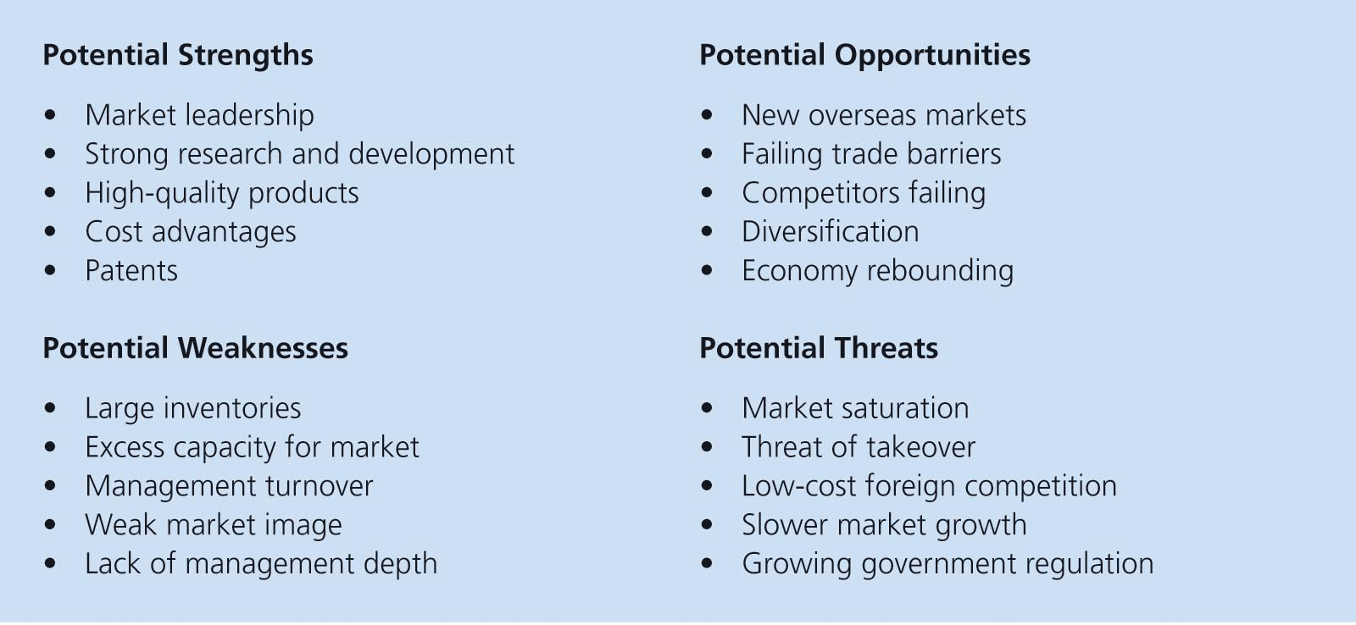
Review
Definition
Strategies
Policies
Service-oriented example
Notes:
In this section, we have defined strategic human resource management as formulating and executing human resource policies and practices. Such policies and practices can produce employee competencies and behaviors the company needs to improve its competitive position.
Strategies are then developed for the organization that suggest certain workforce requirements. With these workforce requirements, HR management formulates strategies to produce the desired workforce skills, competencies, and behaviors.

Slide 21
Give at least five examples of HR metrics.
Notes:
We’ve seen that strategic human resource management means formulating HR policies and practices that produce the employee competencies and behaviors the company needs to achieve its strategic goals. For example if you set “better customer service” as a goal you have to measure customer service. These measures might include, for instance, hours of training per employee, productivity per employee, and (via customer surveys) customer satisfaction.

Slide 22
HR Metrics and Benchmarking
Notes:
Being able to measure what you are doing is an integral part of the HR strategy process.
First, management translates its strategic plan into workforce requirements. Such requirements are tracked in terms of measurable worker competencies and behaviors (such as outstanding service). Given these workforce requirements, the human resource manager then formulates supportive HR strategies, policies, and practices such as new training programs.
Finally, the HR manager picks measures by which to gauge whether his or her new policies and practices are producing the required employee competencies and behaviors.
Benchmarking means comparing the practices of high-performing companies to your own, in order to understand what they do that makes them better.

Slide 23

HR Metrics and Benchmarking
HR metrics
  Types of metrics
Benchmarking
What Are HR Audits
Evidence-Based HR
  The scientific method
Notes:
Being able to measure what you are doing is an integral part of the HR strategy process.
First, management translates its strategic plan into workforce requirements. Such requirements are tracked in terms of measurable worker competencies and behaviors (such as outstanding service). Given these workforce requirements, the human resource manager then formulates supportive HR strategies, policies, and practices such as new training programs.
If the new strategy calls for doubling profits by improving customer service, to what extent are our new training practices helping to improve customer service? Managers use strategy-based metrics to answer such questions. Strategy-based metrics focus on measuring the activities that contribute to achieving a company’s strategic aims.
Such analyses often employ data-mining techniques. Data mining sifts through huge amounts of employee data to identify correlations that employers then use to improve their employee-selection and other practices.
Finally, the HR manager picks measures by which to gauge whether his or her new policies and practices are producing the required employee competencies and behaviors.
Benchmarking means comparing the practices of high-performing companies to your own, in order to understand what they do that makes them better.
Human resource managers often collect data on matters such as employee turnover and safety via human resource audits. An HR audit is an analysis by which an organization measures where it currently stands and determines what it has to accomplish to improve its HR functions.
Evidence-based human resource management means using data, facts, analytics, scientific rigor, critical evaluation, and critically evaluated research/case studies to support human resource management proposals, decisions, practices, and conclusions.
But how can HR managers be scientific? Objectivity, experimentation, and prediction are the heart of science. For managers, the point of being “scientific” is to make better decisions by forcing you to gather the facts.

Slide 24
Strategy and Strategy-Based Metrics
Workforce/Talent Analytics
Analytics improves performance
Analytics answers six types of talent management questions
Notes:
Data such as cost-per-hire are interesting but relatively useless until converted to information.
Information is data presented in a form that makes it useful for making decisions.
Analytics improves performance. For example, a talent analytics team at Google analyzed data on employee backgrounds, capabilities, and performance. The team was able to identify the factors (such as an employee feeling underutilized) likely to lead to the employee leaving. In a similar project, Google analyzed data on things like employee survey feedback to identify the attributes of successful Google managers. Microsoft identified correlations among the schools and companies that the employees arrived from and the employees’ subsequent performance. This enabled Microsoft to improve its recruitment and selection practices.
Employers are using talent analytics to answer six types of talent management questions:
Human capital facts.
Analytical HR.
Human capital investment analysis.
Workforce forecasts.
Talent value model.
Talent supply chain.

Slide 25
IMPROVING PERFORMANCE:
HR Tools for Line Managers and Entrepreneurs
Scientific evidence-based approach
  Employee analysis shows productivity
  Company instituted health programs linked to increased productivity
Notes:
Examples abound of human resource managers taking a scientific, evidence-based approach to making
decisions. For example, an insurance firm was considering cutting costs by buying out senior underwriters,
most of whom were earning very high salaries. But after analyzing the data, HR noticed that these
underwriters also brought in a disproportionate share of the company’s revenue. In fact, reviewing data on
things such as employee salaries and productivity showed that it would be much more profitable to eliminate
some low-pay call-center employees, replacing them with even less-expensive employees.
As another example, the chemical company BASF Corp. analyzed data on the relationship among stress, health,
and productivity in its 15,000 U.S. headquarters staff. Based on that analysis, the company instituted health
programs that it calculated would more than pay for themselves in increased productivity by reducing stress.
Discussion Question 3-2: If it is apparently so easy to do what BASF did to size up the potential
benefits of health programs, why do you think more employers do not do so?

Slide 26
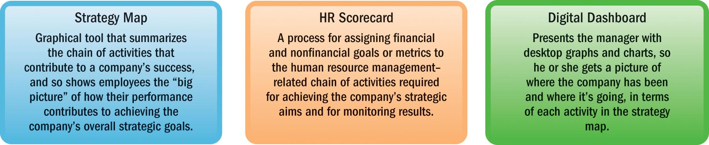
Review
Strategy and strategy-based metrics
Audits
Evidence-based HR
  The scientific method
  Talent analytics
Notes:
For this learning objective, we have discussed the relationship between business and HR strategies and the metrics used to measure them.
Workforce or talent analytics help you understand and track and improve results.
Data has to be useful and involves statistical analysis to find hidden or new relationships among different variables.
HR audits are a way for an organization to measure current policies and practices.
Evidence-based HR is the use of data, facts, etc. to support HR activities.
For managers, the key point of being “scientific” is to make better decisions through objective experimentation.
All of these elements together are designed to help integrate business goals with HR practices and policies while improving results.

Slide 27
Give five examples of what employers can do to have high-performance systems.
Notes:
One reason to measure, benchmark, and scientifically analyze human resource management
practices is to promote high-performance work practices. A high-performance work system
(HPWS) is a set of human resource management policies and practices that together produce
superior employee performance.

Slide 28
High-Performance Work Systems
Notes:
High-Performance Work Systems
A set of human resource management policies and practices that promote organizational effectiveness.

Slide 29

High-Performance Work Systems
High-Performance Human Resource Policies and
Practices
Notes:
A high-performance work system (HPWS) is a set of HR policies and practices that together produce superior employee performance. These policies and practices illustrate the importance of HR metrics and how they help to assess HR performance. They also reveal what HR systems must do to be successful. Such success may include helping workers aspire to manage themselves. HR practices also highlight measureable differences between HR systems in high and low performing companies.

Slide 30
Review
What exactly are these high-performance work practices?
For example, in terms of HR practices, high-performing companies recruit more job candidates, use more selection tests, and spend many more hours training employees.
Notes:
We looked at how studies show recruitment, selection, training, appraisal, pay, and other practices differ in high-performance and Low-performance companies. Studies show that high-performance work systems’ policies and practices do differ from less productive ones.

Slide 31

Improving Performance at
the Hotel Paris
Hotel Paris International Strategy
The Strategically Required Organizational Outcomes
The Strategically Relevant Workforce Competencies and Behaviors
Notes:
Hotel Paris International
As a corporate strategy, the Hotel Paris’s management and owners want to continue to expand geographically. They believe doing so will let them capitalize on their reputation for good service, by providing multicity alternatives for their satisfied guests. The problem is, their reputation for good service has been deteriorating. If they cannot improve service, it would be unwise for them to expand, since their guests might prefer other hotels after trying the Hotel Paris.
The Strategy
All Hotel Paris managers—including the director of HR services—must now formulate strategies that support this competitive strategy approved by the board and top managers. “The Hotel Paris International will use superior guest services to differentiate the Hotel Paris properties, and to thereby increase the length of stays and the return rate of guests, and thus boost revenues and profitability.”
The Strategically Required Organizational Outcomes
Each step in the hotel’s value chain provides opportunities for improving guest service. Management must take steps that produce fewer customer complaints and more written compliments, more frequent guest returns and longer stays, and higher guest expenditures per visit.
The Strategically Required Organizational Outcomes
Management asked, “What competencies and behaviors must our hotel’s employees exhibit if we are to produce required organizational outcomes such as fewer customer complaints, more compliments, and more frequent guest returns?” Thinking through this question helps Lisa come up with an answer. For example, the hotel’s required employee competencies and behaviors would include, “high quality front-desk customer service,” “taking calls for reservations in a friendly manner,” “greeting guests at the front door,” and “processing guests’ room service meals efficiently.” All require motivated, high morale employees.
*The accompanying strategy map for this chapter is in the MyManagementLab, and the overall map on the inside back cover of this text outlines the relationships
involved.

Slide 32

Improving Performance at
the Hotel Paris
The Strategically Relevant HR Policies and Activities
The Strategy Map
How We Will Use the Hotel Paris Case
Notes:
The Strategically Relevant HR Policies and Activities
The HR manager’s task now is to identify and specify the HR policies
and activities that will enable the hotel to produce these crucial workforce
competencies and behaviors.
The Strategy Map
Next management working with the hotel’s chief financial officer (CFO), outlines a strategy map for the hotel. This outlines the cause-and-effect links among the HR activities, the workforce behaviors, and the organizational outcomes (the figure on this book’s inside back cover shows the overall map; you’ll find detailed maps for each HR function in each chapter’s related MyManagementLabs page).
How We Will Use the Hotel Paris Case
A Hotel Paris case in each chapter will show how Lisa, the Hotel Paris’s HR director, uses that chapter’s concepts and techniques to: (1) create HR policies and practices that help the Hotel Paris (2) produce the employee competencies and behaviors the company needs (3) to produce the customer service the Hotel Paris needs to achieve its strategic goals.

Slide 33
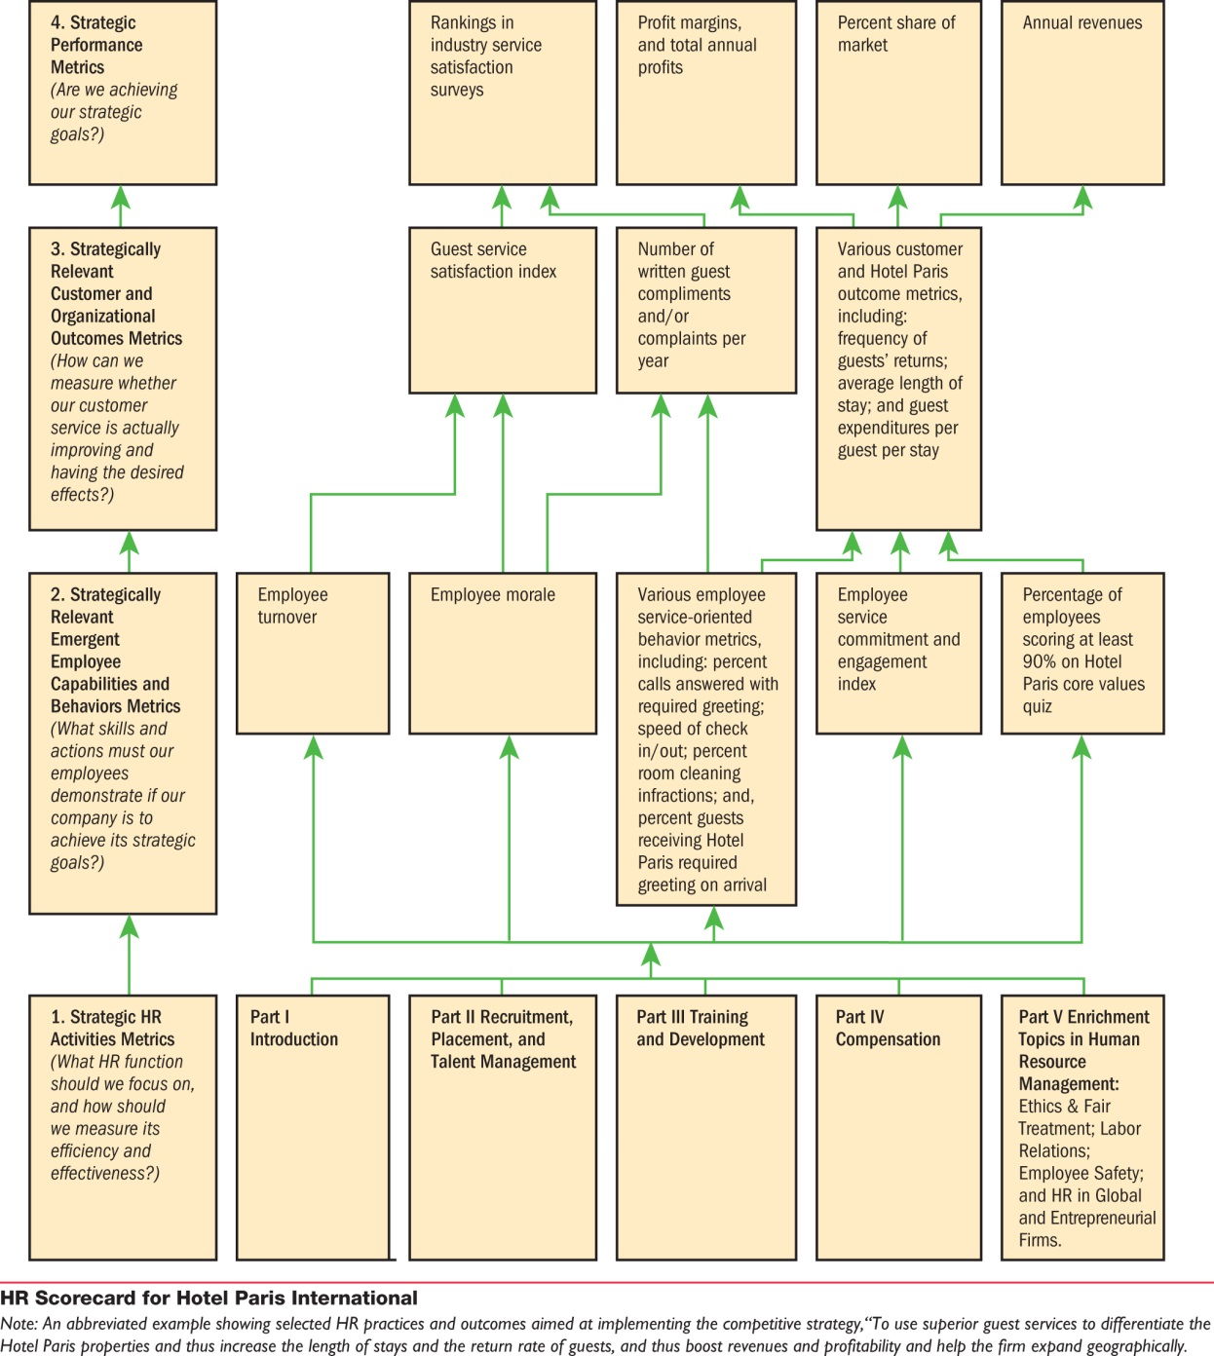
Hotel Paris Strategy Chapter 3
Notes:
Hotel Paris Strategy Chapter 3

Slide 34

Notes:
Copyright

