Slide 1
Multinational Financial Management:international flow of funds and international financial markets
CHAPTER 1
© 2020 Cengage Learning. All Rights Reserved. May not be copied, scanned, or duplicated, in whole or in part, except for use as permitted in a license distributed with a certain product or service or otherwise on a password-protected website for classroom use.

Slide 2
Learning Objectives
Factors that make multinational financial management different
Discover what is different about international financial management, and which market imperfections give rise to the multinational enterprise
Exchange rates and trading
Examine international flow of funds
Overview of international Financial Markets
Understand the complexity of risks associated with financial globalization
Explore how global capital markets are critical for the exchange of products, services, and capital in the execution of global business
Consider how the theory of comparative advantage establishes the foundations for the justification for international trade and commerce

Slide 3
What is a multinational corporation?
A multinational corporation is one that operates in two or more countries.
At one time, most multinationals produced and sold in just a few countries.
Today, many multinationals have world-wide production and sales.

Slide 4
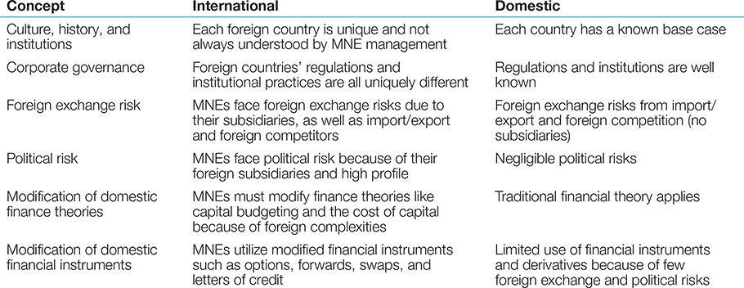
Exhibit 1.1 What Is Different About International Financial Management?

Slide 5
Market Imperfections: A Rationale for the Existence of the Multinational Firm
Strategic motives drive the decision to invest abroad and become a MNE and can be summarized under the following categories:
  Market seekers
  Raw material seekers
  Production efficiency seekers
  Knowledge seekers
  Political safety seekers
These categories are not mutually exclusive.

Slide 6
Exchange rates and trading:
The Market for Currencies
Most currencies are quoted against the dollar as in “so many units per dollar”
A few are quoted as “dollars per unit” due to custom e.g., $/£ and $/€.
There are also several symbols that can be used to write the quotations, but this is the author’s stated preference.

Slide 7
Example of exchange rates and trading
Consider the following exchange rates
 | U.S. Dollars Required to Buy One Unit of Foreign Currency | Units of Foreign Currency Required to Buy One U.S. Dollar
Euro | 1.2500 | --
Swedish krona | -- | 7.0000

Slide 8
Notation
The notation EUR/USD and SEK/USD use the currency labels designated by the international Organization for Standardization (ISO)
A quote has two currencies: The left-hand currency and the right-hand currency. A quote of LEFT/RIGHT is for the value of the LEFT currency expressed in units of the RIGHT currency.
EUR/USD is a quote for euros expressed in dollars.
SEK/USD is a quote for Swedish kronor expressed in dollars.
USD/SEK is a quote for dollars expressed in kronor.

Slide 9
Notation
The quotes in the first column of the table express the relative value of the euro to the dollar and the krona to the dollar.
  EUR/USD = 1.25
  The press would report the euro trading at $1.25.
The quotes in the second column express the relative value of the dollar to the foreign currency.
  USD/SEK = 7
  Or one U.S. dollar is worth 7 Swedish kronor.

Slide 10
Direct Quotations and indirect quotations
From a U.S. perspective, the quotes in the first column are called direct quotes because they are number of units of a foreign currency that can be purchased by 1 unit of the home currency.
Direct quote = Dollars per foreign currency
An indirect quotation gives the amount of a foreign currency required to buy one unit of home currency. In our example, the U.S. dollar is the home (currency per dollar).
Euros and British pounds are normally quoted as direct quotations.
Most other currencies are quoted as indirect

Slide 11
Exchange rate risk and currency appreciation
Exchange rate risk is the risk that the value of a cash flow in one currency translated from another currency will decline due to a change in exchange rates.
Currency appreciation
Suppose the exchange rate goes from 7 kronor per dollar to 9 kronor per dollar.
A dollar now buys more kronor. The percentage increase in kronor per dollar is:
  (9 − 7)/7 = 28.6%
We would say that the dollar appreciated against the krona by 28.6%.

Slide 12
International flow of funds
International Monetary Systems: Gold Standard
Paper currency issued by each country
Could be for gold from country’s treasury
Gold was worth:
  $20.67 an ounce in the U.S.
  £4.24 in the U.K.
Required international cooperation
  Redemption price local currencies
  Free flow from one country to another of:
    Gold
    Trade
Failed! Lack of international cooperation:
  World War I
  Depressions
  World War II

Slide 13
Bretton Woods Agreement
Meeting of industrialized countries in 1944 establish new international monetary system
Created International Monetary Fund (IMF) to promote international:
  Trade
  Prosperity
IMF works to:
  Stabilize exchange rates.
  Reduce restrictions on currency exchanges.
  Provide short-term financial help to countries with financial crises.
Now has over 180 member nations.

Slide 14
International Monetary System from 1946-1971: Fixed Exchange Rates
U.S. dollar was tied to gold at $35 per ounce.
Other currencies were tied to U.S. dollar at fixed exchange rates.
Central banks intervened by purchasing and selling currency to even out demand so that the fixed exchange rates were maintained.
Occasionally the official exchange rate for a country would be changed.
Failed due to economic difficulties from maintaining fixed exchange rates.

Slide 15
Current International Monetary Systems
Floating
Pegged systems
Other arrangements
Monetary unions

Slide 16
Floating Rate Systems
Very little government intervention when currency demand changes due to:
  Trade deficit or surplus
  Capital movements to capture higher interest rates
About 70 industrialized nations
  About 30 are “free floating” with virtually no government intervention.
  About 40 have minor government intervention.

Slide 17
Pegged Exchange Rates
Exchange rate that is “pegged,” or fixed, with respect to another currency.
About 70 countries
Examples of pegged currencies:
  To U.S. dollar: Belize, Barbados, Saudi Arabia.
  To euro: Denmark

Slide 18
Managed Arrangements
Managed currency
  Country doesn’t report its currency as pegged.
  But it behaves like it is pegged.
Other Managed Arrangement
  Doesn’t fit into any other IMF category
  Includes China
    Pegged to basket of currencies
    Doesn’t tell world what currencies are in basket
    Sometimes lets exchange rate float
    Sometimes manages it more actively

Slide 19
Monetary Unions
Monetary union
  Multiple countries
  No individual currencies
  Use a common currency
European Monetary Union (EMU)
  Began in 2002
  Largest monetary union
  Uses the euro
  European Central Bank controls the monetary policy

Slide 20
Balance of payments
The measurement of all international economic transactions between the residents of a country and foreign residents is called the balance of payments (BOP)

Slide 21
The Balance of Payments
BOP data is important for government policymakers and MNEs as it is a gauge of a nation’s competitiveness or health (domestic and/or foreign)
For a MNE, both home and host country BOP data is important as:
  An indication of pressure on a country’s foreign exchange rate
  A signal of the imposition or removal of controls in various sorts of payments (dividends, interest, license fees, royalties and other cash disbursements)
  A forecast of a country’s market potential (especially in the short run)

Slide 22
Fundamentals of BOP Accounting
A BOP statement is a statement of cash flows over an interval of time.
A credit is an event, such as the export of a good or service, that records foreign exchange earned—an inflow of foreign exchange to the country.
A debit records foreign exchange spent, such as payments for imports or purchases of services—an outflow of foreign exchange.

Slide 23
Fundamentals of BOP Accounting
The BOP must balance.
It cannot be in disequilibrium unless something has not been counted or has been counted improperly.
Therefore, it is incorrect to state that the BOP is in disequilibrium.

Slide 24
The Accounts of the BOP
The BOP has three major sub-accounts—the current account, the capital account, and the financial account.
In addition, the official reserves account tracks government currency transactions.
A fifth account, the net errors and omissions account is produced to preserve the balance of the BOP.

Slide 25
What is a freely convertible currency?
A currency is convertible when the issuing country promises to redeem the currency at current market rates.
Convertible currencies are freely traded in world currency markets.
Residents and nonresidents are allowed to freely convert the currency into other currencies at market rates.
Also know as fully convertible currency or a hard currency.
All countries with free floating currencies have fully convertible currency.

Slide 26
BOP Impacts on Key Macroeconomic Rates
A country’s balance of payments both impacts and is impacted by the three macroeconomic rates of international finance:
  exchange rates;
  interest rates; and
  inflation rates

Slide 27
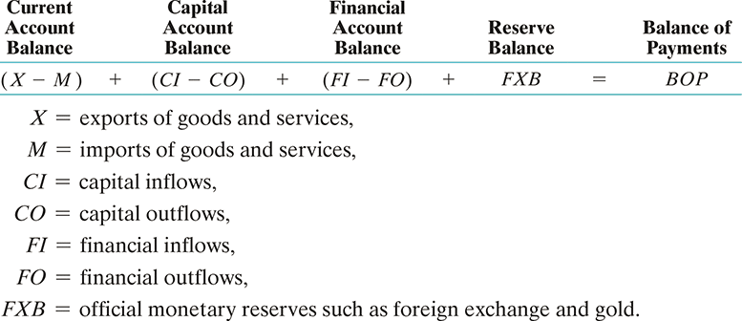
The BOP and Exchange Rates
The relationship between the BOP and exchange rates can be illustrated by use of a simplified equation:

Slide 28
The BOP and Exchange Rates
Fixed Exchange Rate Countries
  Under a fixed exchange rate system, the government bears the responsibility to ensure that the BOP is near zero
Floating Exchange Rate Countries
  Under a floating exchange rate system, the government has no responsibility to peg its foreign exchange rate
Managed Floats
  Countries operating with a managed float often find it necessary to take action to maintain their desired exchange rate values

Slide 29
The BOP and Interest Rates
Relatively low real interest rates should normally stimulate an outflow of capital seeking higher rates elsewhere
The opposite has occurred in the U.S. due to perceived growth opportunities and political stability—allowing it to finance its large fiscal deficit
The favorable inflow on the financial account is diminishing while the current account balance is worsening—making the U.S. a bigger debtor nation vis-à-vis the rest of the world

Slide 30
The BOP and Inflation
Imports have the potential to lower a country’s inflation rate.
Foreign competition substitutes for domestic competition to maintain a lower rate of inflation than might have been the case without imports.
On the other hand, to the extent that lower-priced imports substitute for domestic production and employment, gross domestic product will be lower and the balance on the current account will be more negative.

Slide 31
Trade Balances and Exchange Rates
A country’s import and export of goods and services is affected by changes in exchange rates
The transmission mechanism is in principle quite simple: changes in exchange rates change relative prices of imports and exports, and changing prices in turn result in changes in quantities demanded through the price elasticity of demand
Theoretically, this is straightforward; in reality global business is more complex

Slide 32
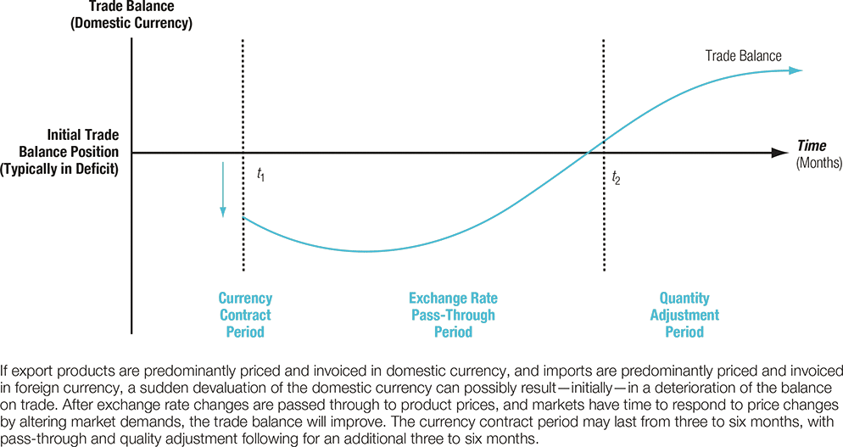
Trade Adjustment to Exchange Rates: The J-Curve

Slide 33
Capital Mobility
The degree to which capital moves freely across borders is critically important to a country’s balance of payments
The United States’ financial account surplus has at least partially offset the current account deficits over the last 20 or more years
China has run a surplus in each of these accounts in recent years

Slide 34
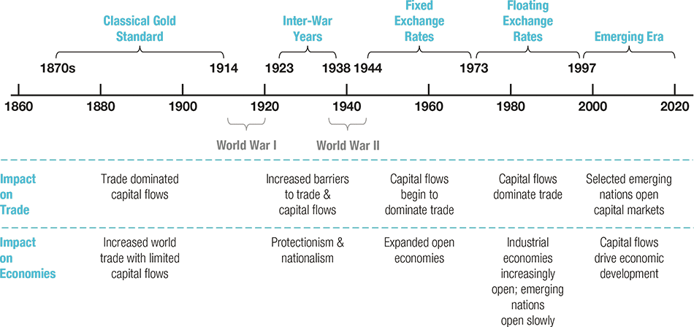
Exhibit 1.4 The Evolution of the Global Monetary System

Slide 35
Capital Controls
A capital control is any restriction that limits or alters the rate or direction of capital movement into or out of a country
Free movement of capital is more the exception than the rule
Exhibit 3.8 outlines several methods of and purposes for capital controls
Dutch Disease is the name given to the problem of a substantial currency appreciation due to the demand for a specific natural resource faced by several resource-rich smaller nations

Slide 36
Capital Flight
0
Capital flight—the rapid outflow of capital in opposition to or in fear of domestic political and economic conditions and policies—is one of the problems that capital controls are designed to control.
Although it is not limited to heavily indebted countries, the rapid and sometimes illegal transfer of convertible currencies out of a country poses significant economic and political problems.
Many heavily indebted countries have suffered significant capital flight.

Slide 37
Globalization of Capital Flows
Capital inflows are short-term in duration
Even mature markets can encounter crisis

Slide 38
Internationalization of Financial Markets
Eurodollar markets
  Dollars held outside the U.S.
  Mostly Europe, but also elsewhere
International bonds
  Foreign bonds: Sold by foreign borrower, but denominated in the currency of the country of issue.
  Eurobonds: Sold in country other than the one in whose currency it is denominated.

Slide 39
Eurocurrencies and LIBOR
Eurocurrency Interest Rates: LIBOR
  In the Eurocurrency market, the reference rate of interest is the London Interbank Offered Rate (LIBOR)
  This rate is the most widely accepted rate of interest used in standardized quotations, loan agreements, and financial derivatives transactions.

Slide 40
Eurocurrencies and LIBOR
Eurocurrencies (a major linkage in the global and capital markets)
  These are domestic currencies of one country on deposit in a second country
  The Eurocurrency markets serve two valuable purposes:
    Eurocurrency deposits are an efficient and convenient money market device for holding excess corporate liquidity
    The Eurocurrency market is a major source of short-term bank loans to finance corporate working capital needs (including export and import financing)

Slide 41
Internationalization of Financial Markets
> FOLLOWING THE FINANCIAL NEWS
Foreign Stock Market Indexes | Blank
Foreign stock market indexes are published daily in newspapers and Internet sites . Examples of some stock market indices are: Dow Jones Industrial Average (DJIA) An index of the 30 largest publicly traded corporations in the United States maintained by the Dow Jones Corporation. S&P 500 An index of 500 of the largest companies traded in the United States maintained by Standard & Poor’s. Nasdaq Composite An index for all the stocks that trade on the Nasdaq stock market, where most of the technology stocks in the United States are traded. | FTSE 100 An index of the 100 most highly capitalized UK companies listed on the London Stock Exchange. DAX An index of the 30 largest German companies trading on the Frankfurt Stock Exchange. CAC 40 An index of the largest 40 French companies traded on Euronext Paris. Hang Seng An index of the largest companies traded on the Hong Kong stock markets. Strait Times An index of the largest 30 companies traded on the Singapore Exchange.

Slide 42
Impact of relative Inflation on Interest Rates and Exchange Rates
Lower inflation leads to lower interest rates, so borrowing in low-interest countries may appear attractive to multinational firms.
However, currencies in low-inflation countries tend to appreciate against those in high-inflation rate countries, so the true interest cost increases over the life of the loan.

Slide 43
Financial Globalization and Risk
The global financial market place is a combination of complex risks:
  The international monetary system is an eclectic (made up of elements from various sources) mix of floating and managed fixed exchange rates. China is more and more a dominant player.
  Monetary and fiscal policies are complicated by large fiscal deficits.
  Large and continuing balance of payments imbalances will shift the exchange rate landscape.
  The dominant form of business has shifted from the publicly-traded firm to the privately owned model.
  Global capital markets are shrinking and changing.
  Large inflows and outflows of capital travel through industrial and emerging markets complicating financial management.

Slide 44
The Global Financial Marketplace
Assets, institutions, and linkages comprise one method to map (sketch) global capital markets (see Exhibit 1.1).
Assets are debt securities issued by governments (e.g., U.S. Treasury Bonds). These form the baseline for other forms of financing.
Institutions are the central banks, commercial, and investment banks. Their health keeps the global financial system stable.
Linkages are the interbank networks using currency. Without ready exchange of currencies the market is hard-pressed to operate efficiently.

Slide 45
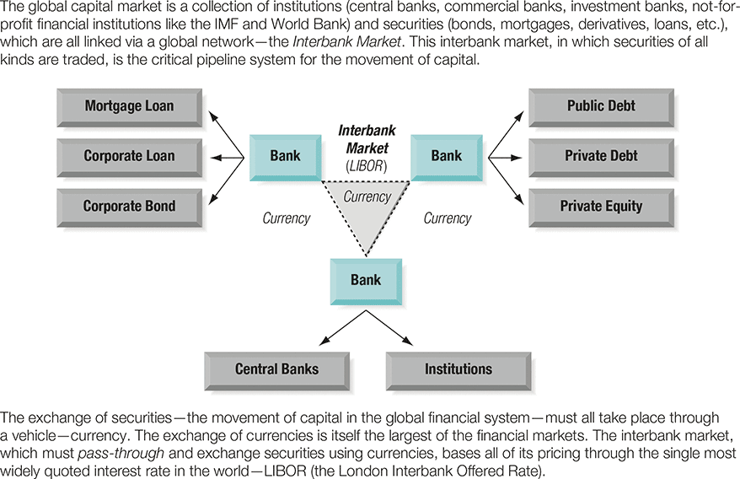
Exhibit 1.1 Global Capital Markets

Slide 46
The Theory of Comparative Advantage
The theory of comparative advantage provides a basis for explaining and justifying international trade in a model world assumed to enjoy:
  free trade;
  perfect competition;
  no uncertainty;
  costless information; and
  no government interference.

Slide 47
The Theory
of Comparative Advantage
The theory contains the following features:
  Exporters in Country A sell goods or services to unrelated importers in Country B
  Firms in Country A specialize in making products that can be produced relatively efficiently, given Country A’s endowment of factors of production, that is, land, labor, capital, and technology
  Firms in Country B do likewise, given the factors of production found in Country B
  In this way the total combined output of A and B is maximized

Slide 48
Market Imperfections: A Rationale for the Existence of the Multinational Firm
Strategic motives drive the decision to invest abroad and become a MNE and can be summarized under the following categories:
  Market seekers
  Raw material seekers
  Production efficiency seekers
  Knowledge seekers
  Political safety seekers
These categories are not mutually exclusive.

Slide 49
The Globalization Process
Stage I: early domestic phase growing into the international trade phase
Stage II: A successful firm will continue to grow from simple international trade to the multinational phase characterized by production and investment both at home and abroad
Growth may be limited by the twin agency problems of corporate insiders and the rulers of sovereign states

Slide 50
Factors affecting international trade flows
Cost of labour , inflation, national income, credit conditions, government policies,
Exchange rate-limitations of a weak home currency solution
–competitiveie ( foreign companies may lower prices to remain competitive)
Impact of other currencies. A county that has balance of trade deficit with may country is not likely to solve all deficit simultaneously .
prearranged international trade transactions international transactions cannot be adjusted immediately. The lag is estimated to be about 18 months or longer leading to J curve effect. See exhibit
Intracompany trade: many firms purchase products that are produced by their subsidiaries, these transactions are not necessarily affected by currency fluctuations.
Exchange rate and international friction

Slide 51
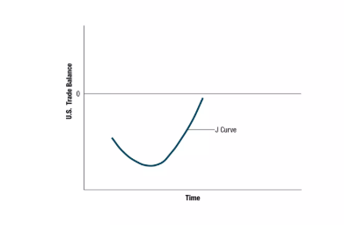
J-curve effect

Slide 52
International capital flows
Factors affecting direct foreign investment
Changes in restrictions
Privatization
Potential economic growth
Tax
Factors affecting international portfolio investment
tax rates on interest or dividends, interest and exchange rates,

Slide 53
Agencies that facilitate international flows
International Monetary fund (IMF)
World trade organization (WTO)
Inernational Finance corporation (IFC)
International Development Association (IDA)
World Bank
Bank for international settlements (BIS)
Regional Development Agencies (Eg:Asian Development Bank), Inter-American Development Bank, Afrtican Development Bank…
OECD -organisation for economic co-operation and development

