Slide 1
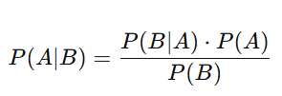

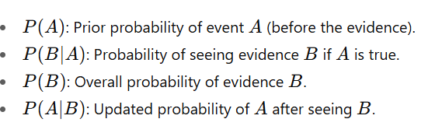
Bayes’ Theorem
If I get new evidence, how can I update my belief about an event?
In other words: It tells us how to calculate the updated probability of something after new information appears.

Slide 2
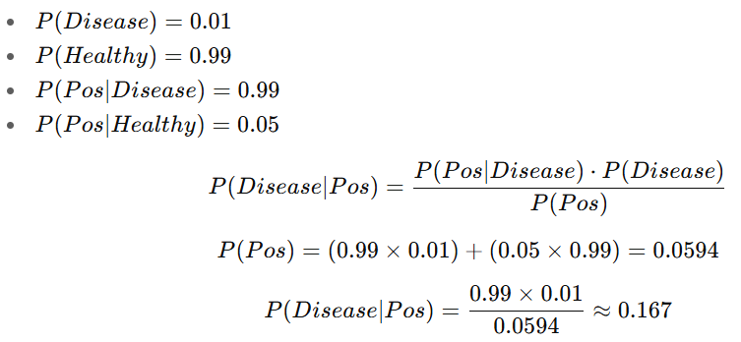

Example 1: Medical Test
A rare disease affects 1% of the population.
The test:
If a person is sick: test is positive 99% of the time.
If a person is healthy: test is falsely positive 5% of the time.
A person tests positive. What’s the probability they are actually sick?
Even though the test is highly accurate, the chance that the person is sick after a positive result is only 17%, because the disease is rare.
Solution:

Slide 3
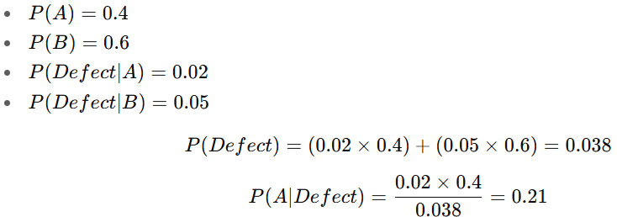

Example 2: Industry (Defective Product)
Factory A makes 40% of products, defect rate = 2%.
Factory B makes 60% of products, defect rate = 5%.
If we find a defective product, what’s the probability it came from Factory A?
Solution:
The probability that the defective product came from Factory A is 21%

Slide 4

An AI spam filter used words in emails to detect spam.
20% of emails are spam.
In spam emails, the word “discount” appears 40% of the time.
In non-spam emails, the word “discount” appears 5% of the time.
👉 If you see the word “discount” in an email, what is the probability that the email is spam?
Solution

Slide 5
An AI system identifies whether a voice command is from the authorized user.
90% of the time, the command is from the authorized user.
The system correctly recognizes the user’s voice 95% of the time.
If the voice is from someone else, the system incorrectly recognizes it as the authorized user 10% of the
If the system says the command is from the authorized user, what is the probability it really is?
P(User ∣ Recognized) = ?????

