Slide 1

Department of Civil Engineering
CVE 212 [3.0 hrs.]
Structural Analysis (1)
Instructor : Dr. Fahad Alsharari

Slide 2
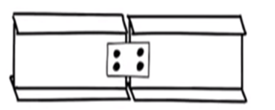
Analysis of determinate compound beams
Intermediate hinge

Slide 3
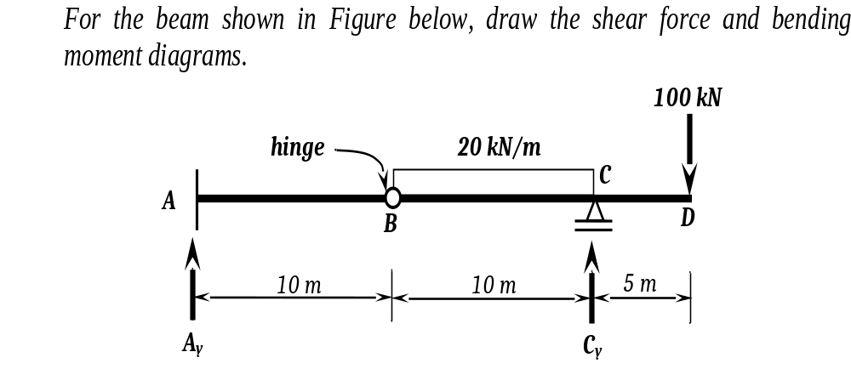
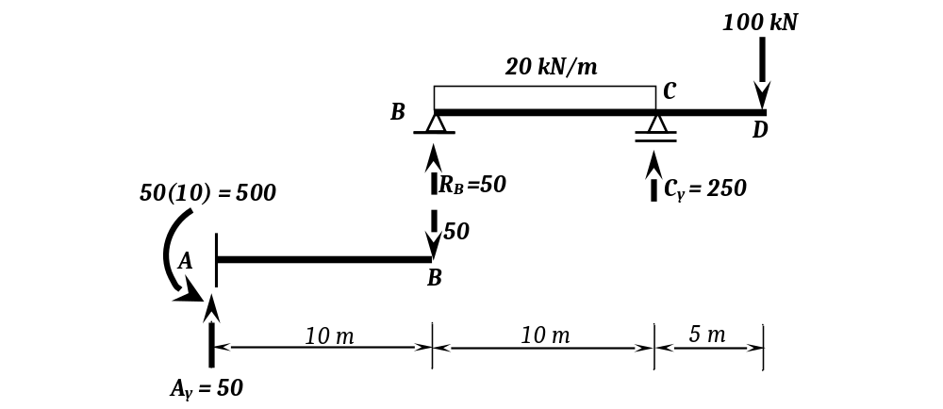
Take the balance of portion BD separately by inserting hinge support at B.

Slide 4
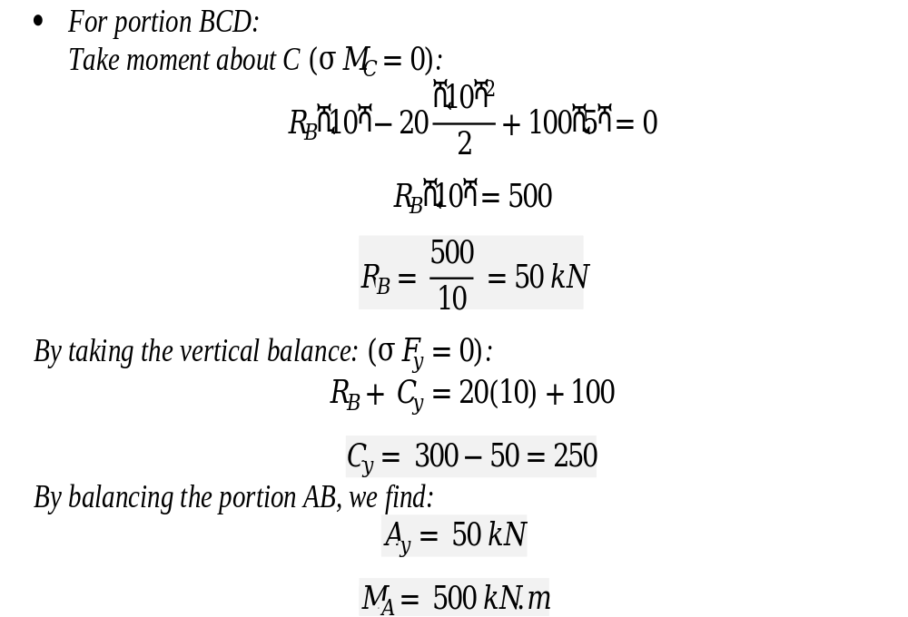

Slide 5
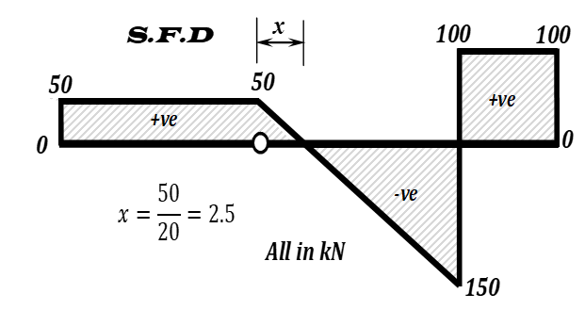
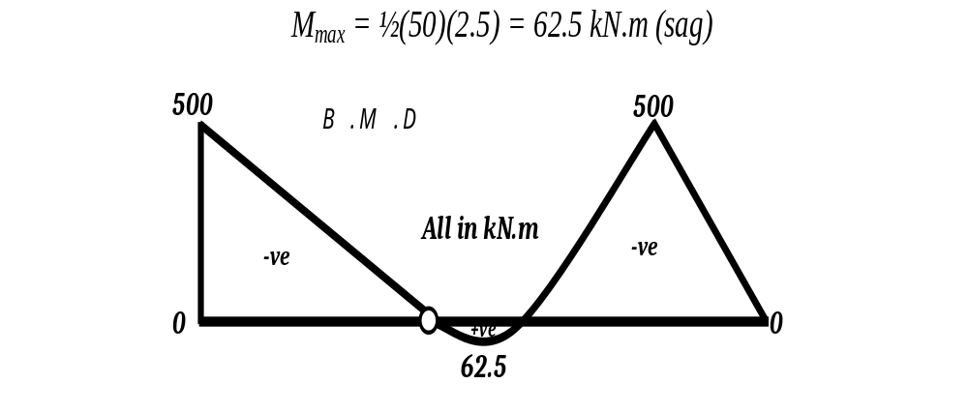

Slide 6
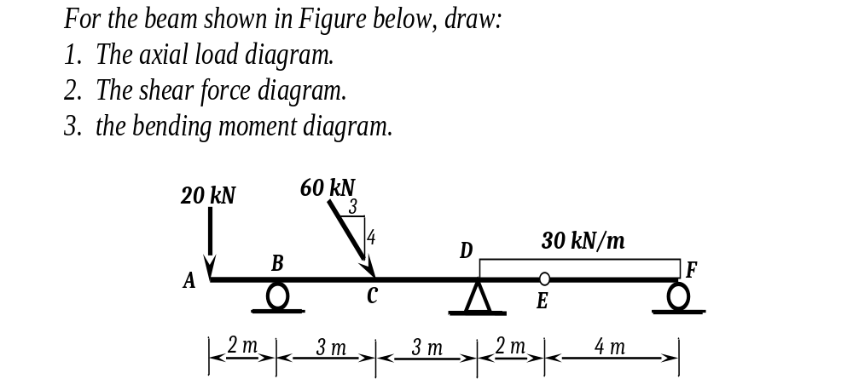
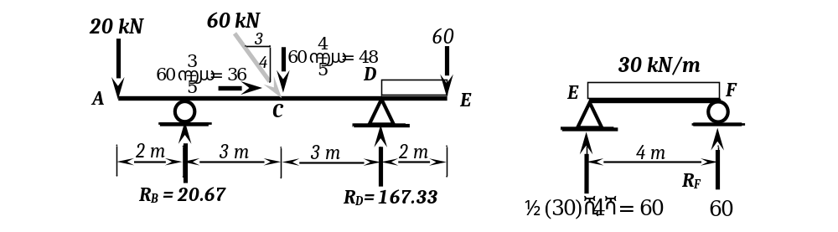

Slide 7
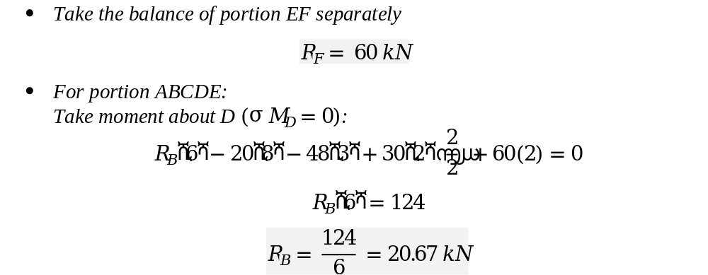
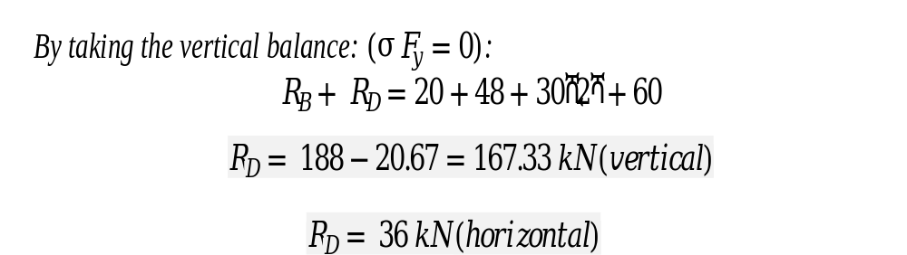

Slide 8

