Slide 1
General Chemistry I
CHEM 100
Chemistry Department
University of Ha’il
Chapter 2
A Very Brief History of Chemistry
This slide deck contains animations. Please disable animations if they cause issues with your device. MathType software is needed to view all mathematical symbols in these slides.
Copyright ©2022 John Wiley & Sons, Inc.

Slide 2
Atomic Theory
Most significant theoretical model of nature
Atoms
Tiny submicroscopic particles
Make up all chemical substances
Make up everything in macroscopic world
Smallest particle that has all properties of given element

Slide 3
Atomic Theory
Two important ideas
Law of Definite Proportions
  In a given compound, the elements are always combined in the same proportion by mass
  Always find 1 g H to 8 g O in water
Law of Conservation of Mass
    No detectable gain or loss of mass occurs in chemical reactions. Mass is conserved.
    A closed vessel with 16 g O and 2 g H will weigh 18 g after water is formed from them

Slide 4
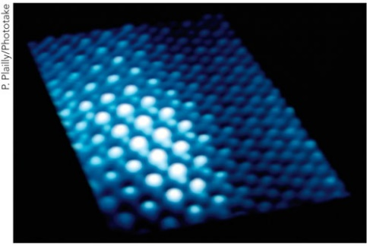
Proof of Atoms
Early 19 80’s, use Scanning Tunneling Microscope (S T M)
Surface can be scanned for topographical information
Image for all matter shows spherical regions of matter
  Proof of atoms
STM of palladium

Slide 5
Atomic Structure
Electrons
    Very low mass
Occupy most of atom’s space
Balance of attractive and repulsive forces controls atom size
Attraction between protons
  and electrons
holds electrons around nucleus
Repulsion between electrons helps them spread out over volume of atom
In neutral atom
  Number of electrons must equal number of protons
Diameter of atom ~10,000 × diameter of nucleus

Slide 6
Properties of Subatomic Particles
Three kinds of subatomic particles of principal interest to chemists
Particle | Mass (g) | Electrical Charge | Symbol
Electron | BLANK | –1 | BLANK
Proton | BLANK | +1 | BLANK
Neutron | BLANK | 0 | BLANK

Slide 7
Atomic Notation (1 of 2)
Atomic number (Z)
Number of protons that atom has in nucleus
Unique to each type of element
Element is substance whose atoms all contain identical number of protons
Z = number of protons

Slide 8
Atomic Notation (2 of 2)
Mass number (A)
A = (number of protons) + (number of neutrons)
A = Z + N
For charge neutrality, number of electrons and protons must be equal
Atomic Symbols
Every Element defined by two numbers Z and A
Symbolized by
Example: What is the atomic symbol for helium?
  He has

Slide 9
Isotopes
Atoms of same element with different masses
Most elements are mixtures of two or more stable isotopes
Each isotope has slightly different mass
Chemically, isotopes have virtually identical chemical properties
Isotopes distinguished by mass number (A):
Different number of neutrons
example:
  Three isotopes of hydrogen (H)
Four isotopes of iron (Fe)

Slide 10
Your Turn!
An atom of
has ___ protons, ___ neutrons,
and ___ electrons.
A. 82, 206, 124
B. 124, 206, 124
C. 124, 124, 124
D. 82, 124, 82
E. 82, 124, 124
Answer: D

Slide 11
Your Turn!
What is the correct symbol for an element that has 27 protons, 33 neutrons, and 27 electrons.
A.
B.
Answer: E
C.
D.
E.

Slide 12


Learning Check:
Fill in the blanks:
symbol
neutrons
protons
electrons
$${}_{53}^{131}I$$
$${}_{35}^{81}{Br}$$
36
29
29

Slide 13

Learning Check:
Fill in the blanks:
symbol
neutrons
protons
electrons
78
53
53
46
35
35
36
29
29
$${}_{29}^{65}{Cu}$$

Slide 14
Carbon-12 Atomic Mass Scale
Need uniform mass scale for atoms
Atomic mass units (symbol u)
Based on carbon:
1 atom of carbon-12 = 12 u (exactly)
mass 1 atom of carbon-12 (exactly)
Why was
selected?
Common
Most abundant isotope of carbon
All atomic masses of all other elements ~ whole numbers
Lightest element, H, has mass ~1 u

Slide 15
Calculating Atomic Mass
Generally, elements are mixtures of isotopes
Example: Hydrogen
Isotope | Mass | % Abundance
¹H | 1.007825 u | 99.985
²H | 2.0140 u | 0.015
How do we define atomic mass?
Average of masses of all stable isotopes of given element
How do we calculate average atomic mass?
  Weighted average
  Use isotopic abundances and isotopic masses

Slide 16
Learning Check!
Naturally occurring magnesium is a mixture of 3 isotopes; 78.99% of the atoms are ²⁴Mg (atomic mass, 23.9850 u), 10.00% of ²⁵Mg (atomic mass, 24.9858 u), and 11.01% of ²⁶Mg (atomic mass, 25.9826 u). From these data calculate the average atomic mass of magnesium.
Total mass of average atom = 24.3053 u rounds up to 24.31 u

Slide 17
Your Turn!
Answer: E
A naturally occurring element consists of two isotopes. The data on the isotopes:
isotope #1 | 68.5257 u | 60.226%
isotope #2 | 70.9429 u | 39.774%
Calculate the average atomic mass of this element.
70.943 u
69.487 u
69.526 u
69.981 u
69.734 u

Slide 18
Periodic Table
  Summarizes periodic properties of elements
Early Versions of Periodic Tables
  Arranged by increasing atomic mass
  Mendeleev (Russian) and Meyer (German) in 1869
  Noted repeating (periodic) properties
Modern Periodic Table
  Arranged by increasing atomic number (Z ):
  Rows called periods
  Columns called groups or families
    Identified by numbers
    1 – 18 standard international
    1A – 8A longer columns and 1B – 8B shorter columns

Slide 19
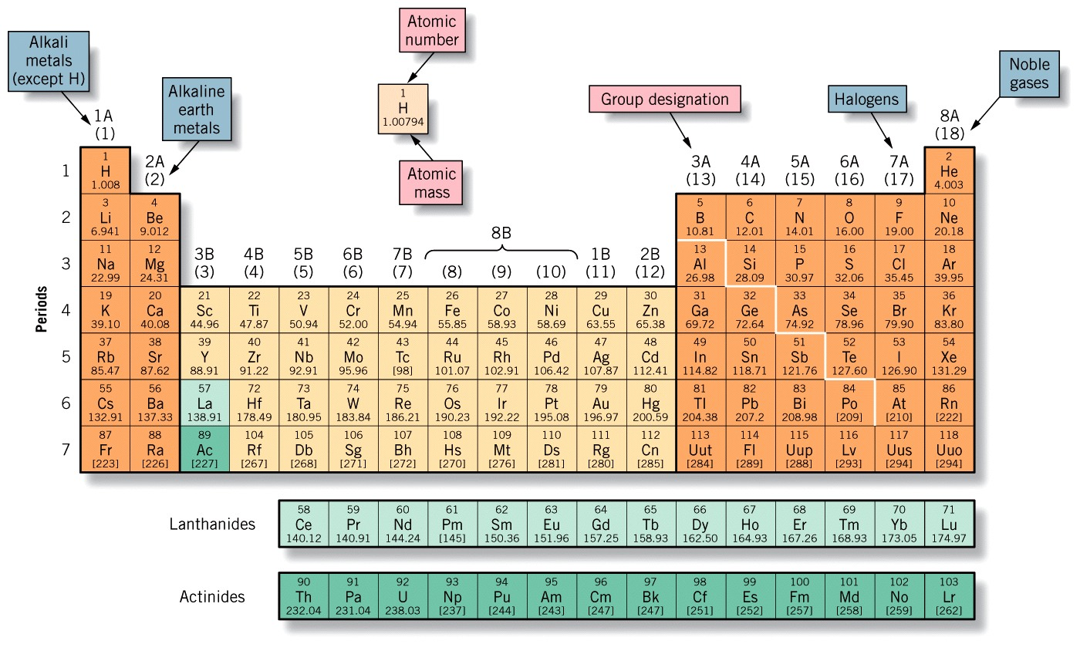
Modern Periodic Table
with group labels and chemical families identified
Note: Placement of elements 58 – 71 and 90 – 103 saves space

Slide 20
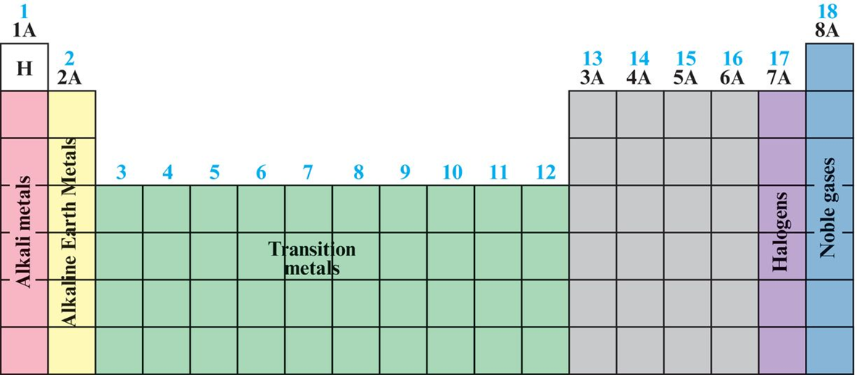
The eight tall columns are called representative elements, or main group elements.
The elements in the center are called the transition metals. These are shown in green.

Slide 21
Representative/Main Group Elements
A groups—Longer columns
Alkali Metals
  1A = first group
  Very reactive
  All are metals except for H
  Tend to form +1 ions
  React with oxygen
    Form compounds that dissolve in water
    Yield strongly caustic or alkaline solution (Na₂O)

Slide 22
Representative/Main Group Elements
A groups—Longer columns
Alkaline Earth Metals
  2A = second group
  Reactive
  Tend to form +2 ions
  React with oxygen
  Oxygen compounds are strongly alkaline (MgO)
Many are not water soluble

Slide 23
Representative/Main Group Elements
A groups—Longer columns
Halogens
  7A = next to last group on right
  Reactive
  Form diatomic molecules in elemental state
  2 gases – F₂, Cl₂
  1 liquid – Br₂
    2 solids – I₂, At₂
  Form –1 ions with alkali metals—salts (Example, NaF, NaCl, NaBr, and NaI)

Slide 24
Representative/Main Group Elements
A groups—Longer columns
Noble Gases
  8A = last group on right
  Inert—very unreactive
  Only heavier elements of group react and then very limited
  Don’t form charged ions
  Monatomic gases (Example, He, Ne, Ar)

Slide 25
Transition Elements
B groups—shorter columns
  All are metals
In center of table
  Begin in fourth row
Tend to form ions with several different charges
Example
Note: Last 3 columns all have 8B designation

Slide 26
Inner Transition Elements
  At bottom of periodic table
  Tend to form +2 and +3 ions
  Lanthanide elements
  Elements 58 to 71
  Actinide elements
  Elements 90 to 103
All actinides are radioactive

Slide 27
Metals, Nonmetals, or Metalloids
Elements break down into three broad categories
Organized by regions of periodic table
  Metals
  Left-hand side
  Sodium, lead, iron, gold
Nonmetals
  Upper right-hand corner
  Oxygen, nitrogen, chlorine
Metalloids
  Diagonal line between metals and nonmetals
  Boron to astatine

Slide 28
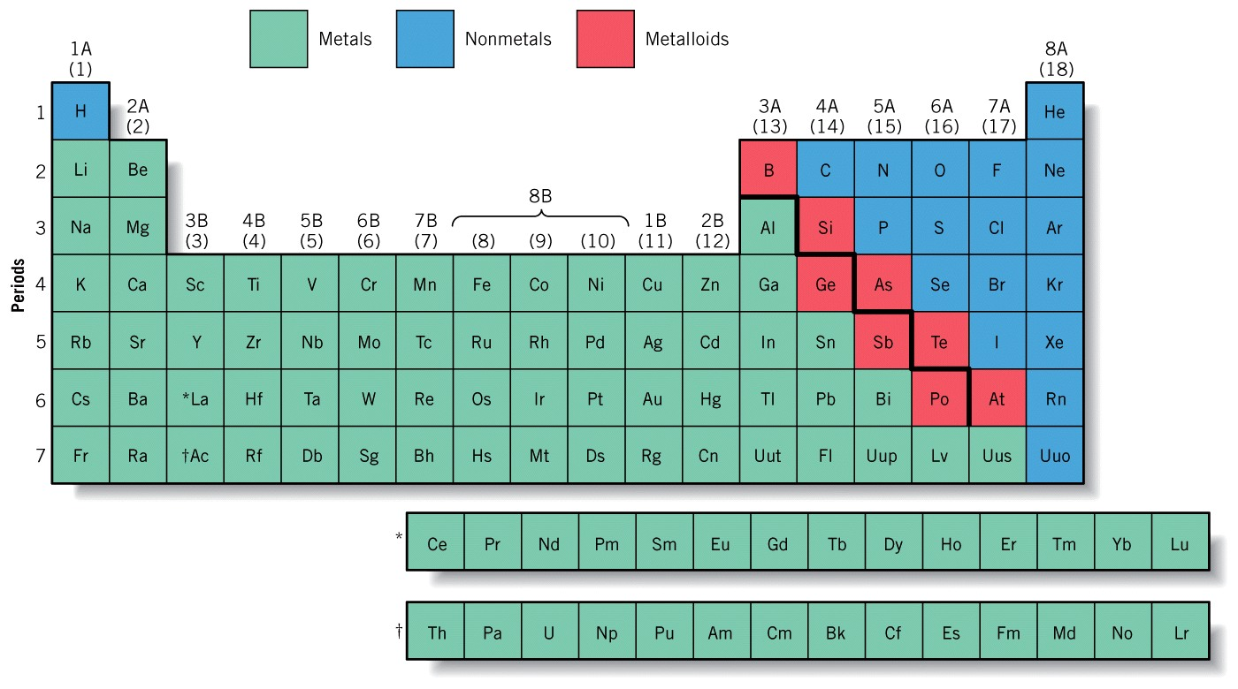
Metals, Nonmetals, or Metalloids

Slide 29
Your Turn!
Answer: C
Strontium (Sr) is a _______, ruthenium (Ru) is a ________, and iodine (I) is a_________.
alkali metal, transition metal, halogen
transition metal, alkaline earth metal, halogen
alkaline earth metal, transition metal, halogen
transition metal, alkali metal, noble gas
alkali metal, actinide, halogen

Slide 30
Metals
Most elements in periodic table
Properties
Metallic luster
  Shine or reflect light
Malleable
  Can be hammered or rolled into thin sheets
Ductile
  Can be drawn into wire
Hardness
  Some hard – iron and chromium
  Some soft – sodium, lead, copper

Slide 31
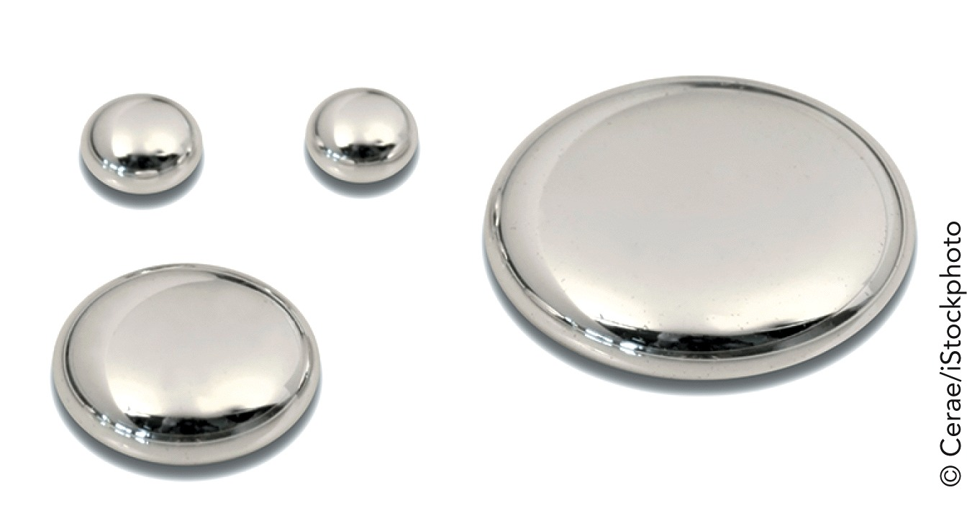
Properties of Metals
Conduct heat and electricity
Solids at room temperature
  Melting points (mp) > 25 °C
  Hg only liquid metal (mp = –39 °C)
  Tungsten (W) (mp = 3400 °C)
    Highest mp for a metal
Chemical reactivity
  Varies greatly
    Au, Pt very unreactive
    Na, K very reactive

Slide 32
Nonmetals
Seventeen elements
  Upper right-hand corner of periodic table
Exist mostly as compounds rather than as pure elements
Many are gases
  Monatomic (Noble) He, Ne, Ar, Kr, Xe, Rn
  Diatomic H₂, O₂, N₂, F₂, Cl₂
Some are solids: I₂, Se₈, S₈, P₄, C∞
  Three forms of carbon (graphite, coal, diamond)
One is liquid: Br₂

Slide 33
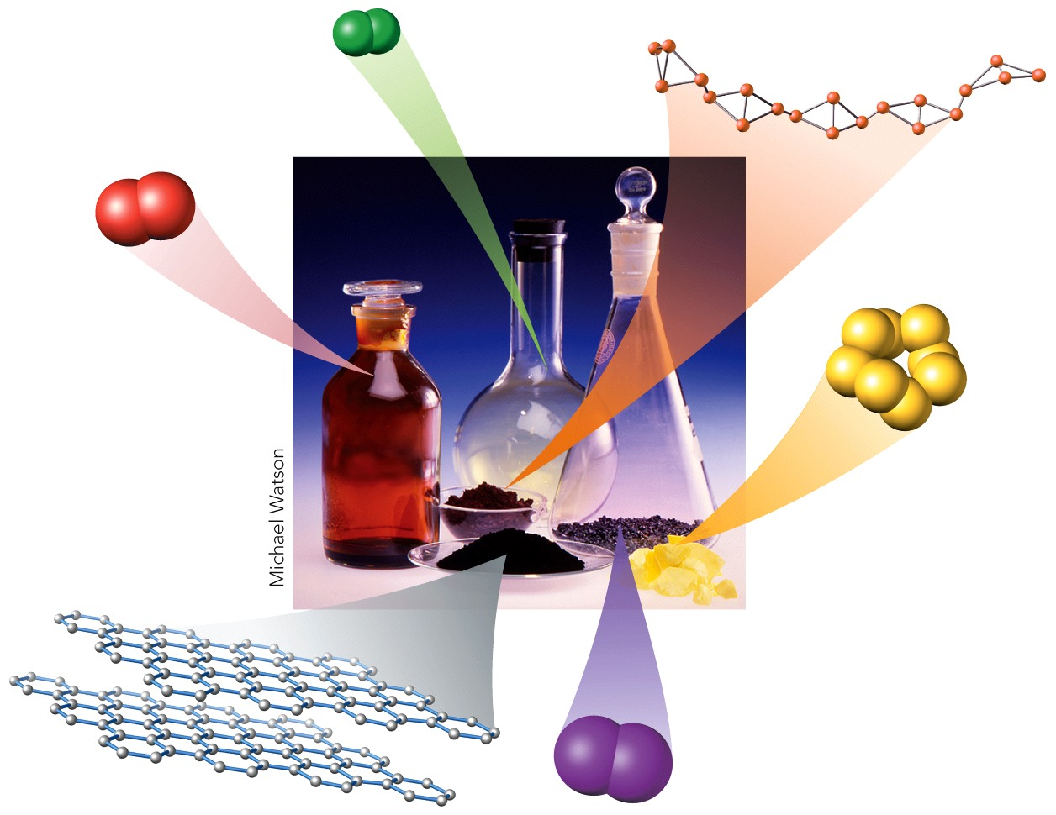
Properties of Nonmetals
Brittle
  Pulverize when struck
Insulators
  Non-conductors of electricity and heat
Chemical reactivity
  Some inert
    Noble gases
  Some reactive
    F₂, O₂, H₂
  React with metals to form ionic compounds

Slide 34
Metalloids
Eight Elements
  Located on diagonal line between metals and nonmetals
  B, Si, Ge, As, Sb, Te, Po, At
  Properties
  Between metals and nonmetals
    Metallic shine
    Brittle like nonmetal
  Semiconductors
    Conduct electricity
  But not as well as metals
    Silicon (Si) and germanium (Ge)

Slide 35
Your Turn!
Answer: D
Which of the following statements is correct?
Cu is an alkali metal element
Na is an alkaline earth metal
Al is a metalloid in group 3A
F is a representative halogen
None of these are correct

Slide 36
Your Turn!
Answer: E
All of the following are characteristics of metals except:
Malleable
Ductile
Lustrous
Good conductors of heat
Act as semiconductors

Slide 37
Molecules
Atoms combine to form more complex substances
Discrete particles
Each composed of two or more atoms
Example,
  Molecular oxygen, O₂
  Carbon dioxide, C O₂
  Ammonia, NH₃
  Sucrose, C₁₂H₂₂O₁₁

Slide 38
Chemical Formulas (1 of 2)
Specify composition of substance
Chemical symbols
  Represent atoms of elements present
Subscripts
  Given after chemical symbol
  Represents relative numbers of each type of atom
Example,
Fe₂O₃ : iron and oxygen in 2:3 ratio

Slide 39
Chemical Formulas (2 of 2)
Free Elements
  Element not combined with another in compounds
  Just use chemical symbol to represent
Example: Iron Fe Neon Ne Sodium Na Aluminum Al
Diatomic Molecule
  Molecules composed of two atoms each
  Many elements found in nature
Example: Oxygen O₂ Nitrogen N₂
Hydrogen H₂ Chlorine Cl₂

Slide 40
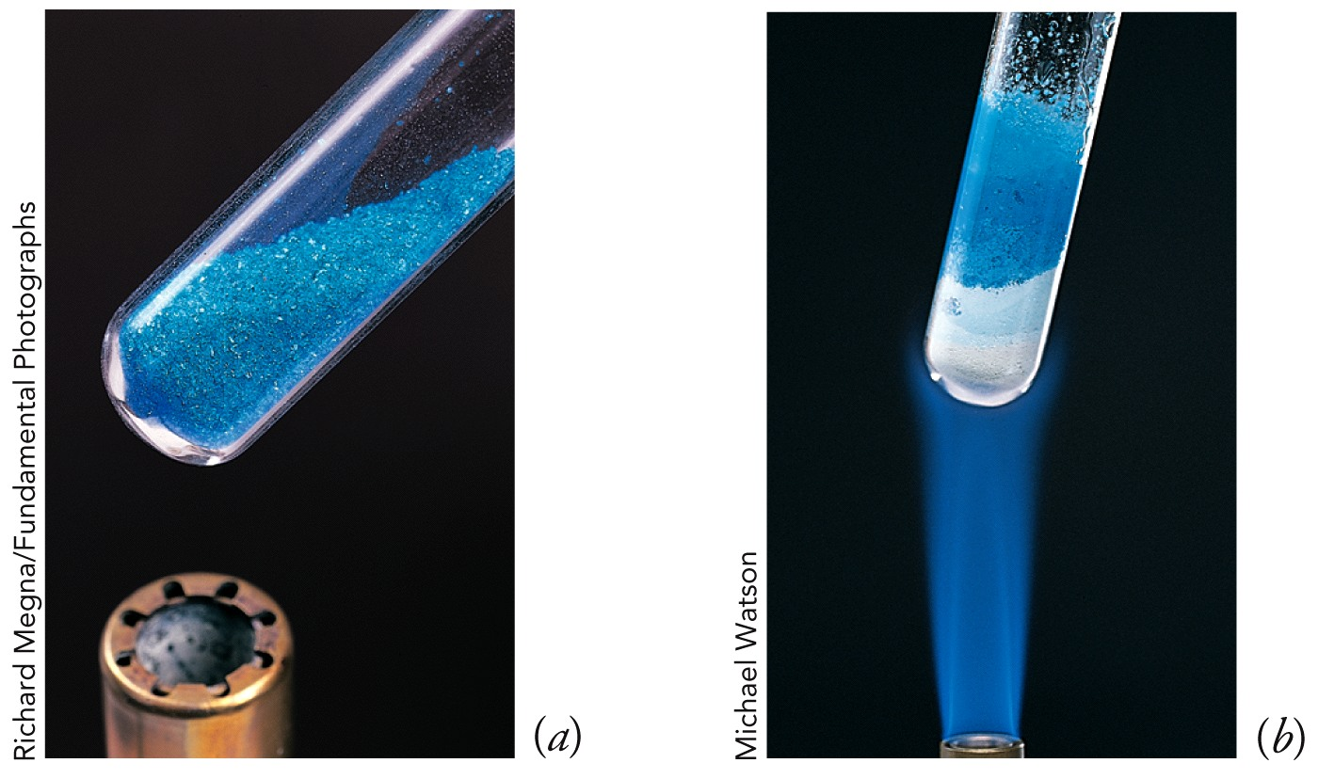
Hydrates
Crystals that contain water molecules
Example, Plaster: CaSO₄∙2H₂O calcium sulfate dihydrate
  Water is not tightly held
Dehydration
  Removal of water by heating
  Remaining solid is anhydrous (without water)
Blue =
CuSO₄ ·5H₂O
White = CuSO₄

Slide 41
Counting Atoms (1 of 3)
Subscript following chemical symbol indicates how many of that element are part of the formula
  No subscript implies a subscript of 1
Quantity in parentheses is repeated a number of times equal to the subscript that follows
Raised dot in formula indicates that the substance is a hydrate
Number preceding H₂O specifies how many water molecules are present

Slide 42
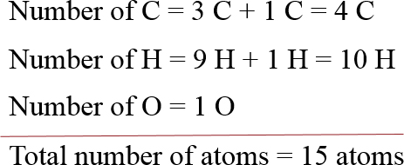
Counting Atoms (2 of 3)
Example 1 : (CH₃)₃COH
Subscript 3 means 3 CH₃ groups
So from (CH₃)₃ we get
  3 × 1 C = 3 C
  3 × 3 H = 9 H

Slide 43
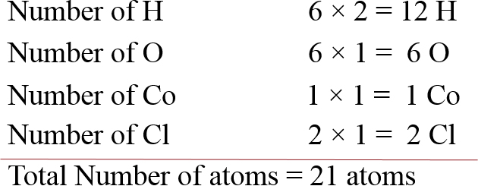
Counting Atoms (3 of 3)
Example 2: CoCl₂·6H₂O
The dot 6H₂O means you multiple both H₂ and O by 6
So, there are:

Slide 44
Your Turn!
Count the number of each type of atom in the chemical formula given below
a. Na₂CO₃
b. (NH₄)₂SO₄
c. Mg₃(PO₄)₂
d. CuSO₄∙5H₂O
e. (C₂H₅)₂N₂H₂
a. 2 Na, 1 C, 3 O
b. 2 N, 8 H, 1 S, 4 O
c. 3 Mg, 2 P, 8 O
d. 1 Cu, 1 S, 9 O, 10 H
e. 4 C, 12 H, 2 N

Slide 45
Thanks

